Slide 1
Administration Code Training 703 KAR 5:080
Office of Assessment and Accountability
Notes:
Welcome to module three of the Admin Code Regulation training 703 KAR 5:080. My name is [Insert Name], a program consultant in the Office of Assessment and Accountability or OAA.

Slide 2
Module 3: Appropriate Assessment Practices
Required Training
Nondisclosure
Notes:
During module 3, we will look at appropriate assessment practices, such as the required training for administering a state assessment.

Slide 3
Required Training _{p.4}
Plan annual dedicated time for test administrator training in Admin Code and Inclusion regulations.
_{p.4}
Interactive training must occur BEFORE test-related processes.
_{p.4}
Distribute Test Administration Manuals in advance of testing.
_{p. 6}
Signature Page
must be signed.
_{p.4}
Notes:
The Administration Code applies to all state-required pieces of the accountability system using paper or pencil, computers or digital technology.
Anyone with the potential to be involved with any component of state-required testing must be trained on the Administration Code regulation before beginning the work. This could include, but is not limited to, principals, off-grade teachers, substitutes, accommodation providers, librarians, etc. Individuals providing accommodations to special needs students must also receive training on the Inclusion of Special Populations regulation.
Volunteers involved in state testing (such as providing accommodations or helping with proctoring) must meet certain stipulations that also apply to school staff. No student may administer a state assessment; this includes peer tutors.
All volunteers must have Administration Code and Inclusion of Special Populations training, and sign nondisclosure forms.
The volunteers must be under the strong oversight of a certified person, who will be responsible for the test administration. Suppose there should be a testing allegation involving a volunteer. In that case, the certified staff person (i.e., BAC or proctor) in charge of the testing environment must be submitted on the allegation report.
Schools and districts may use materials provided by the Kentucky Department of Education (KDE) or locally produced.
Solely reading the regulation and signing the signature page at the end of the document shall not be considered adequate training. Training shall include interaction regarding the content of the regulation with supporting examples and situations, the opportunity to ask questions, etc. The intent or meaning of “interaction” is for the training to be more than being assigned to read and sign the document.
The DAC/BAC Manual and TAMs are the guiding documents for test administration procedures. Reading the TAMs is expected as part of the required training. Following vendor test administration manuals is of the utmost importance.

Slide 4
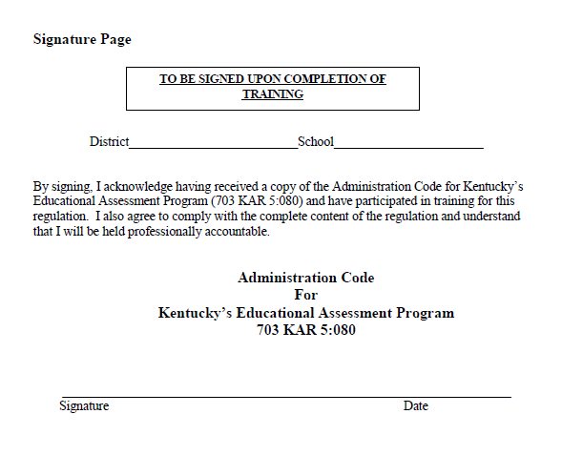
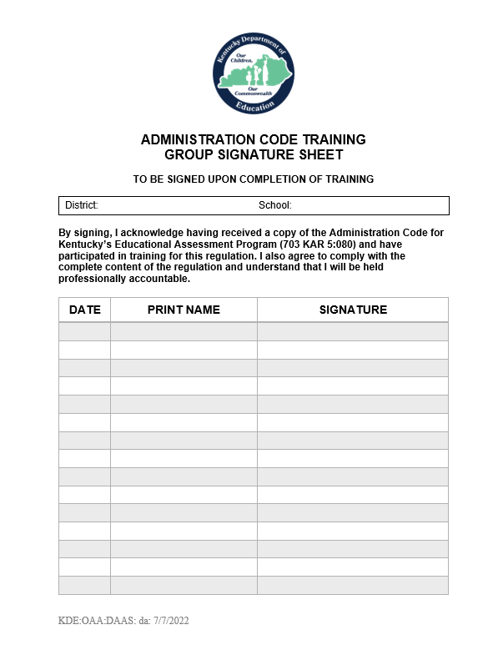
Training Signature Page
Notes:
Districts are charged with maintaining records of individuals receiving Administration Code training. The participants’ records may be maintained through collecting individual signature sheets found on the last page of the Administration Code regulation document or by the retention of group training attendance signature pages. Copies of the signature page or group training attendance sheet may be maintained in hard copy or electronic format.
​
A copy of the Group Signature Sheet is available on the Kentucky Department of Education or KDE website.
https://education.ky.gov/AA/distsupp/Documents/Administration%20Code%20Training%20Group%20Signature%20Sheet.doc ​
​
Training participants are held professionally accountable for their actions after signing either type of signature sheet. Notice that both sheets state: “By signing, I acknowledge having received a copy of the Administration Code for Kentucky’s Educational Assessment Program 703 KAR 5:080 and have participated in training for this regulation. I also agree to comply with the complete content of the regulation and understand that I will be held professionally accountable.”
​

Slide 5
Nondisclosure of Secure Test Information
In addition to the required training, all persons helping with testing (i.e., packing materials, providing accommodations, escorting students to test sites) must annually sign a form committing to nondisclosure of information and to follow appropriate practices as outlined in the regulation.
_{p.5}
Nondisclosure Form
Notes:
Anyone assisting with state testing will sign a nondisclosure form. Assistance includes handling of testing materials, escorting students, providing accommodations and more. Discussion or sharing test content details with others, even though they have been trained and are participating in test administration, is not allowed.
​
Nondisclosure forms can be found on the Forms page in the Accountability and Assessment section of the KDE website.

Slide 6
Classroom Materials
Resources
Calculators
Electronic Devices
Walls and Bulletin Boards
Notes:
Resources and materials available to students during testing are dependent upon the assessment. Please check the test administration manual for further guidance on what should be at a student workstation during testing.

Slide 7
Resources
Acceptable |  | Not Acceptable
At the student’s request, providing resources in the testing environment that are specified in a student’s IEP, 504 Plan or PSP that are consistent with instructional strategies _{p.8} |  | Providing any resources not listed in the administration manuals during testing _{p.8}
Making available blank writing or graph paper, blank (clear or colored) overlay sheets and bookmarks free of content at student workstations _{p.9}
Notes:
During an assessment, test administrators shall not distribute, make available, or attach to students’ workstations any information or materials that are not sent as part of the assessment materials or specified in the test administration manuals or a student’s plan. Examples of Not Acceptable resources include copies of acronym sheets or sheets of paper containing a system for organizing answers, textbooks, computer tools or other reference resources. This includes printed copies of writing rubrics.
A student’s IEP, 504 Plan or PSP allows the student to have additional resources not mentioned in the script. Please check with your BAC concerning accommodations.
If using test booklets, blank writing or graph paper, clear or colored overlay sheets and bookmarks free of content are allowed at student workstations. Some schools use a brightly colored piece of paper or a district or school-supplied bookmark to mark where testing will stop in the session.
If using the online test, blank writing or graph paper are allowed at student workstations. Additionally, students have access to the online tool available in TestNav, such as the calculator, dictionary, contrast tool, and much more.

Slide 8
Dictionaries and Thesauri
Acceptable |  | Not Acceptable
Using dictionaries and thesauri, including non-programmable, electronic dictionaries and thesauri only for on-demand writing _{p.8} Online Testing: An electronic dictionary or thesaurus is provided for writing. |  | Using dictionaries and thesauri on the reading, mathematics, science, or social studies content area tests _{p.8}
Allowing a student to have non-content-related materials such as books, puzzles, etc., at the workstation after the test administrator has collected an individual student’s test materials _{p.9} |  | During testing, distributing, making available, or attaching to students’ workstations any information or materials that are not sent as part of the assessment materials or specified in the test administration manuals. _{p. 8}
Notes:
Whether or not a dictionary or thesaurus is allowed on a test will be covered in the Test Administration Manual or TAM. Test administrators should refer to the listing of approved and unapproved materials in the TAM to determine when to provide a resource.
On-demand writing is the only content area where a student is allowed to have a dictionary or thesaurus. Online testing provides an electronic dictionary and thesaurus to each student. A classroom set of dictionaries and thesauri should be available for students for paper/pencil testing or as a backup for online testing.
Reading, mathematics, science or social studies content-area tests do not allow the use of a dictionary or thesaurus unless clearly stated as an accommodation in a student plan.
It is a local decision by schools or districts on whether to allow students access to non-content related materials, such as books or puzzles, after the student has turned in his/her testing materials to the test administrator. Please note that this is AFTER the student has no testing materials at the workstation.

Slide 9
Calculators
Acceptable |  | Not Acceptable
Providing students access to the types of calculators as designated in the test administration manuals accompanying each state-required assessment _{p.8} |  | Allowing students to leave the testing area to gain access to any calculators, dictionaries or thesauri, blank writing or graph paper, or any resources used for accommodations as specified in 703 KAR 5:070 _{p.8}
Schools providing calculators to students (Permitted electronic devices such as calculators will be listed in test administration manuals.) _{p.9}
 |  | Students sharing calculators within the testing session. _{p.9}
Notes:
Calculators may be used in more than one content area. Check the TAM to determine if a calculator is allowed or if this test section is a no-calculator math test.
Online testing will provide the student with the type of calculator needed for that test section. It is expected that the student will use the online calculator and not a handheld calculator unless the student’s accommodations plan specifies using a handheld calculator.
Handheld calculators used for paper/pencil or accommodated testing should adhere to the KDE Calculator Policy, which is available on the KDE website. Be familiar with the requirements of each assessment that you administer. Some test vendors have calculator policy requirements that may differ from KDEs, such as the ACT.
KDE recommends that schools provide calculators for each student that meets the current calculator acceptable-use criteria; however, students can use their own approved calculators for paper/pencil tests. Test administrators are responsible for ensuring that communication and internet capabilities are disabled during testing sessions. This also includes turning off a computer-algebraic system on a calculator. See the KDE calculator policy for details.
It is Not Acceptable for students within the same testing session to share calculators, even if the test administrator clears the programs between uses. There should be a one-to-one ratio of calculators to students during a test session.
Allegation Tip: Plan ahead of time to have all the necessary related materials, such as dictionaries, thesauri, calculators, etc., needed for testing both accommodated and general education students. However, it is critical to review the test administration manual to check which materials are allowed for a test session as the policy does differ per vendor, such as the ACT; ACT allows students to use either the online calculator or an approved handheld calculator.

Slide 10
Electronic Devices
Acceptable |  | Not Acceptable
Students using personal electronic devices for test administration as long as the device meets the acceptable use criteria for a particular assessment (Communication and Internet features must be disabled.) _{p.9} |  | Using electronic devices in any way to gain a testing advantage _{p.7}
Test administrators using electronic devices to contact school administrators regarding test sessions _{p.9} |  | Students or test administrators using electronic devices except in the case of an emergency _{p.9}
If directed by KDE or test vendors for the purpose of test administration, accessing the Internet or imaging capabilities during test sessions _{p.6} |  | Accessing the Internet, wireless communication functions or imaging capabilities on electronic devices during testing sessions for purposes other than test administration _{p.7}
Notes:
Internet access is necessary for computer-based testing, but constant changes in personal technology make our job of maintaining a fair and unbiased testing environment harder.
Using electronic devices or the Internet is unacceptable to gain a testing advantage. Online testing provides a secure browser to prevent accessing other parts of the internet, therefore not allowing a student to gain an unfair advantage during testing. Except in cases where allowed (such as online testing in a secure web browser), students should not have access to electronic devices until all testing in the building is completed to ensure that students are not communicating with others in testing sessions. Smartwatches or Fitbits are not allowed since those devices can connect to the internet. Online testing can only be conducted by trained staff in person. Remote testing is not acceptable with any state testing.
Offsite testing is an acceptable practice with online and paper testing. As a reminder, in-person online testing can only be conducted by trained staff. Please ensure the testing environment is free of content, only the student and trained staff are present, and the student does not have additional internet devices in the room.
It is Acceptable for test administrators to use electronic devices to contact school administrators regarding test sessions (i.e., problems with materials, student illness, administration questions, breaks, etc.). BACs or principals may routinely request that teachers use their personal cell phones to notify the office of a need in the classroom. However, neither students nor test administrators shall use electronic devices such as, but not limited to, cell phones, tablets, and e-readers for personal reasons during testing sessions except in the case of an emergency. Test administrators should be communicating with the building assessment coordinator or designee for assistance with a situation in the classroom and not each other while testing is occurring.
Allegation Alert: a student had hidden his cell phone in the pocket of a hoodie. The student takes a picture of the test and places it on social media. This would be an example of an allegation of lack of monitoring, a student using an electronic device during testing and accessing the internet during the test administration. As a best practice, test administrators have students power down cell phones and put them away during the testing session. Additionally, ensure proper monitoring is being conducted throughout the testing session.
We’ve looked at cell phones, electronic devices, etc. Let’s move on to the testing environment.

Slide 11
Walls and Bulletin Boards
Acceptable |  | Not Acceptable
Placing materials on classroom walls and bulletin boards for instructional purposes anytime during the year _{p.8} |  | Displaying or leaving any materials containing content information or strategies for solving problems uncovered _{p.8}
Leaving periodic tables or materials without content or strategies for solving problems uncovered _{p.8}
Notes:
A few years ago, when this regulation was updated, it was decided that testing room surfaces should be free of content during operational and field testing. Yes, this means bulletin boards…and walls…all surfaces.
It is Acceptable to place instructional materials on bulletin boards, walls, etc., throughout the year, but when the room is used for testing, those same content materials must be removed or covered. Covered means with a covering that is not see-thru or opaque.
Some examples of materials are any content information or strategies for solving problems. These may be anywhere in the room: walls, ceilings, floors, windows, and clothing (yes, clothing). When the room wasn’t required to be sanitized, some schools printed tee shirts with content on them for the students. That sounds like a great idea. I can read your back, and you can read mine, but what about the poor person at the front of the row? He doesn’t have a shirt to read; he is now at a disadvantage. You could say the same thing about posters. If I was sitting next to a poster that just happened to answer one of my test questions, I had an advantage over the person across the room who was too far away to read the poster. The covering of a room in content did get a bit extreme. To make sure that all students have the same resources and advantages, the posters had to go.
Let’s look closer at some of these materials.

Slide 12
Posters _{p.8}
Basic periodic tables and motivational materials may remain posted.
ACCEPTABLE
testing http://oneextradegreeteaching.com/
star motivation http://krazee4kindergarten.blogspot.com/
periodic table http://www.wpclipart.com
Notes:
Motivational posters or materials without content and standard periodic tables can remain on the walls. Periodic tables? Yes. Periodic tables without additional content. It does not give you an advantage if you do not understand how to read a periodic table.
​
Clipart:
star motivation http://krazee4kindergarten.blogspot.com/
periodic table http://www.wpclipart.com
testing http://oneextradegreeteaching.com/

Slide 13
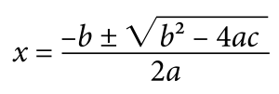
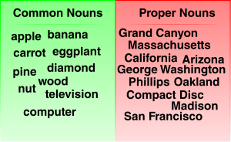
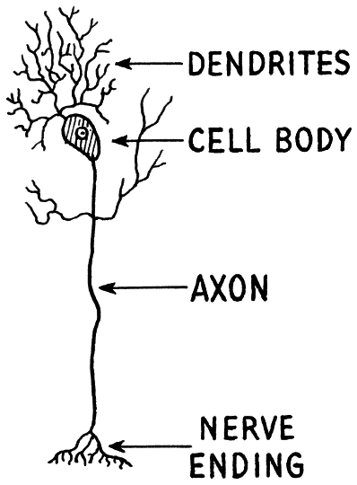
Classroom Displays _{p.8}
Materials used during direct instruction, containing content, or strategies/processes should not be displayed on classroom surfaces including walls, workstations or clothing. Classroom materials shall not provide a testing advantage to any student.
NOT ACCEPTABLE
www.openclipart.com
www.openclipart.com
www.openclipart.com
Notes:
Materials appropriate for instruction and display may not be appropriate during testing sessions. Materials that contain content, problem-solving strategies, processes, etc., are unacceptable for display or use during testing sessions. Even things painted on the walls (see the first equation that was painted on a classroom wall), three-dimensional sculptures or paintings used in a lesson must be covered.
Clipart:
Algebraic equation www.openclipart.com
Nouns www.openclipart.com
Neuron www.wpclipart.com

Slide 14
Check for Understanding (3)
Is it acceptable for a teacher to use his/her personal cellphone to communicate with another teacher about a testing situation in the classroom?
Is it acceptable to allow general education students to use a handheld calculator instead of the online calculator?
Is it acceptable to leave content on the walls in the testing room when administering a field test?
Is it acceptable to allow students to read library or personal books as each student finishes and test materials are collected?
Notes:
It’s time for our third Check for Understanding. I’ll give you a couple of minutes to read through these Yes or No questions, then we will discuss the answers.
Is it acceptable for a teacher to use his/her personal cellphone to communicate with another teacher about a testing situation in the classroom?
Is it acceptable to allow general education students to use a handheld calculator instead of the online calculator?
Is it acceptable to leave content on the walls in the testing room when administering a field test?
Is it acceptable to allow students to read library or personal books as each student finishes and test materials are collected?

Slide 15
Administration Code Training Modules
Module 1 – Introduction to Administration code
Module 2 – Preparation for State Assessment – Test Security
Module 3 - Preparation for State Assessment –Appropriate Assessment Practices & Classroom Materials
Module 4 - Preparation for State Assessment - Seating Charts & Student Motivation and Rewards
Module 5 - Administration of State Assessment
Module 6 - Completion of State Assessment
Notes:
This concludes Module 3 of 6 of the Administration Code regulation.
Please review all six modules to complete the administration code training.

Slide 16
Division of Assessment and Accountability Support
Contact Information
KDE DAC Information dacinfo@education.ky.gov (502) 564-4394
Notes:
If you have questions, please contact us at KDE DAC Information, dacinfo@education.ky.gov, or call us at 502-564-4394.
Thank you for participating in this section of the training with the Office of Assessment and Accountability.

