Slide 1
Accountability Indicator Training:
Progress on English Language Proficiency
Chris Williams, Program Consultant
Ben Riley, Systems Consultant
Office of Assessment and Accountability

Slide 2
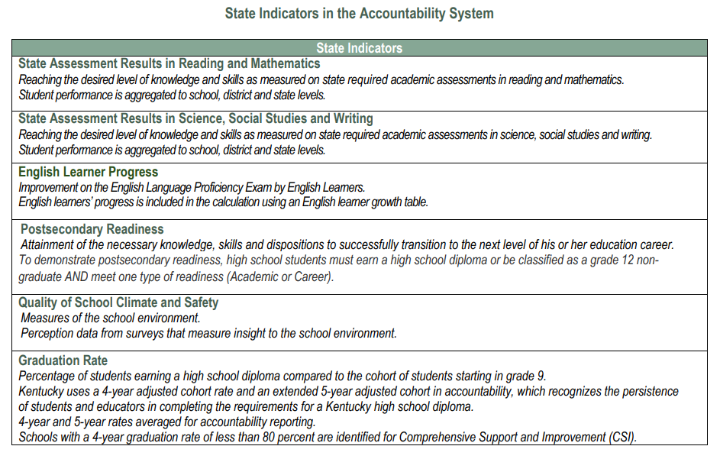
English Learner Progress
Notes:
Progress on English Language Proficiency is one of 6 state indicators in the accountability system.

Slide 3
Overall Accountability Weights
 | State Assessment Results (Reading and Mathematics) | State Assessment Results (Science, Social Studies and Combined Writing) | English Learner Progress | Quality of School Climate and Safety | Postsecondary Readiness | Graduation Rate (4- and 5-year cohort)
Elementary Schools | 51 | 40 | 5 | 4 | -- | ---
Middle Schools | 46 | 45 | 5 | 4 | -- | --
High Schools | 45 | 20 | 5 | 4 | 20 | 6
Federal law requires the greatest emphasis on Reading and Mathematics and English Language progress at elementary and middle schools. If a school does not have EL population, then the weights get distributed proportionally towards the other indicators.

Slide 4
Agenda
ESSA Plan Indicator
EL Indicator Tables-ACCESS and Alternate ACCESS
Examples of English Learner (EL) Progress
Score Calculation for Status
Change
Change Calculation
Indicator Performance Rating
Overall Performance Score
School Configuration
Feeder Schools
Students Not Included in the Calculation
English Learner Long Term Goals

Slide 5
Kentucky’s ESSA Plan
Access to Kentucky’s ESSA Plan
Progress on English Language Proficiency Indicator
(ESEA section 3113(b)(6)): Describe how the State Education Agency (SEA) will assist eligible entities in meeting: (i) The State-designed long-term goals established under ESEA section 1111(c)(4)(A)(ii), including measurements of interim progress towards meeting such goals, based on the State’s English language proficiency assessments under ESEA section 1111(b)(2)(G)
Points from the EL Table based on the current composite score from the English Language Proficiency (ELP) assessment-ACCESS or Alternate ACCESS
To show progress on this indicator, schools and districts must look at individual student’s scores from previous year to current year

Slide 6
EL Progress Indicator Tables-ACCESS
English Language Progress Value Table
Regular Assessed Students
Proficiency Levels of 1.0-6.0 on ACCESS, 1 being the lowest and 6 being the highest
Prior year score on the left of the table
Current year score across the top of the table
Exit criteria for ACCESS is an overall composite of a 4.5 on a Tier B/C
Current year Performance Level on Access for ELL’s
 |  | 1.0-1.4 | 1.5-1.9 | 2.0-2.4 | 2.5-2.9 | 3.0-3.4 | 3.5-3.9 | 4.0-4.4 | 4.5-6.0
Prior Year performance Level on Access for ELL’s | 4.0-4.4 | 0 | 0 | 0 | 0 | 0 | 0 | 0 | 80
 | 3.5-3.9 | 0 | 0 | 0 | 0 | 0 | 0 | 60 | 100
 | 3.0-3.4 | 0 | 0 | 0 | 0 | 0 | 60 | 100 | 140
 | 2.5-2.9 | 0 | 0 | 0 | 0 | 60 | 100 | 140 | 140
 | 2.0-2.4 | 0 | 0 | 0 | 60 | 100 | 140 | 140 | 140
 | 1.5-1.9 | 0 | 0 | 60 | 100 | 140 | 140 | 140 | 140
 | 1.0- 1.4 | 0 | 60 | 100 | 140 | 140 | 140 | 140 | 140

Slide 7
EL Progress Indicator Tables- Alternate ACCESS
Proficiency levels of A1-P2 for Alternate ACCESS, only can get a P3 in writing domain only, A1 being the lowest and P2 being the highest
Prior year score on the left of the table
Current year score across the top of the table
Exit criteria for Alternate is an overall composite of a P2
English Language Progress Value Table
Alternate Assessed Students
Current year Performance Level on Alternate Access for ELL’s
 |  | A1 | A2 | A3 | P1 | P2
Prior Year Performance on Alternate Access for ELL’s | P1 | 0 | 0 | 0 | 0 | 60
 | A3 | 0 | 0 | 0 | 60 | 100
 | A2 | 0 | 0 | 60 | 100 | 140
 | A1 | 0 | 60 | 100 | 140 | 140

Slide 8
EL Progress Status Examples
Positive Progress Toward English Language Proficiency
Negative Progress Toward English Language Proficiency
Student previous score on ACCESS for ELLs is 2.0
Current student score on ACCESS for ELLs is 2.5
Student points is 60 points
Student previous score on ACCESS for ELLs is 3.5
Current student score on ACCESS for ELLs is 3.0
Student points would be 0

Slide 9
Calculation for Status
Calculated by comparing a student’s WIDA ACCESS or Alternate ACCESS performance from last year to this year using the EL tables to assign points and averaging the scores
Students are reported based on Full Academic Year - 100 days in the schools and districts
Students must be tested in same assessment - ACCESS/Alternate ACCESS both years
Students who have point value - 0 points through 140 points- are included
Who met the n-count of 30 students for elementary, middle and high school are included

Slide 10
EL Indicator Status Calculation
Total amount of EL growth points
___________________divided by______________________
Total population of EL students that have a prior year and current year score

Slide 11
Status Scores
The Status Score represents the current year outcome for a given indicator.
It is calculated according to the metric described in the performance level descriptor documents.
Indicator | State Assessment Results in Reading and Mathematics | State Assessment Results in Science, Social Studies, and Writing | English Learner Progress | Quality of School Climate and Safety | Postsecondary Readiness (HS only) | Graduation Rate (HS only)
Metric | Weighted performance index based on student assessment performance levels | Weighted performance index based on student assessment performance levels | Points assigned based on student-level growth as measured by a value table | Average of student scores for applicable questions in the QSCS survey | Percent of 12th grade students demonstrating academic or career readiness | Average 4- and 5-year graduation rates

Slide 12
Status Levels
There are five Status Levels.
Status | Very Low | Low | Medium | High | Very High

Slide 13
Change Score
To get the Change Score by school:
The Status Score is determined by comparing a student’s scores on ACCESS tests, to assign points, and then averaging these scores. The students scores are the Prior Year Performance Level and Current Year Performance Level.
Subtract the Prior Year Status Score from the Current Year Status Score to get the Change Score
  Current Year Status Score – Prior Year Status Score = Change Score
Add that resulting value to the 2023 Status Score to get the Indicator Score
  Current Year Status Score + Change Score = Indicator Score
If the Indicator Score is less than 0, it is forced to be 0 and if it is greater than 140 than it is forced to be 140

Slide 14
Example of Change Score
Calculate by comparing a student’s WIDA ACCESS or Alternate ACCESS performance from last year to this year using the EL tables to assign points and averaging the scores.
  2023 Current Year Status Score of 75
  2022 Prior Year Status Score of 70
Current Year Status Score - Prior Year Status Score = Change Score
75-70= 5
Current Year Status Score + Change Score= Indicator Score
75+5= 80

Slide 15
Change Scores
Change Score calculation is a simple subtraction of Prior Year Status Score from Current Year Status Score.
They are calculated the same way for every Indicator.
Current Year Status Score – Prior Year Status Score = Change Score
Prior Year Score is used to calculate Change Score. They are not used to influence the Indicator Performance Rating.
Current Year Status Score
Prior Year Status Score
Change Score
There are five Change Levels:
Change | Declined Significantly | Declined | Maintained | Increased | Increased Significantly

Slide 16
Indicator Scores
The Indicator Score is a simple combination of Status Score and Change Score.
It is calculated the same way for every Indicator.
Current Year Status Score + Change Score = Indicator Score
The Indicator Score is used to calculate the Overall Score. They do not influence Indicator Performance Ratings.
Current Year Status Score
Change Score
Indicator Score

Slide 17
Indicator Performance Ratings
Table: Indicator Performance Ratings based on combined Change and Status Levels*
 | Change Declined Significantly | Change Declined | Change Maintained | Change Increased | Change Increased Significantly
Very High Status in current year | Yellow | Green | Blue | Blue | Blue
High Status in current year | Yellow | Yellow | Green | Green | Blue
Medium Status in current year | Orange | Orange | Yellow | Green | Green
Low Status in current year | Red | Orange | Orange | Yellow | Yellow
Very Low Status in current year | Red | Red | Red | Orange | Yellow

Slide 18
Overall Score – High School
State Assessment Results in Reading and Mathematics Indicator Score * .45
State Assessment Results in Sc, SS and Writing Indicator Score * .20
English Learner Progress Indicator Score *.05
Quality of QSCS Indicator * .04
Postsecondary Readiness
*.20
Graduation Rate *.06
Overall Score
Overall Scores represent the combined outcomes across all applicable Indicators, with appropriate weights applied.
High School Overall Score Calculation

Slide 19
Overall Designations
An Overall Performance Rating combines performance on the exclusive state indicators for elementary, middle and high schools.
The ratings will be reported using a color rating system to communicate performance of schools, with Red being the lowest rating and Blue being the highest rating.
Color ratings include five performance levels from highest to lowest, Blue, Green, Yellow, Orange and Red.
Blue
Green
Yellow
Orange
Red

Slide 20
School Configurations
For accountability, standard configuration is:
  Elementary schools- K-5
  Middle schools- 6-8
  High schools- 9-12
Other school configurations
  K-5 schools- 1-5 for elementary
  K-8 schools- 1-5 for elementary, 6-8 for middle school
  K-6 schools- 1-6 for the elementary
  K-3 schools- 1-3 for elementary
  K-12 schools- 1-5 for elementary, 6-8 for the middle school, 9-12 for high schools
  Grade 9 A1 school only- would be included in the 10-12 school for all accountability reporting.

Slide 21
Feeder Schools
Kentucky’s accountability system includes schools without tested grades (i.e., K-1 and K-2 schools). These K-1 and K-2 schools feed to a higher-level school(s) which receives a federally required accountability classification. The feeder school(s) receive the classification of the higher- level school where the majority of the students are enrolled. Feeder schools include K-1 and K-2 schools that feed to elementary schools and grade 9 that feed to a high school.
Using the state’s student information system, students at schools that have a high grade of 2 or lower are tracked to see where the student attended the next grade up. Based on where student enrolled, the feeder school must have 90% of its students attending the higher-level school to be assigned the same federal status as the higher-level school. Currently Kentucky has a 1 to 1 school connection using this process.

Slide 22
Feeder Schools Example
If the school has a grade configuration, like Grades 3-6, EL students who took tests in grades 1 and 2 at preceding schools could be counted towards the minimum N for the indicator.

Slide 23
Students Are and Are Not Included in the Calculation
The table below contains a list of Student Status that are and those not included in the N Count and calculation for more comprehensive information please review our guidance on the Minimum N Count.
EL (English Learner) Student Status | Included in N Count
Exited in Prior Year | No
Has Approved Nonparticipation (medical) for Either Year | No
Tested with Different Test in Prior Year | No
Tested in Current Year Only (E.G. kindergarten) | No
Student was promoted grade levels (ex. Grade 10-Grade 12) | No
Student who took ACCESS or Alternate ACCESS in another state | No
Tested in Current Year and Prior Year | Yes
Tested in Prior Year and Current Year (without approved nonparticipation {medical}) | Yes *(with lowest possible score on current year on test)
Notes:
As we navigate the intricacies of the ACCESS and Alternate ACCESS calculation, it's important to clarify which students are not included in this assessment measure. Each of these exclusions has specific reasons that uphold the integrity and consistency of our data. Let's delve into these categories:
Kindergarten students: These students only have a current year score as they naturally don't have a prior year to reference.
Students who repeat a grade: For instance, those who were in Grade 3 last year and remain in Grade 3 this year.
Non-participation instances: This could be either from the previous year or the current one.
Assessment switchers: Some students might switch between Alternate-ACCESS and the standard ACCESS, which affects their inclusion.
Grade-level promotions: Say, a student jumps from Grade 10 directly to Grade 12.
Inter-state movements: Students who took the ACCESS or Alternate ACCESS in another state prior to coming to Kentucky.
Non-attempts: Those who did not even attempt the test in the preceding year.
These nuances are crucial for maintaining the accuracy and consistency of our ACCESS calculations. By understanding who isn't included, we gain a clearer picture of the data we're analyzing and ensure that our outcomes are based on consistent criteria.
The students who are included are Tested in Both Current and Prior Year and Students who tested in the prior year or received the lowest score but not tested in current year without an approved medical nonparticipation.

Slide 24
Long Term Goals
ESSA requires long-term goals for improved academic achievement, as measured by proficiency on the annual statewide assessments, for all students and for each group of students. The long-term goals are as follows: to reduce the percentage of students scoring lower than proficient by 50 percent from 2019 by 2030. Because of COVID 19’s impact on instruction and accountability, all long-term goals will be shifted 2 years starting in 2020 (IE 2020’s goal will become 2022. With 2030 shifting to 2032).
Based upon WIDA ACCESS for ELLs progress toward proficiency
It is currently based on a student reaching proficiency in five years, so it takes the student’s first year and creates a trajectory for each student to be proficient by the end of the year five. If the student is at or above the target value then the student is classified as being on track.

Slide 25
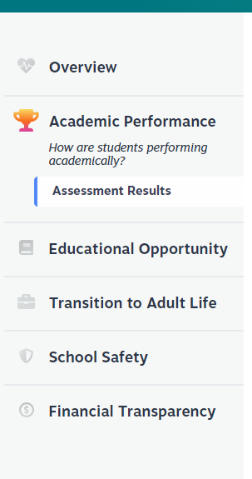

Where to Find EL Data in the SRC
Data is released publicly in the School Report Card (SRC)
Search by school or district or explore Statewide Data
Once logged into the SRC, Click on “Academic Performance” then “Assessment Results” and finally click the tab in the middle of the screen called “English Learners”

Slide 26
Other 2023-2024 Trainings
Accountability Overview
State Assessment Results in Reading and Mathematics and Science, Social Studies and Writing (on-demand and editing/mechanics);​
Quality of School Climate and Safety Survey;​
Postsecondary Readiness (high school only); and​
Graduation Rate (high school only)

Slide 27
Division of Assessment and Accountability Support
  Chris Williams, Program Consultant,
  chris.williams@education.ky.gov
  Ben Riley, Systems Consultant
  ben.riley@education.ky.gov
OAA/DAAS
(502) 564-4394
dacinfo@education.ky.gov

Slide 28

Thanks for Attending

