Slide 1
DAC Webcast June 8, 2023
Jennifer Stafford, Ed.D, Director
Division of Assessment and Accountability Support
Office of Assessment and Accountability

Slide 2
Agenda
Spring 2023 Testing Highlights
Standards Validation
K Screen Train the Trainer Updates
2023 Accountability Standard Setting

Slide 3
Spring 2023 Testing Highlights
Jennifer Stafford, Ed.D, Director
Division of Assessment and Accountability Support
Office of Assessment and Accountability

Slide 4
Spring 2023 Testing Highlights
Kentucky Summative Assessment (KSA), Alternate KSA, and ACT went well!
Thanks to each District Assessment Coordinator for your leadership!
Kudos to each Building Assessment Coordinator, testing staff and everyone who assisted with testing for their tremendous efforts!
4

Slide 5
Online Testing Highlights
High Marks for KSA Online Testing:
Largest Number of Tests Completed in a Single Day: 228,758
Total Number of Tests Completed Total: 1,579,816
Call Log Event List (KSA Online Testing):
Internet Service Provider Outages
Denial-of-service attack (DDoS)
District Network/Internal Issues
5

Slide 6
Standards Validation
Christen Roseberry, Education Academic Program Consultant
Division of Assessment and Accountability Support
Office of Assessment and Accountability

Slide 7
Standards Validation Process
The work continues…
This week volunteers from across the state are working to validate the cut scores that were set last year.
The purpose of these meetings is to provide recommendations for retaining or adjusting cut scores.
Panelists will authenticate current cut scores or provide a meaningful content-based rationale for recommending a change to a cut score.
7

Slide 8
Standards Validation Process Continued
These recommendations will inform the Kentucky Department of Education (KDE) decisions regarding the final cut scores for reporting student performance on the Kentucky Summative Assessments in Mathematics, Reading, Writing, and Social Studies.
We appreciate all those that are helping us with these tasks this week!
8

Slide 9
K Screen Updates
Lisa Jett, Education Academic Program Consultant
Division of Assessment and Accountability Support
Office of Assessment and Accountability

Slide 10
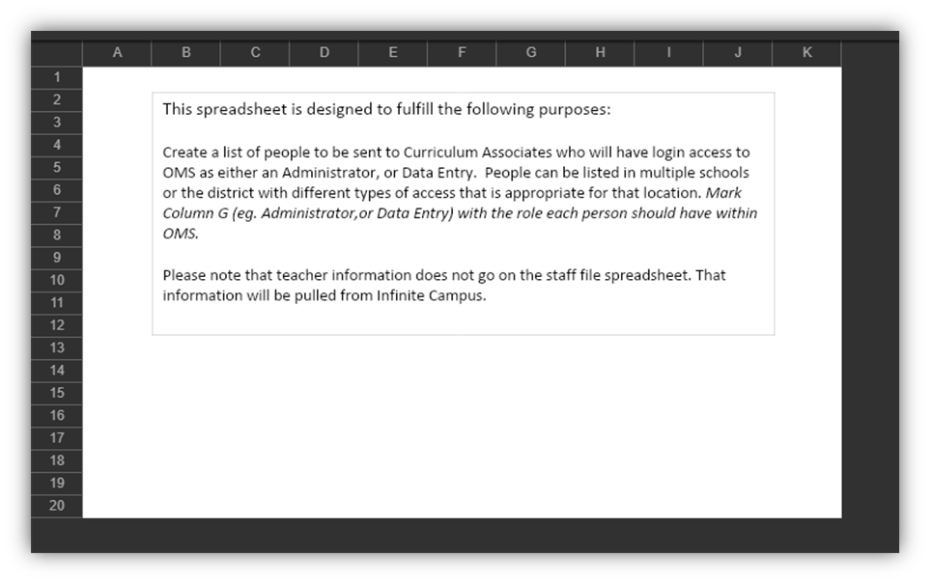
2023-2024 K Screen Staff File
District Assessment Coordinators must access the spreadsheet from the Kentucky Department of Education Secure Web Applications website.
Student Data Detail (Excel and PDF)
SD24_district code_K_Screen_Users_ (name of district)_XXXXXXXX.xlsx
2023-2024 K Screen Staff File Submission Form
K Screen Staff Files due June 16

Slide 11
July Train the Trainers
In-person K Screen Train the Trainers July 20 from 9:00 a.m.- 2:00 p.m. ET at the Sower Building in Frankfort
Participants are asked to bring the following materials:
Copy of the K&1 Screen III Manual
The manipulatives (packages of blocks and shapes)
Children’s books with at least 3 pages of text on each page
K Screen Train the Trainers In-Person Training Registration Form

Slide 12
August Train the Trainers
Virtual K Screen Train the Trainers event on August 8 and August 9 from 4 – 6 p.m. ET.
Participants will be asked to complete an hour of pre-work before the first training date.
Registration information will be made available in July

Slide 13
2023 Accountability Standard Setting
Jenni Larkins, Academic Program Manager
Division of Assessment and Accountability Support
Office of Assessment and Accountability

Slide 14
Accountability Cut Scores in 2022
The 2022 Standard Setting process set cut scores for the first year of implementation using one year of data:
Indicator and School Performance Level Descriptors
Status performance for each Indicator (very low through very high labels)
Overall School Performance Rating {Colors} (data from Indicators evaluated on Status only)
The inclusion of the Change component in the system necessitates an additional standard setting.
Notes:
Although the 2021-2022 Indicator Performance Ratings were color-associated to support dashboard style reporting in the School Report Card, cut scores were only set for the labels of very low through very high for Status. No cut score ranges were set for colors in the 5x5 indicator tables due to the absence of the Change component.

Slide 15
Setting Accountability Cut Scores in 2023
The 2023 Standard Setting process will set cut scores for full implementation using two years of data:
Indicator and School Performance Level Descriptors
Status performance for each Indicator*(very low through very high labels)
Change performance for each Indicator (declined significantly through increased significantly labels)
Indicator Performance Rating {Color} (score ranges for colors on the 5x5 indicator tables based on the combination of Status and Change)
Overall School Performance Rating {Color} (score ranges for colors based on data aggregated from all available Indicators)
*2022 Status cut scores will be reviewed but could remain as established in 2022.

Slide 16
Multi-Step Process for 2023
June 22-23*
September 13-15*
October
Develop Indicator and School Performance Level Descriptors
Set cut scores for Status and Change labels, Indicator Performance Ratings and Overall School Performance Ratings
Approval of final cut scores by KDE and LSAC followed by public data release activities
*Meetings will be held in the State Board Room, 5th Floor, at the Sower Building in Frankfort.

Slide 17
2023 Committee Members
Kentucky has a strong history of setting accountability performance standards through an open process that involves a broad group of stakeholders.
The committee will include 25-30 panelists (awaiting a few final decisions).
The diverse panel includes members from all Kentucky geographic regions serving in a variety of statewide, district, school and community roles.
Most panelists who served on the 2022 Committee are returning to participate in 2023.

Slide 18
Questions and Answers
Please send questions or comments to dacinfo@education.ky.gov.
The next Monthly DAC Webcast is scheduled for July 13 at 11 a.m. ET.
Thank you for your participation!
18

Slide 19
Division of Assessment and Accountability Support
Contact Information
KDE DAC Information
dacinfo@education.ky.gov
(502) 564-4394
19

