Slide 1
WIDA Alternate Screener
Chris Williams, Program Consultant
Office of Assessment and Accountability

Slide 2
Agenda
Purpose
Before Screening
Participation
Beginning of the Year Guidance
Testing
Accommodations
Training
Scoring
Resources

Slide 3
Guidance Before Screening
Obligations and Purpose, Participation

Slide 4
Obligation and Purpose
Districts are responsible for implementing consistent procedures to identify and serve ELs, in alignment with Section 3113(b)(2) of the Elementary and Secondary Education Act (ESEA), as amended by Every Student Succeeds Act ( ESSA) and Title VI of the Civil Rights Act of 1964. These procedures include administering the Home Language Survey (HLS), conducting the state-approved English language proficiency screener WIDA Screener for Kindergarten, WIDA Screener Online and the WIDA Alternate Screener), and notifying parents of placement in a Language Instruction Educational Program (LIEP).
The WIDA Alternate Screener is used to screen potential English Learners (ELs) with significant cognitive disabilities who will participate in the WIDA ACCESS and who will or who would be likely to take the Alternate Kentucky Summative Assessment (AKSA).

Slide 5
Before Screening
Give each new potential EL student in the district the Home-Language Survey (HLS).
If the answer to any of the four required HLS questions is any language other than English, then administer one of the screeners: WIDA Screener for Kindergarten, the WIDA Screener Online for grades 1-12 or WIDA Alternate Screener (K-12).
The WIDA Alternate Screener (paper) is downloadable free for districts to print from the WIDA Secure Portal under Resources.
Contact the District Assessment Coordinator (DAC) if school or district staff need a screener password. Chris Williams will create the accounts.

Slide 6
Participation
To reliably assess the language proficiency of students with disabilities, students' Individualized Education Program (IEP) and 504 teams must determine whether the student should take one of the following, with or without accommodations:
  WIDA Screener Online
  WIDA Screener for Kindergarten
  WIDA Alternate Screener
IEP teams will follow Kentucky’s Alternate Assessment participation guidance and the WIDA Alternate Screener Participation Criteria Decision Tree.

Slide 7
Beginning of School Year Guidance for the WIDA Screeners
The WIDA screeners can be administered to students who are attending in-person schooling or to students who are enrolled in virtual learning. The schools will arrange a time with the parents for the screener to be administered in-person this school year.
The WIDA Screener Online, the WIDA Screener for Kindergarten and the WIDA Alternate Screener cannot be administered remotely.

Slide 8
During Screening
Materials, Testing Details, Printing, Accommodations, Administration

Slide 9
Materials to Administer the WIDA Alternate Screener
Download the free materials to print locally in the district from the WIDA Secure Portal under Resources
Test Administrators (TAs) will need the following to administer:
  Test Administration Manual (TAM)
  TA Script
  Student Response Booklet (SRB)
  Student Test Booklet with Listening, Reading, Speaking and Listening domains within - (includes pictures and prompts for all four domains and can be cut apart for students’ needs)
Please note: All materials are reusable except the SRB. Materials can be printed in grayscale if color printing is not available.

Slide 10
Testing Details for WIDA Alternate Screener
Individually tested by the EL Teacher and Special Teacher
Kindergarten through Grade 12
Paper/pencil assessment, will not use WIDA Assessment Management System (AMS)
Grade levels clusters: (K-2), (3-5) and (6-12)
Domains: Listening, Reading, Writing and Speaking
Items target the WIDA Alternate Proficiency Standards, including (PL 3-5)
Represents the five English Language Proficiency Standards:
  Language for Social and Instructional Purposes
  Language for Language Arts
  Language for Mathematics
  Language for Science
  Language for Social Studies

Slide 11
Printing Guidelines for the WIDA Alternate Screener Materials and Low-Vision Students
Material | Usage | Print Size
TA Script | Contains everything the TA says to guide students through all four domains | Letter- 8.5” by 11”
Student L, R, S and W Test Booklet | Contains the pictures and prompts students see for all domains | Legal- 8.5” by 14”
SRB | Contains space to score individual items for each domain and includes space for students to write the responses for the W domain | Letter- 8.5” by 11”
TAM | Contains all the instructions for administering and scoring the screener | Letter- 8.5” by 11”
Any of the test materials may be enlarged to fit on 11x17 paper
If a student needs materials enlarged more, they may test using the low-vision aids or magnification tools

Slide 12
Testing Times and Domains
Thirty minutes or less to administer the screener per individual
Domains are administered in the following order:
  Listening
  Reading
  Speaking
  Writing
Please Note: Listening and Reading test administrations typically require less time than Speaking and Writing.

Slide 13
TA Training and Certification
TAs must complete and pass the following training to administer the WIDA Alternate Screener on the WIDA website under the WIDA Secure Portal in Canvas:
  WIDA Alternate Screener: Administration and Scoring
The training course to administer the WIDA Alternate Screener takes TAs one to two hours to complete and is available starting Wednesday, July 1
TAs must provide a copy of the certification to the DAC to be kept on file in the district office
TAs must read the Test Administration Manual in its entirety and sign a district form, provided by the DAC, to show completion

Slide 14
Testing Accommodations Guidance
Found in the Accessibility and Accommodations Manual
TAs must have the WIDA Alternate Screener Checklist completed by the IEP Team to provide the appropriate accommodations for an EL with an IEP or 504 Plan on the WIDA Alternate Screener during testing

Slide 15
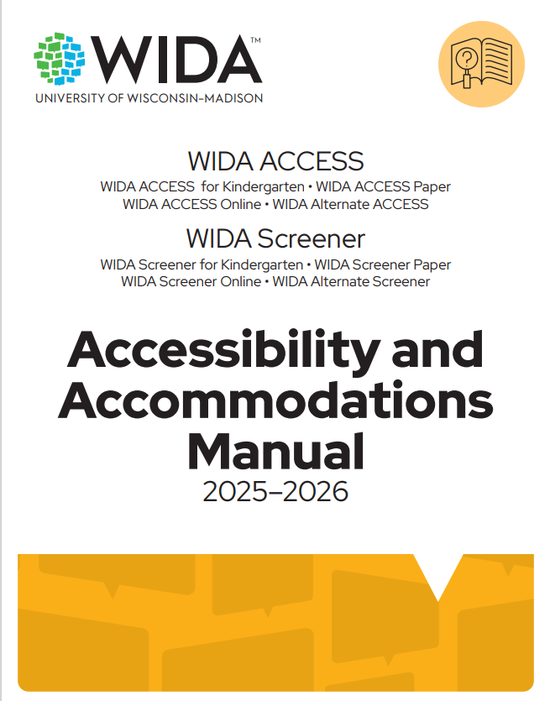
Accessibility and Accommodations Manual
EL students with an IEP or 504 Plan can be offered the following on the WIDA Screeners:
  Participation guidance
  Framework
  Types of support
  Keyboard shortcuts
  Scribe and Transcription guidance
  Accommodation checklists WIDA Screener for Kindergarten, WIDA Screener Online, WIDA Alternate Screener, WIDA ACCESS online and paper, WIDA ACCESS for Kindergarten and WIDA Alternate-WIDA Secure Portal
  Accessibility and Accommodations Manual- Appendix E: Checklists, p. 34

Slide 16
Test Administration Logistics Before, During and After
It is a secure test
Items per domain:
  Listening and Reading have three items each
  Speaking has two items
  Writing has one item
Students will attempt all items
No stopping rules
Same scaffolded cue/question process at WIDA Alternate ACCESS- more details in the TAM
Student may take as many breaks as needed between domains
Students will use the preferred writing instrument and communications tools (example: AAC device)
Test in a quiet and familiar testing space
Cover or remove any posters, etc. that could assist students during testing
Post a Do not Disturb sign outside the testing room
Monitor students closely during testing
Maintain test security with all test materials before, during and after testing

Slide 17
After Screening
Scoring, Printing Reports, Entering Data into IC and Resources

Slide 18
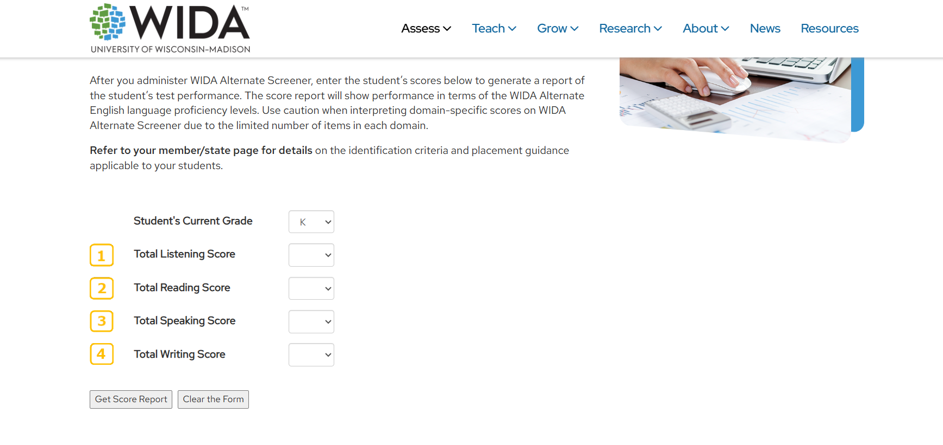
WIDA Alternate ACCESS Scoring and Printed Report
TA scores the assessment on the SRB using the Alternate Screener Scoring Sheet found on the WIDA Secure Portal
TA marks one score for each item
Once scoring is complete, the TA will enter the student’s scores on the Alternate Screener scoring calculator located on the WIDA website to get a printed score report

Slide 19
Entering the WIDA Screener Scores into IC
District or school staff will manually enter the WIDA screener scores into Infinite Campus (IC)
Additional information can be found in the EL Data Standards

Slide 20
Exit Criteria for WIDA Alternate Screener
To exit, the student in grade 1-12 must have an overall composite of a P3.
Kindergarten and first semester Grade 1 students will qualify regardless of their scores and take WIDA Alternate ACCESS to exit.

Slide 21
WIDA Screener Resources
TAM- the test administration manual assists with assessing the student
Accessibility and Accommodations Manual- the manual assists the student who has an IEP or 504 Plan with the appropriate accommodations for each domain of listening, reading, speaking and writing
WIDA Screener Interpretive Guide for Score Reports- reports that explain the scores, proficiency levels and how they connect
Identification and Placement Guidance- document that provides guidance on the identification and placement process for newly arrived ELs
What is the WIDA Alternate Screener?
  Handout to share with parents to help the families of students learn what to expect with Alternate Screener
  Includes a section for families to take notes and ask questions about English language services
  It is translated in the most common 16 languages in the WIDA consortium

Slide 22
Instructional Resources for EL Students with Significant Cognitive Disabilities
Alternate Can Do Descriptors- what the student can do with communication and language at various stages of English language development
Alternate Proficiency Level Descriptors- explanation of how students use the English language at each proficiency level
English Language Development (ELD) Standards- standards for the classroom that align with the Alternate ACCESS

Slide 23
Division of Assessment and Accountability Support
OAA/DAAS
(502) 564-4394
Dacinfo@education.ky.gov
  Chris Williams, Program Consultant
  (502) 564-4394 ext. 4750
  Chris.Williams@education.ky.gov

