Slide 1
ACCESS for ELLs Writing Tier Placement and Testing Writing Online
Chris Williams, Program Consultant
Division of Assessment and Accountability Support
KDE:OAA:DAAS:hj 1/27/2021

Slide 2
Agenda
Writing Tier Placement
Log in for WIDA AMS
WIDA AMS Landing Page
Writing Tier Placement Report
ACCESS Writing Online Grades 1-3
ACCESS Writing Online Grades 4-12
Resources
Contact Information

Slide 3
Writing Tier Placement
After students have completed Reading and Listening domain tests online, test administrators or designated staff should go to the Tier Placement Report in WIDA Assessment Management System (AMS) for students needing to take the Writing domain.
Use the Tier Placement Report to identify the Writing tier level for students who will be handwriting their responses in grades 1-3.
Please see slide #7 for step-by-step instructions for accessing the Tier Placement Report in WIDA AMS.

Slide 4
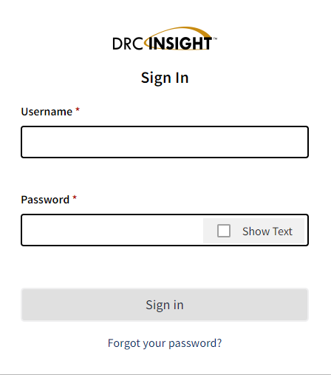
Login to WIDA AMS
If District Assessment Coordinators (DACs) and District Technology Coordinators (DTCs) need a WIDA AMS account, contact Chris Williams
If school personnel need an account, contact the DAC
4

Slide 5
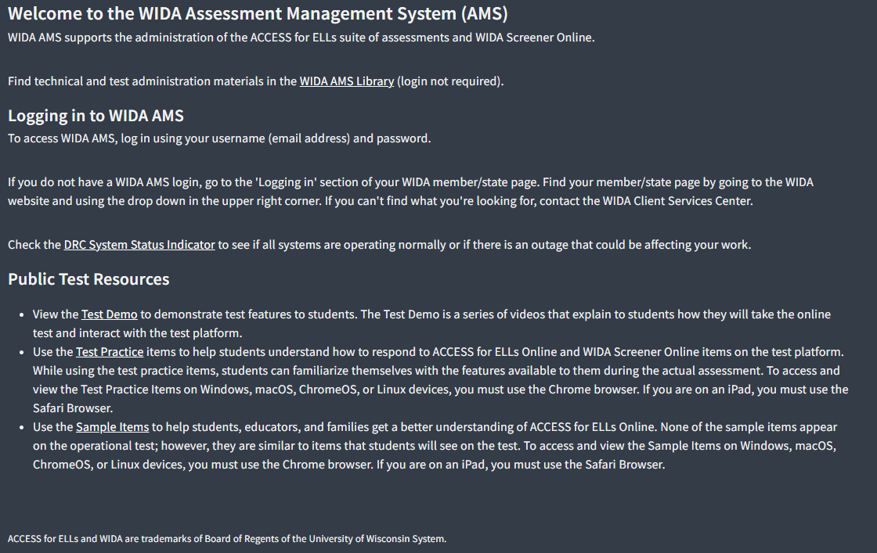
WIDA AMS
5
Notes:
Need to use Chrome for the test practice and the test demo. For everything else in WIDA AMS, you can use any browser.

Slide 6
WIDA AMS Landing Page
6

Slide 7
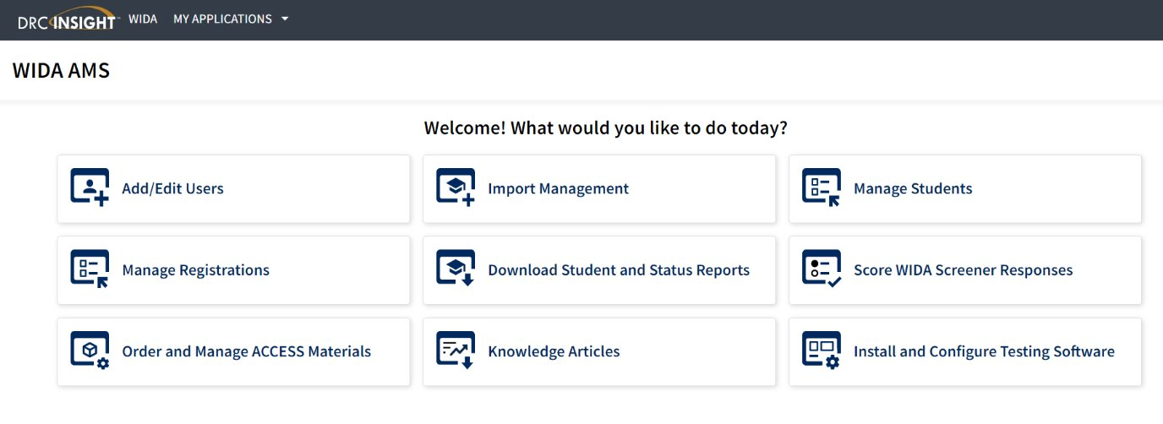
Tier Placement Report
To access the Tier Placement report:
Click on Test Management from the WIDA AMS My Applications from the drop-down menu after logging into WIDA AMS.
Confirm or enter your site criteria in the upper right corner. Click Save.
Confirm or enter your Registration Window in the drop-down menu.
Select the View Registration(s) tab.
Apply one or more filter criteria such as State Student ID, Student Name, Domain, Registration Name, and/or Assessments to refine your search. Or, to view the tier placement of multiple registrations, leave the filters blank.
Select the checkboxes next to the registration(s) and click Export Details. The resulting .csv file will contain columns for Writing Tier and Speaking Tier, providing staff with the necessary tier placement details for one or more registrations.
7

Slide 8
Tier Placement Report Examples
There will be no tier level for the student if the student has not completed testing in the domains of reading and listening first for ACCESS- It will show “In Progress” or “Not Started”.
This is what the report will look like when the student has completed testing in the domains of reading and listening for ACCESS.
Before Listening and Reading are completed online
Once Listening and Reading are completed online
8

Slide 9
ACCESS Writing Grades 1-3 Online
Writing is the only domain, when testing ACCESS for ELLs online, that has a writing test booklet for grades 1-3 and there are no test registrations for writing in WIDA AMS.
Reading, Listening and Speaking domains are all tested online.
Data Recognition Corporation (DRC) will only ship a certain amount of Tier A or Tier B/C level booklets based off the initial order placed in Oct.
If districts need more tier-level booklets, order during the Additional Materials Window (Dec. 3 - Feb. 7, 2025) for ACCESS in WIDA AMS.
9

Slide 10
Writing Grades 4-12 Online
Grades 4-12 test writing all online and are assigned a test registrations in WIDA AMS.
No writing test booklets are used.
Should a student in grades 4-12 require a handwriting booklet rather than keyboarding their response, test coordinators will need to order these as Additional Materials in WIDA AMS. Please refer to the District and School Test Coordinator Manual for more information on this process.
10
Notes:
Should a student in grades 4-12 require a handwriting booklet rather than keyboarding their response, test coordinators will need to order these as Additional Materials in WIDA AMS. Please refer to the District and School Test Coordinator Manual for more information on this process.

Slide 11
Resource in WIDA AMS
Online Help- for assistance with any task in WIDA AMS by clicking on a tile from the landing page and then select the ? at the top of the screen to the right next to Select a Site
WIDA AMS User Guide - a guide for how to use WIDA AMS to complete administrative functions for testing with DRC INSIGHT
Log into WIDA AMS
Click on My Applications, then General Information
Click on Documents
Under Document Type-Select Manuals from the drop-down menu
Open or Save WIDA AMS
WIDA AMS Knowledge Articles- assist with all the functions in WIDA AMS
Login into WIDA AMS
Click on WIDA AMS Knowledge Articles tile from the landing page
11

Slide 12
Kentucky ACCESS Trainings on KDE Website
User Accounts
Materials Ordering
Test Setup
Writing Tier Placement
Overview
ACCESS Roster Training in SDRR (coming soon)
ACCESS Trainings are located on ACCESS for ELLs webpage of the Kentucky Department of Education (KDE) website.
12
Notes:
Each of the Kentucky ACCESS trainings are required along with the WIDA online training and quizzes.

Slide 13
Contact Information:
KDE:
Chris Williams
502-564-4394 ext. 4750
DRC:
WIDA DRC Customer Service
Data Recognition Corporation
855-787-9615
13

