Slide 1
WIDA Screener for Kindergarten, WIDA Online Screener/ ACCESS For ELLs® and User Accounts
Username, Passwords and Online Quizzes
Chris Williams, Program Consultant
Division of Assessment and Accountability Support

Slide 2
WIDA Screener Online and WIDA Screener Kindergarten
Accounts, Administration, and Manuals

Slide 3
Home-Language Survey, WIDA Screener for Kindergarten and WIDA Online Screener
Give each new student in the district the Home-Language Survey (HLS).
If the answer to any of the four required HLS questions is any language other than English, then administer the screener, WIDA Screener for Kindergarten or the WIDA Online Screener for grades 1-12.
The WIDA Screener Online is in WIDA Assessment Management System (AMS). The WIDA Screener for Kindergarten (paper) is downloadable and free to districts from the website: https://wida.wisc.edu
Contact the DAC if school or district staff need a screener password. Chris Williams will create the accounts.
The results of the WIDA Screener for Kindergarten and the WIDA Online Screener must be shared with parents within two weeks of enrollment during the school year and the scores entered in Infinite Campus (IC).
Notes:
The four required home-language survey questions are:
What is the language most frequently spoken at home?
Which language did your child learn when he/she first began to talk?
What language does your child most frequently speak at home?
What language do you most frequently speak to your child?
To print WIDA Screener for Kindergarten off the WIDA website, districts will need to use their ACCESS password.
ACCESS for ELLs® passwords will enable printing of the WIDA Screener for Kindergarten materials.
Training for the WIDA Screener Kindergarten are found on the WIDA website under the Secure Portal.
Trainings for the WIDA Online Screener are found on the ACCESS for ELLs page of the KDE website.
http://education.ky.gov/AA/Assessments/Pages/EL-Testing.aspx

Slide 4
WIDA Screener for Kindergarten
WIDA Screener for Kindergarten
  This screener replaced the Kindergarten WIDA-ACCESS Placement Test (K W-APT)
  Paper/Pencil screener
  Two quizzes for Test Administrators (TAs) to complete prior to screening students
Testing Times:
  Up to 30 minutes - oral domains of listening and speaking- first semester
  Up to 45 minutes - listening, speaking, reading, and writing- second semester
Materials needed to administer:
  Storybook
  Test Administrator (TA) script
  Cards
  Score Sheet
  Response Booklet
Recorded Training for the Screener for Kindergarten is on the WIDA secure portal
Notes:
First semester kindergarten and first grade students take the oral domains of listening and speaking only. Second semester kindergarten and first grade students take all four domains of listening, speaking, reading, and writing.

Slide 5
WIDA Screener for Kindergarten Scores
All kindergarteners regardless of their screener scores, must be administered ACCESS the following January.
Kindergarten students cannot exit an EL program until after taking the Kindergarten ACCESS for ELLs®.
Notes:
First semester first grade EL students also take the WIDA Screener for Kindergarten and listening and speaking domains only so they can’t exit from EL services until after Kindergarten ACCESS.
Second Semester Kindergarten students will take all four domains of WIDA Screener for kindergarten.
Parents can refuse EL services but still will have to take ACCESS for ELLs®.

Slide 6
WIDA Screener Online
Administered in Grade level clusters: 1, 2-3, 4-5, 6-8 and 9-12
Tested in in all four language domains: Listening, Reading, Speaking and Writing
Scored in the domains Speaking and Writing by the TA
Needed materials to administer: TA script, Student Test Tickets and Student Test Roster, Writing Test Booklets for Grade 1-3 only, Scratch Paper if needed
Notes:
Test tickets, and scratch paper should be destroyed securely after all screening is completed. All materials are to be kept in locked storage until screening is complete.
Reading Up to 15 minutes
Listening Up to 15 minutes
Speaking Up to 25 minutes
Writing Up to 25 minutes
TOTAL Up to 80 minutes

Slide 7
WIDA Online Screener Scores – Grades 1-12
For Grades 1-12, if a student scores an overall composite proficiency level of less than a 4.5 on the WIDA Online Screener the student is considered an EL and will be placed in an EL program. The student will take ACCESS for ELLs® in January.
For Grades 1-12, if a student scores an overall composite proficiency level of a 4.5 on the WIDA Online Screener the student is considered Initially Fully English Proficient (IFEP). The student is not an EL and will not take ACCESS for ELLs® in January.

Slide 8
WIDA Screener Online in WIDA AMS
Watch the training video that provides brief overviews on common tasks in WIDA AMS
  Each one-two minute segment of the video will show how to complete tasks on creating a student, creating a registration and downloading test tickets
  Videos are available in the WIDA Secure Portal under Resources-Screener Online
Updated test demos, test practice and online sample items available in WIDA AMS and DRC INSIGHT
Review step-by-step directions on how to complete tasks in WIDA AMS through the WIDA AMS User Guide

Slide 9
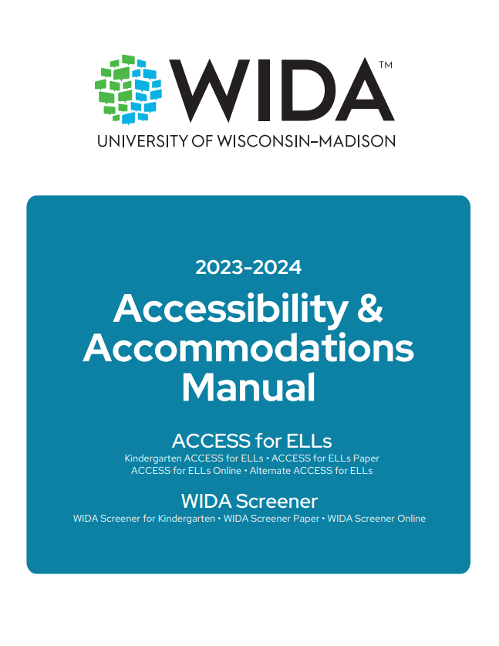
Accessibility and Accommodations Manual
Participation guidance
Framework
Types of supports
Alternate ACCESS for ELLs criteria
Keyboard shortcuts
Scribe and Transcription guidance
WIDA Screener for Kindergarten and Online
Accommodation checklists ACCESS online and paper, Kindergarten and Alternate ACCESS
Notes:
Accommodations for EL students with an IEP or 504 Plan only.

Slide 10
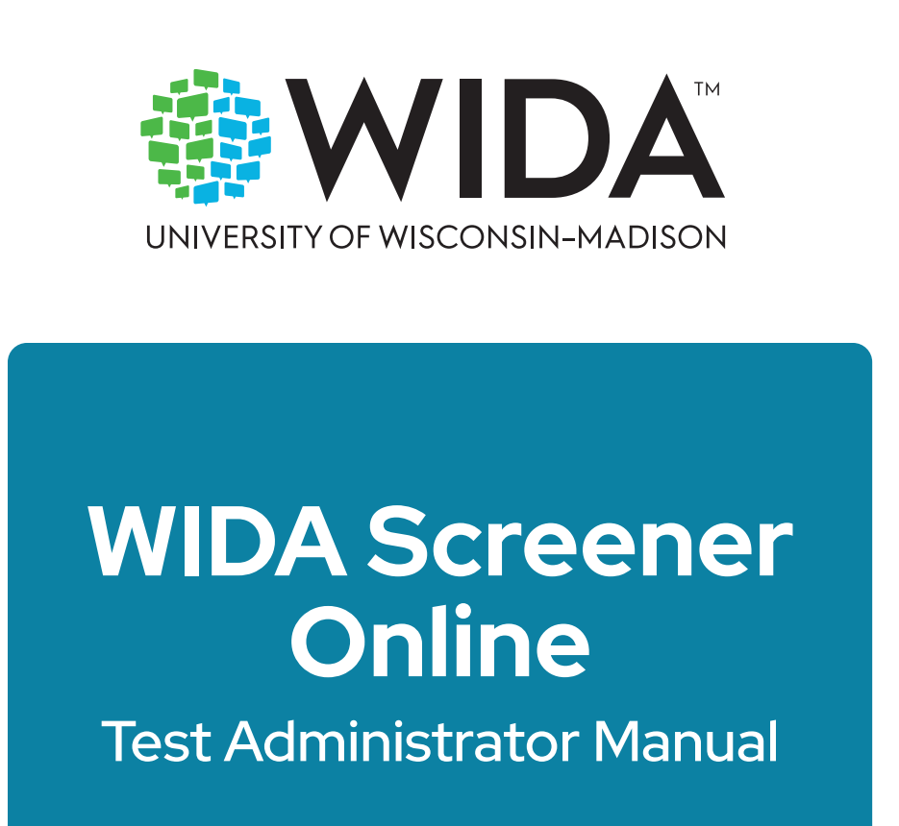
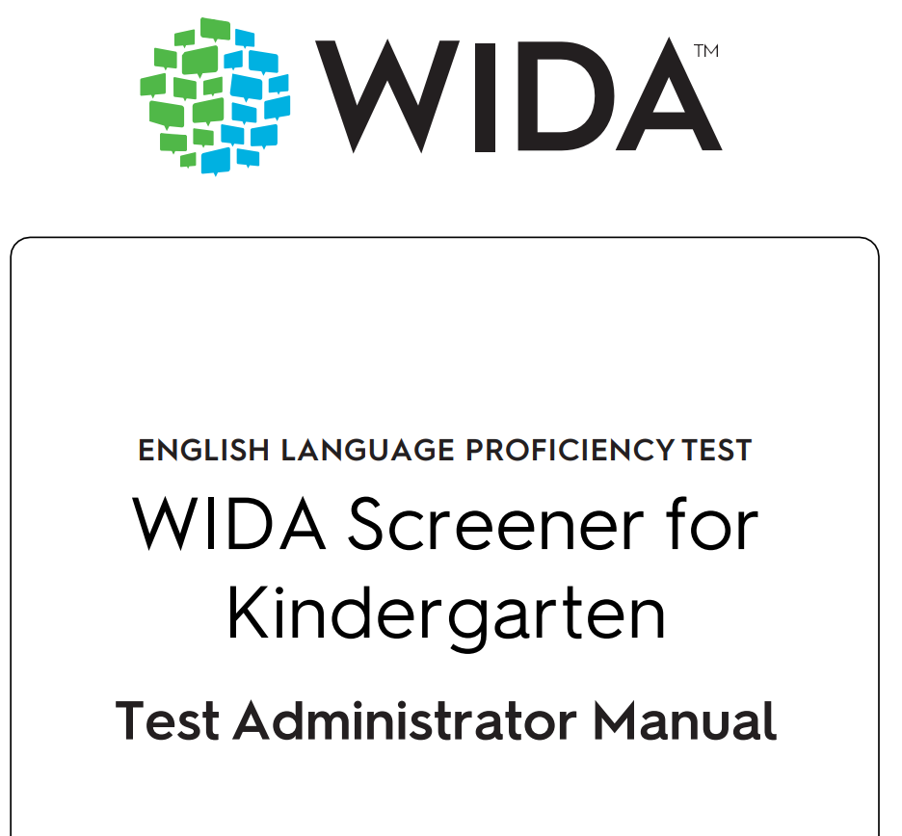
WIDA Screener Manuals
WIDA Screener Manuals can be viewed on the WIDA Portal.

Slide 11
WIDA Secure Portal
Assessment training courses and quizzes

Slide 12
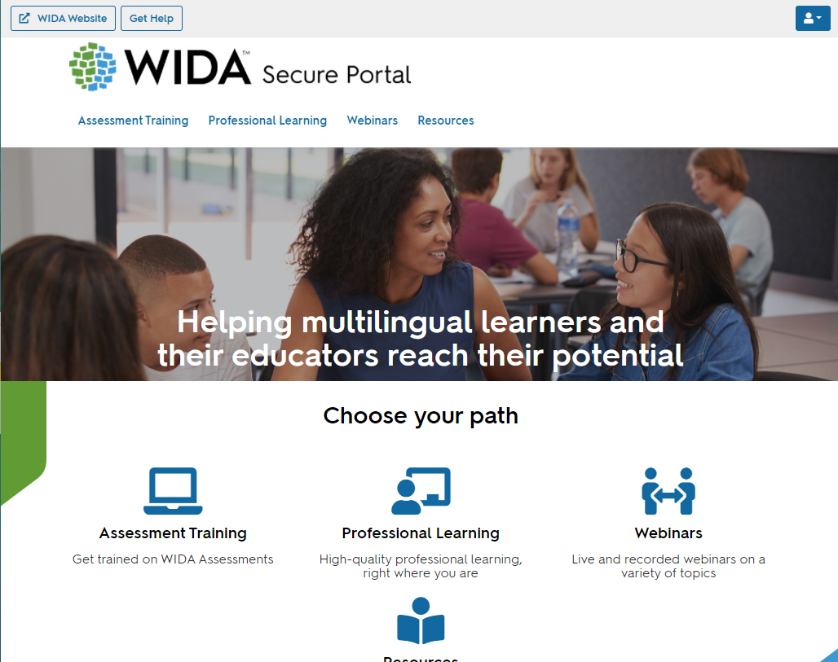
WIDA Secure Portal cont’d
WIDA Secure Portal
Assessment Training
Professional Learning
Webinars
Resources
Users will continue to see courses, webinars, and resources based on permissions.
If a user has been given access to professional learning courses only, they will not see the assessment training category— nor any resources tagged solely to assessment training.
Users will be able to update their own personal information.
Test Administrators are provided a login to the WIDA Secure Portal (must be added to the google form that the District Assessment Coordinator (DAC) has) to:
Access the training course and quiz specific to the assessment(s)
Manage User Account

Slide 13
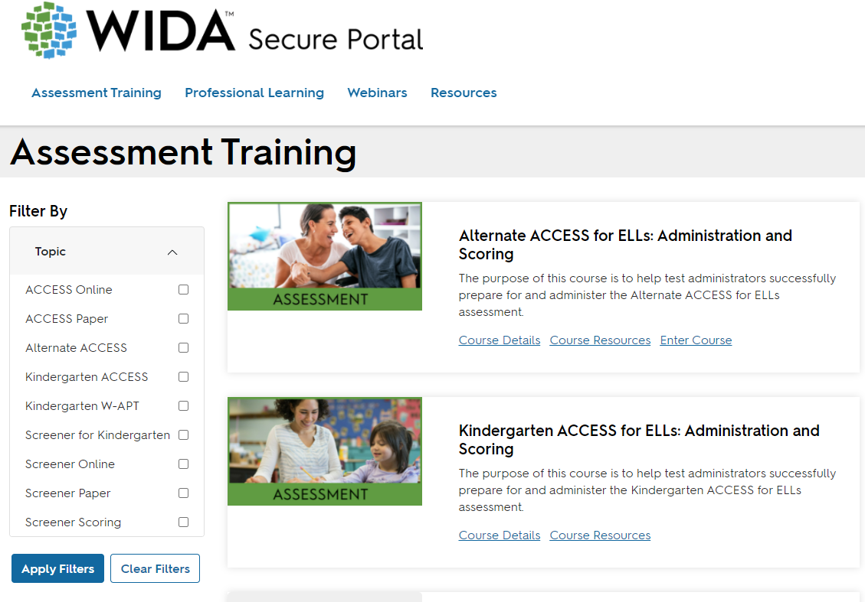
Assessment Training

Slide 14
ACCESS for ELLs® Training Course
The following courses will be available under Assessment Training (depending on user permission):
Kindergarten ACCESS for ELLs: Administration and Scoring
Alternate ACCESS for ELLs: Administration and Scoring and Field Test
Paper ACCESS for ELLs: Administration
Online ACCESS for ELLs: Administration
Speaking for Grades 1-5: Scoring Paper ACCESS and WIDA Screener
Speaking for Grades 6-12: Scoring Paper ACCESS and WIDA Screener
Writing for Grades 1-5: Scoring WIDA Screener
Writing for Grades 6-12: Scoring WIDA Screener
WIDA Screener Online: Administration
WIDA Screener Paper: Administration
WIDA Screener for Kindergarten: Administration and Scoring
Annual training certifications are required every year for test administrators prior to Screener or ACCESS for ELLs testing.
Those were reset this year on Sept. 1 instead of July 1 for ACCESS for ELLs, but WIDA Screeners quizzes were available July 1. The quizzes will be available for the test administrator to retake for the current year ACCESS for ELLs Testing Cycle.
Notes:
After you log-on, you’ll be granted access to the My Account and Secure Portal.
Click 1: Records of individuals’ certification quiz progress are available within the WIDA Secure Portal, and individuals can print a certificate of their completed training. All individual certifications will remain available in the WIDA Secure Portal as the tests have not changed, although the format of the training has been updated.
Click 2: Within the ACCESS for ELLs Training Course, information and new web-based training modules for each assessment can be accessed. For Test Administrators who were certified to administer the ACCESS for ELLs suite of assessments, information on recertification can be found within your state checklist. Test Administrators must take all quizzes annually for ACCESS, Alternate ACCESS, and Kindergarten
Click 3: Test Coordinators are responsible for ensuring that all Test Administrators have completed applicable training components before giving ACCESS for ELLs , Alternate ACCESS and Kindergarten. Please make sure your information within the My Account Info is correct.
Click 4: Most importantly, please make sure your e-mail address, district, and school is correct. If not, please update and save.

Slide 15
Test Administration Roles
Test Coordinator, Test Administrator and Technology Coordinators

Slide 16
Test Administration Roles cont’d
Test Coordinator is the individual responsible for facilitating overall test administration from start to finish. This includes managing logistics and supporting others’ roles. Some places have District Test Coordinators and others have School Test Coordinators – and some have both.
Test Administrator gives the assessment and monitors the students while they complete it.
Technology Coordinator provides technological support prior to and during test administration (for ACCESS for ELLs online only).
Notes:
WIDA defines the three main testing roles.
Each role’s training requirements are defined on the following slides.

Slide 17
Test Coordinator (District and School)
Annual Training Requirements:
View training tutorials for the tasks listed in state checklist.
Complete the knowledge checks at the end of each training tutorial.
Recommended to complete the trainings and quizzes for Test Administrators that are appropriate.
Provide Administration Code and Inclusion of Special Populations training for all test administrators.
Make sure all test administrators have completed the quizzes prior to the ACCESS for ELLs Testing window and have a record of the certifications on file in the district.
Make sure that all nondisclosure agreements are signed before the testing window begins.
Notes:
Step 1: Test Coordinators need to view training tutorials that are pertinent to the test coordination. The training tutorials are short presentations designed to teach you about a specific aspect of training. The state checklist should define these tasks.
Step 2: Complete the knowledge checks at the end of each training tutorial. These activities help Test Coordinators review key concepts and prepare for test coordination.
Step 3: Take appropriate quizzes
Kindergarten ACCESS for ELLs
Grades 1–12 Online Administration
Grades 1–12 Paper Administration
Grades 1–5 Paper Speaking (locally scored)
Grades 6–12 Paper Speaking (locally scored)
Alternate ACCESS for ELLs
WIDA recommends that coordinators do the training for Test Administrators to familiarize themselves with all aspects of the administrators responsibilities.

Slide 18
Test Administrator
Annual Training Requirements:
View training tutorials for the tasks listed in the state checklist.
Complete the knowledge checks at the end of each training tutorial.
Complete the appropriate quizzes and a copy is on file in the district office.
Complete Administration Code and Inclusion of Special Populations Trainings.
Review all the trainings on the ACCESS for ELLs page of the KDE website and WIDA Trainings for Kindergarten and WIDA Alternate ACCESS (if administering these assessments) on the WIDA Secure Portal.
Notes:
Step 1: Test Administrators need to view training tutorials that are pertinent to the test administration. The training tutorials are short presentations designed to teach you about a specific aspect of training. Your state checklist should define these tasks.
Step 2: Complete the knowledge checks at the end of each training tutorial. These activities help Test Administrators review key concepts and prepare for the test administration quiz.
Step 3: Take appropriate Quizzes
Kindergarten ACCESS for ELLs
Grades 1–12 Online Administration
Grades 1–12 Paper Administration
Grades 1–5 Paper Speaking (locally scored)
Grades 6–12 Paper Speaking (locally scored)
Alternate ACCESS for ELLs
The next slides define the quizzes in more detail.

Slide 19
Technology Coordinator
Annual Training Requirements:
  Read DRC INSIGHT Technology User Guide.
  Complete Technology Readiness Checklist.
  Make sure all devices in the district are updated with software for Central Office Service (COS) for screeners and ACCESS.
  Review the WIDA Webinar Trainings for Technology Coordinators-schedule, login, and recorded trainings is accessible in WIDA AMS.
Notes:
For Online Testing, Technology Coordinators should read the DRC INSIGHT Technology User Guide, complete the Technology Readiness Checklist., make sure all devices used for testing are updated and review the WIDA trainings for Technology Coordinators. They should work with the Test Coordinator to ensure completion of all tasks.

Slide 20
Resources
Kentucky's Member Page, Additional Trainings and Contacts

Slide 21
State-Specific Guidelines on WIDA Website
Visit Kentucky’s state page for information related to:
Contacting State Educational Agency’s Representatives
Assessment Materials and Training
ACCESS for ELLs Testing Schedules
State-Specific Guidance for ACCESS for ELLs
ACCESS for ELLs Online and Paper Checklist
Identification and Placement Guidance
Professional Development Opportunities
Notes:
Kentucky has its own specific guidance related to this information. Be sure to click on members/states and select Kentucky at wida.wisc.edu to see any specific guidelines and policies.
In 2021-2022, WIDA continues to offer the resource of state specific checklists. State checklists are available as a tool for you to assign and document the tasks that are required to administer ACCESS for ELLs. The state checklist indicates who typically handles each task in our state, along with any state-specific guidance. These are each customized for our state.

Slide 22
Kentucky ACCESS Trainings on KDE Website
ACCESS Trainings
User Accounts
Materials Ordering
Test Setup
Writing Tier Placement
Overview
ACCESS Roster Training in SDRR (coming soon)
Notes:
Each of the Kentucky ACCESS trainings are required along with the WIDA online training and quizzes.

Slide 23
Contact Chris Williams:
Chris.Williams@education.ky.gov502-564-4394 ext. 4750
Kentucky’s Administration WIDA Screener for Kindergarten, WIDA Online Screener and ACCESS/Alternate ACCESS for ELLs®
User accounts for WIDA Screener for Kindergarten, WIDA Online Screener and ACCESS/Alternate ACCESS for ELLs®
Kentucky Specific Trainings for ACCESS/Alternate ACCESS for ELLs®
ACCESS for ELLs Kindergarten®, Alternate ACCESS for ELLs®, ACCESS/Alternate ACCESS for ELLs® Rosters and Accommodations
Policy Questions for WIDA Screener for Kindergarten, WIDA Online Screener and ACCESS/Alternate ACCESS for ELLs®

Slide 24
Contact WIDA:
  WIDA Client Services Center:
  1-866-276-7735
ACCESS for ELLs® Suite Training, Certifications, Content of Score Reports
Kindergarten ACCESS for ELLs® (Paper-based)
ACCESS for ELLs® Grades 1-12 (Paper-based)
ACCESS for ELLs® Grades 1-12 (Online Administration)
Alternate ACCESS for ELLs® Grades 1-12 (Paper-based)
ACCESS for ELLs® Test Administration Preparation and Procedures (Online and Paper-based)
WIDA MODEL Paper, Online and Kindergarten Test Administration and Procedures
WIDA Screener for Kindergarten
WIDA Standards and Can Do Descriptors
WIDA Professional Learning
WIDA Research

Slide 25
Contact DRC:
  DRC Customer Support
  855-787-9615 (TTY: 763-268-2889)
WIDA Assessment Management System (WIDA AMS) Logins and Permissions
ACCESS for ELLs Online® and Paper-based Materials Ordering for Initial and Additional Materials
Returning Test Materials
Test Booklet Labels
Editing/Adding Student Information and Test Sessions
Student Transfers
Printing Test Tickets and Tier Level Reports
ACCESS for ELLs® Online Administration Technology
DRC Central Office Service (COS) and COS Service Devices
DRC INSIGHT (Online Assessments Software)
WIDA AMS/ACCESS for ELLs® Online Technical Issues
ACCESS for ELLs® Data and Reporting- Viewing Reports
Notes:
Please contact DRC Customer Support if you have questions about utilizing DRC’s systems, including the WIDA AMS and INSIGHT Test Engine.

