Slide 1
Manage Users and Test Setup/Registration WIDA Assessment Management System (AMS)
Chris Williams, Program Consultant
Division of Assessment and Accountability Support

Slide 2
Agenda
WIDA AMS Login Information
WIDA AMS Landing Page
Add/Edit Users
Getting Ready for Testing
Student Management
Ordering and Manage ACCESS Materials
Student Export/Transfer/Validation
Adding a Registration in Test Management
Printing Test Tickets
Resources
Contact Information

Slide 3
WIDA AMS–Login Information
Welcome to the WIDA Assessment Management System (AMS)
WIDA AMS supports the administration of the ACCESS for ELLs suite of assessments and WIDA Screener Online.
Logging in to WIDA AMS
To access WIDA AMS, log in using the username (email address) and password. If staff do not have a WIDA AMS login, go to the 'Logging in' section of the WIDA member/state page. Find Kentucky’s member/state page by going to the WIDA website and using the drop down in the upper right corner. The WIDA Client Services Center can also assist staff. Check the DRC System Status Indicator to see if all systems are operating normally or if there is an outage that could be affecting the work.
3
Notes:
Need to use Chrome for the test practice and the test demo. For everything else in WIDA AMS, you can use any browser.

Slide 4
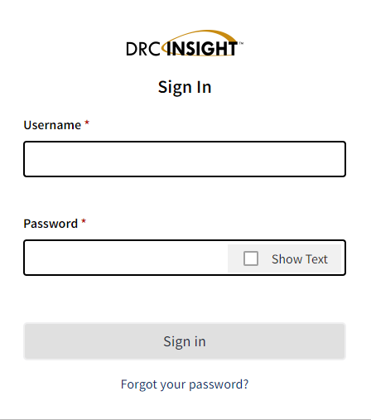
Login to WIDA AMS
WIDA AMS
If District Assessment Coordinators (DACs) and District Technology Coordinators (DTCs) need an account, contact Chris Williams.
If school personnel need an account, contact the DAC.
4

Slide 5
WIDA AMS
WIDA AMS Landing Page:
The names on some WIDA AMS landing page tiles have been renamed.
Import Students has changed to Import Management – with the addition of the import registrations functionality in fall 2024, users will use the application to import students and update registrations.
Test Sessions has been removed from the Manage Registrations button.
Download Individual Student Reports has been changed to Download Student and Status Reports, reflecting the addition of Test Status and Student Status features in Reporting Services.
The Download Status Reports button has been removed and replaced with Knowledge Articles to provide users with an easy way to access this customer support resource.
5

Slide 6
WIDA AMS Landing Page
6

Slide 7
Import Management
NEW Registration Import File:
This file can be used to re-organize and regroup automatically generated registrations en masse.
This function replaces the former Test Session Upload functionality.
Refer to the Online Help in Import Management for the file layout and sample file.
Student Import File Update:
The Student Import (Pre-ID) file layout has a new column A to indicate which testing program students should be assigned to: A = ACCESS or S = WIDA Screener Online.
Important Note: Each subsequent column in the Student Import file layout has been reordered because of this new column.
Refer to the Online Help in Import Management for the file layout and sample file
7

Slide 8
Student Management
Create Student:
The Create Student screen now includes details related to the mode of administration, paper tier, and whether the student is a WIDA Alternate ACCESS tester.
Students added via Import Management: these fields will be populated in the Create Student/Student details screen for each student based on the designations from the Student Import file.
Students added via Create Student: The user can mark these fields for the ACCESS testing program.
The fields on the Create Student screen are for information purposes only.
Student Transfers:
Based on your state policy and permissions, district users can transfer Screener students to a different school in their district.
8

Slide 9
Test Management
Change Assessment:
Available within the View Registrations tab.
This can be used to change an automatically generated registration to a different grade level for Screener or update an ACCESS writing registration to/from a keyboarding or handwriting registration.
Only student registrations that are Not Started can change assessments.
This functionality partially replaces the former Test Session Upload file.
Regroup Students:
Available within the Registration Details.
This can be used to organize registration based on district or school preferences.
Only student registrations that are Not Started can be regrouped.
New Student Tab:
A user can create a new student and register them to all four ACCESS domains at once.
Print Select Test Tickets:
Users can print test tickets for one or multiple students within a registration.
Refer to Online Help in WIDA AMS Test Management for more information on these new features.
9

Slide 10
Test Monitoring Application (TMA)
The changes in WIDA AMS within the Test Monitoring Application (TMA) for 2024-2025.
Users have the option of enabling restricted access (the ‘waiting room’) when using TMA.
The use of test monitoring and restricted access remains optional for districts.
Test monitoring for registrations created through Import Management or Test Management will continue to be turned off by default.
Refer to Online Help in WIDA AMS Test Management for more information on this new feature.
10

Slide 11
Test Monitoring in WIDA AMS
Test Monitoring - the application uses a Monitoring Code to assign a student’s test session to a Test Monitor. The test monitor will open the test monitoring menu under My Application on the home screen where a random unique Monitoring Code will be assigned to that user. The test monitor will share the code with the students whom they are monitoring. After logging in to a test, students will enter the monitoring code and then they will show up on the Test Monitoring Dashboard. Test monitors can view a student’s test status, navigation and test progress in real-time.
11

Slide 12
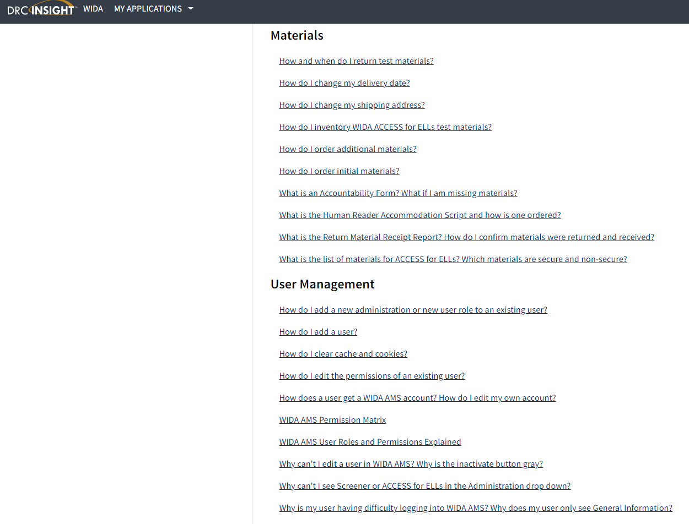
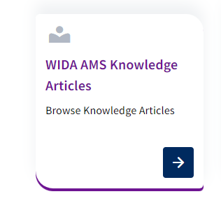
WIDA AMS Knowledge Articles
Under My Application-DRC Customer Service- to find the WIDA AMS Knowledge Articles to assist with questions around WIDA AMS
12

Slide 13
Reporting Services
The changes in WIDA AMS within Reporting Services for 2024-2025.
District level users now have access to the Operational Dashboard in Reporting Services.
The Student Status Dashboard and Online Testing Statistics, formerly located in WIDA AMS under Student Export/Transfers/Validation, and the Status Reports formerly located in Report Delivery have been retired and replaced with two new features:
Test Status:
New for District level users this year. This function is also available for School level users and Test Administrators.
District level users can access data from the 2024-2025 test year only.
Student Status:
New for district level users. This function is also available for school level users and test administrators.
Use this feature to view the status of all students in online registrations, including their demographics, accommodations, and test start and end times.
Changes to student records may take more time to display in Student Status during the ACCESS Pre-ID import period as data is processed. Student Status is most accurate during active testing periods.
13

Slide 14
WIDA AMS-Public Test Resources
Public Test Resources:
View the Test Demo to demonstrate test features to students. The Test Demo is a series of videos that explain to students how to take the online test and interact with the test platform.
Use the Test Practice items to help students understand how to respond to ACCESS for ELLs Online and WIDA Screener Online items on the test platform. While using the test practice items, students can familiarize themselves with the features available to them during the actual assessment. To access and view the Test Practice Items on Windows, macOS, ChromeOS, or Linux devices staff must use the Chrome browser. If staff are on an iPad, must use the Safari Browser.
Use the Sample Items to help students, educators, and families get a better understanding of ACCESS for ELLs Online. None of the sample items appear on the operational test; however, the sample items are similar to items that students will see on the test. To access and view the Sample Items on Windows, macOS, ChromeOS, or Linux devices, staff must use the Chrome browser. If using an iPad, staff must use the Safari Browser.
14

Slide 15
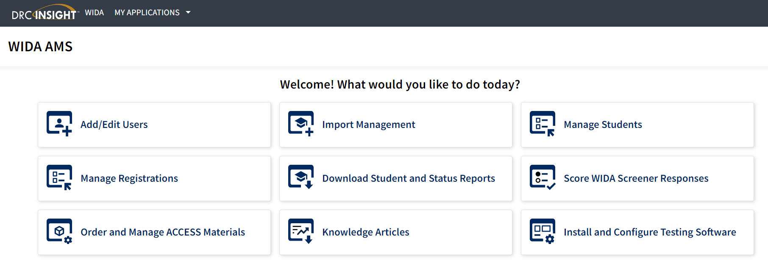
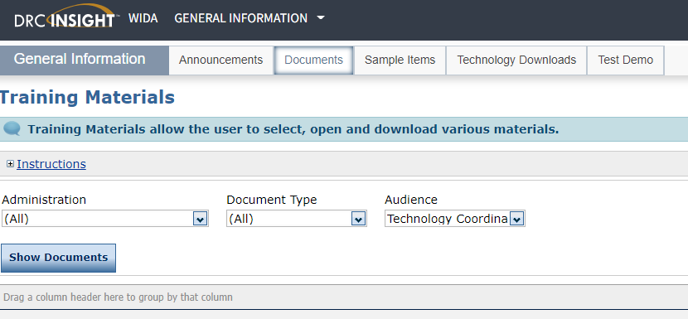
Install and Configure Testing Software Tab
Technology Downloads and Documents for the DTC will be on the General Information Tab
Notes:
When you get to the welcome page of WIDA AMS, select the tile install and Configure Testing Software. This allows the Technology Coordinator get to the software for the devices, the memos, check list and the webinars needs for ACCESS testing.

Slide 16
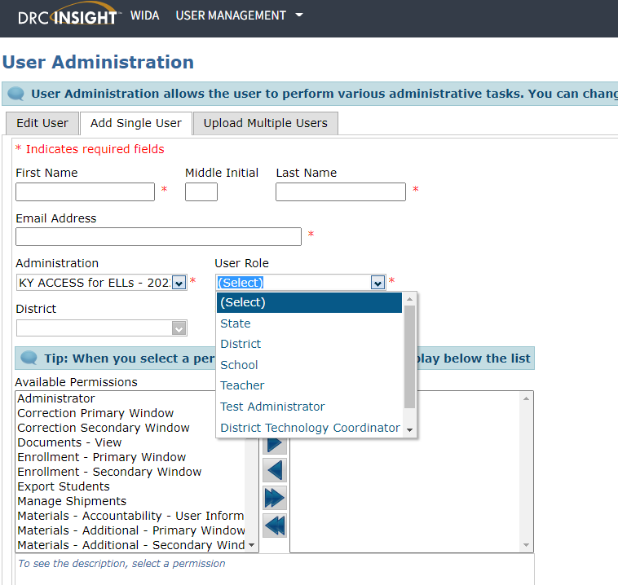
Add/Edit Users-Adding a Single User
After logging into WIDA AMS, click on Add/Edit Users
Add a single user by filling in the following:
First Name, Middle Initial and Last Name
Email Address
Administration: (Select KY ACCESS for ELLs- 2024-2025)
District
School
User Role: Test Administrator (DACs and DTCs already have access to WIDA AMS)
Available Permissions vs. Assigned Permissions
16

Slide 17
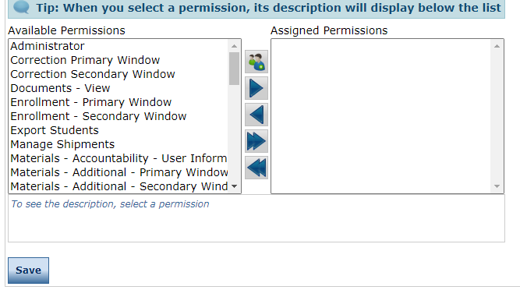
Add/Edit User Tab Continued
Once the user role has been selected for Test Administrator, select the corresponding permission set and the available permissions will highlight on the screen. (See WIDA AMS Guide pp. 35-41 for assistance.)
DACs must use the right arrow to move available permissions to the assigned permissions box.
Once permissions are assigned then hit the save button at the bottom of the screen.
If staff have left or retired from the district, please inactivate the accounts in WIDA AMS. Only current staff should have access to WIDA AMS depending on the role.
17

Slide 18
Add/Edit User Tab-Adding Multiple Users
Click on Upload Multiple Users at the top.
Once the users are in the format, then do the following:
Select ACCESS for ELLs -2024-2025-Kentucky under administration
Click on Browse to find your CSV file
Click on Upload
Upload complete; confirmation will appear if successful
Assign permissions
Click on the File Layout and Sample File to enter the users.
18

Slide 19
WIDA AMS
Getting Ready for Testing, Materials, Student Management, and Test Management

Slide 20
Getting Ready for Testing
A week prior to testing, districts will need to have the students do a practice test to become familiar with the online testing format.
The day before testing in the district, print out the tickets online for the students in grades 1-12. Kindergarten, Alternate, Braille and Large print take the paper-pencil ACCESS.
Online Test Setup Window is Nov. 27, 2024 - Feb. 14, 2025
Testing Window is Jan.6 - Feb. 14, 2025
20

Slide 21
Student Management Tab
The changes for the Student Management Tab in WIDA AMS for 2024-2025.
Student Management allows the district to add new students that were not pre-populated in WIDA AMS from the original pre-id data file sent to DRC in Oct. from the Office of Assessment and Accountability (OAA).
Update Accommodations allows the district or school staff to update the accommodations for students who have an Individual Education Program (IEP) or 504 Plan.
Transfer Students allows the student to be transferred from one school to another within the district in WIDA AMS.
Export Student allows school or district staff to export up to eight thousand students with all the demographics from WIDA AMS.
21

Slide 22
Order and Manage ACCESS Materials Tab
Accountability Form is for the district to enter the quantity of paper materials to be returned or could not be returned to DRC when testing is complete. It is prepopulated with the initial shipment order in Oct.
Additional Materials is for the DACs to order additional paper materials needed for testing during Dec. 3-Feb. 7. DACs will need to contact Chris Williams prior to ordering additional materials.
Materials Ordering is the initial materials order that DACs completed during the materials ordering window Sept. 27-Oct. 23.
Return Materials Receipt Report is the electronic inventory of all materials shipped to the district and schools. Make sure DACs fill this out when shipping materials back to DRC.
22

Slide 23
Student Export/Transfer/Validation
The changes for the Student Export/Transfer/Validation in WIDA AMS for 2024-2025.
Student Status Dashboard allows the user to view the online testing status of each student within a school.
Student Transfer Form allows the student to be transferred from one district to another district within WIDA AMS.
Data Validation allows the district/school to correct demographics, etc. after testing is completed.
23

Slide 24
Manage Registrations Tab
Manage Test Registrations allows the district/school to search or view existing testing registrations for a specific district or school.
Create or edit test registrations.
Assign or remove students for each test registrations.
Export session details, print test tickets or view the status of the test registrations.
24

Slide 25
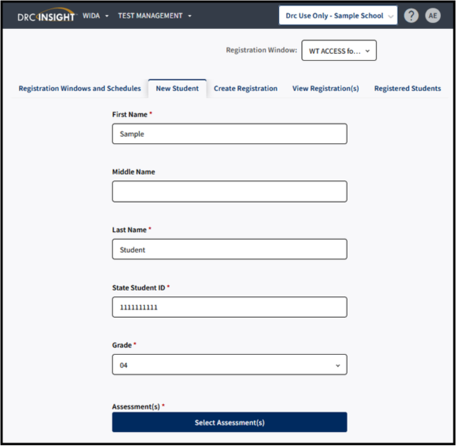
Adding a Registration in Test Management
To add a registration, complete the following steps:
Click Test Management from the WIDA AMS My Applications menu bar.
Confirm or enter your site criteria in the upper right corner. Click Save.
Confirm or enter your Registration Window in the drop-down menu.
Select the New Student tab.
Complete First and Last Name, SSID, and Grade Filters. Button under Assessment(s) will activate.
Click on Select Assessments.
25
Notes:
New Student Tab method simultaneously adds a student into Student Management and creates a registration for a single, new student.
Create Registration creates a registration for a single or group of students who already exist within WIDA AMS under Student Management.
To add a registration, complete the following steps:
Click Test Management from the WIDA AMS My Applications menu bar.
Confirm or enter your site criteria in the upper right corner. Click Save.
Confirm or enter your Registration Window in the drop-down menu.
Select the Create Registration tab.
Enter a Registration Name. The registration name should be descriptive. For example, a user might name the registration by the teacher name and classroom period.
Click Select Assessment(s). A Select Assessments window will appear. For ACCESS for ELLs, you will select an assessment for each domain. For WIDA Screener Online, you will select the assessment by grade cluster. Click Add.
Click Select Student(s) to add one or multiple students to the registration. To select multiple students, click the checkbox next to each student to add to the registration. A user can also filter by grade or last name. Click Add.
A user can choose to activate Test Monitoring and set to “Required.” This action will require all students in the registration to enter a Monitoring Code generated by the Test Administrator on initial login of the assessment.
Click Register.
You will receive a Registration Confirmation message showing the assessment(s) and the number of students added to the registration. If this is correct, select Close.
Click View Registration(s) to see the newly created registrations.
Note: A Registration Window, District and School will need to be selected for the Create Registration tab to activate. If the Create Registration tab does not appear, this will indicate that the user does not have the “Registration-Add/Edit” permission.
The registration name should be descriptive. For example, a user might name the registration by the teacher name and classroom period.
For WIDA Screener Online, you will select the assessment by grade cluster.
Note: If you do not see the student available to be placed into the registration, this will usually indicate that the student has not yet been added to WIDA AMS, or that the student is already enrolled in a registration of the same domain and grade cluster. Search for the student under the Registered Students tab to confirm the student’s enrollment in registrations for the given administration.
If creating a registration for Screener and are unsure which grade cluster registration to use for the student, refer to Knowledge Article “What grade cluster registration should I screen a student?”
For Screener testing, a student will only need to be enrolled in one registration. Screener Online is a single ticket login with one registration.
For more information on how to edit a registration, refer to Knowledge Article “How do I edit a registration?”

Slide 26
Adding a Registration in Test Management Continued
To add a registration, continue the following steps:
7. The Select Assessment(S) will appear. Select the assessments and domains applicable to the student.
8. Click Add to add a student to the following registrations or click Close to cancel the process without saving the changes.
9. Confirm or edit the Registration Name. The Registration Name will default to user's last name and date.
10. Complete other demographic fields as needed.
11. Click Register to register the student to the selected assessment.
12. Click View Registration(s) to see the newly created registration.
26
Notes:
New Student Tab method simultaneously adds a student into Student Management and creates a registration for a single, new student.
Create Registration creates a registration for a single or group of students who already exist within WIDA AMS under Student Management.
To add a registration, complete the following steps:
Click Test Management from the WIDA AMS My Applications menu bar.
Confirm or enter your site criteria in the upper right corner. Click Save.
Confirm or enter your Registration Window in the drop-down menu.
Select the Create Registration tab.
Enter a Registration Name. The registration name should be descriptive. For example, a user might name the registration by the teacher name and classroom period.
Click Select Assessment(s). A Select Assessments window will appear. For ACCESS for ELLs, you will select an assessment for each domain. For WIDA Screener Online, you will select the assessment by grade cluster. Click Add.
Click Select Student(s) to add one or multiple students to the registration. To select multiple students, click the checkbox next to each student to add to the registration. A user can also filter by grade or last name. Click Add.
A user can choose to activate Test Monitoring and set to “Required.” This action will require all students in the registration to enter a Monitoring Code generated by the Test Administrator on initial login of the assessment.
Click Register.
You will receive a Registration Confirmation message showing the assessment(s) and the number of students added to the registration. If this is correct, select Close.
Click View Registration(s) to see the newly created registrations.
Note: A Registration Window, District and School will need to be selected for the Create Registration tab to activate. If the Create Registration tab does not appear, this will indicate that the user does not have the “Registration-Add/Edit” permission.
The registration name should be descriptive. For example, a user might name the registration by the teacher name and classroom period.
For WIDA Screener Online, you will select the assessment by grade cluster.
Note: If you do not see the student available to be placed into the registration, this will usually indicate that the student has not yet been added to WIDA AMS, or that the student is already enrolled in a registration of the same domain and grade cluster. Search for the student under the Registered Students tab to confirm the student’s enrollment in registrations for the given administration.
If creating a registration for Screener and are unsure which grade cluster registration to use for the student, refer to Knowledge Article “What grade cluster registration should I screen a student?”
For Screener testing, a student will only need to be enrolled in one registration. Screener Online is a single ticket login with one registration.
For more information on how to edit a registration, refer to Knowledge Article “How do I edit a registration?”

Slide 27
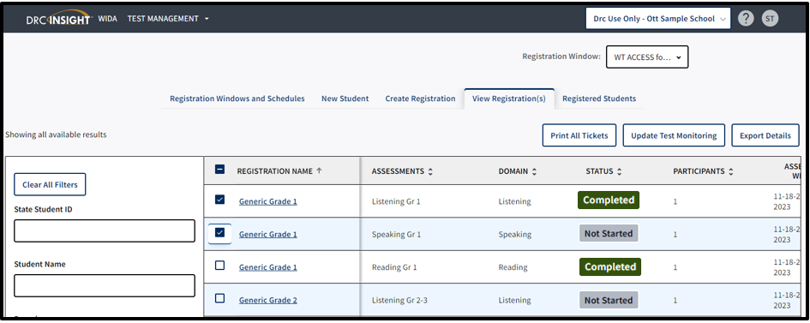
Printing Test Tickets
To print test tickets for students in a registration, complete the following steps:
Click Test Management from the WIDA AMS My Applications menu bar.
Confirm or enter your site criteria in the upper right corner. Click Save.
Confirm or enter your Registration Window in the drop-down menu.
Select the View Registrations(s) tab.
Apply one or more filter criteria such as SSID, Student Name, Domain, Registration Name, and/or Assessments to refine your search. Or, to print the test tickets for multiple registrations, leave the filters blank
Select the checkbox next to the registration(s) and click Print All Tickets.
27
Notes:
District and school staff must keep test tickets secure before and after testing of the WIDA Online Screener. Must maintain test security through out the screening process-before, during and after.
Note: If the Print all Tickets button does not appear, please select a school in the site selector in the upper right corner.
If a PDF file does not appear, disable your browser’s pop-up blocker.
A test ticket includes the Student Name, Date of Birth, Accommodations, Domain, Registration Name, State Student ID, Username, and Password.
Prior to testing, Test Administrators should confirm the student’s identity when passing out the test tickets to the student to prevent the student from logging in under the incorrect profile.
Screener Online has one login and a single test ticket for all four domains.
How do I print test tickets for individual students?
To print test tickets for individual students in a registration, complete the following steps:
Click Test Management from the WIDA AMS My Applications menu bar.
Confirm or enter your site criteria in the upper right corner. Click Save.
Confirm or enter your Registration Window from the drop-down menu.
Select the Registered Student(s) tab and search for the student by name or state student ID. Any student with related search criteria will automatically filter on the screen with his or her current registrations.
If you need further assistance with WIDA AMS, please contact DRC Customer Service at 855-787-9615 or wida@datarecognitioncorp.com.

Slide 28
Resources in WIDA AMS
WIDA AMS User Guide
WIDA AMS Knowledge Articles
Technology Resources- Documents and Downloads
Technology Memos and Webinars-recorded and upcoming webinars-On the landing page, select My Applications > General Information > Documents and filter the Document Type by Memos/Documents.
28

Slide 29
Kentucky ACCESS Trainings on KDE Website
User Accounts
Materials Ordering
Test Setup
Writing Tier Placement
Overview
ACCESS Roster Training in SDRR (coming soon)
ACCESS Trainings are located on ACCESS for ELLs webpage of the Kentucky Department of Education (KDE) website.
29
Notes:
Each of the Kentucky ACCESS trainings are required along with the WIDA online training and quizzes.

Slide 30
Contact Information:
KDE:
Chris Williams
502-564-4394 ext. 4750
DRC:
WIDA DRC Customer Service
Data Recognition Corporation
855-787-9615 TTY: 763-268-2889
30

