Slide 1
Student Data Review and Rosters (SDRR)
ACCESS For ELLs ® (ACCESS and WIDA Alternate Rosters)
Chris Williams, Program Consultant
Division of Assessment and Accountability Support

Slide 2
Agenda
ACCESS for ELLs Reminders
Secure Web Application-SDRR
Resources and Reminders

Slide 3
ACCESS for ELLs Reminders
SDRR

Slide 4
ACCESS for ELLs in SDRR
Rosters to submit nonparticipations for ACCESS for ELLs will open on Jan. 6 and close on Mar. 10 at 5 p.m. ET for new tickets.
The student listing will be blank initially.
Do not add students to the roster who are participating in ACCESS or WIDA Alternate ACCESS.
Only add students to the student listing for the following reasons:
Medical Nonparticipation
Withdrew After the Testing Window Began
Expelled Without Services
IFEP-Initially Fully English Proficient on the WIDA Online Screener (Grades 1-12)
RFEP-Redesignated Fully English Proficient on ACCESS (Grades K-12)
Upload scanned copies of the completed Medical nonparticipation form(s) in SDRR.
Keep a copy of the ACCESS for ELLs Roster nonparticipation changes made by the district prior to closing on Mar. 10.

Slide 5
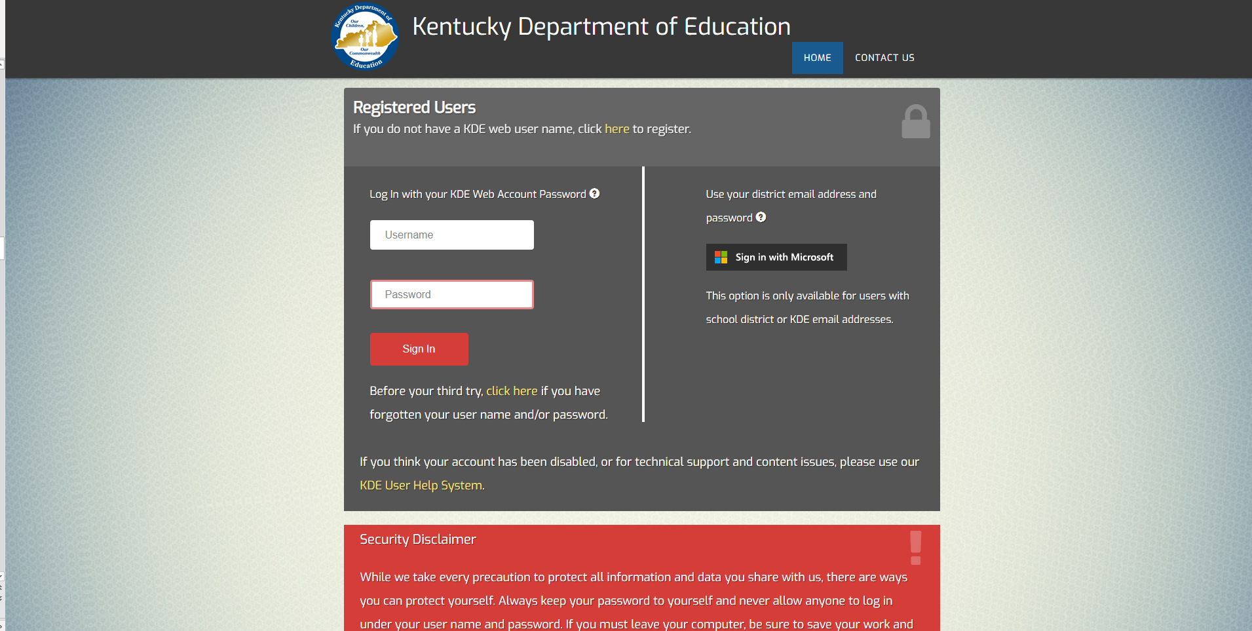
Secure Web Applications Login Page
https://applications.education.ky.gov/login/default.aspx

Slide 6
Secure Web Application-SDRR
Application - Login (ky.gov)

Slide 7
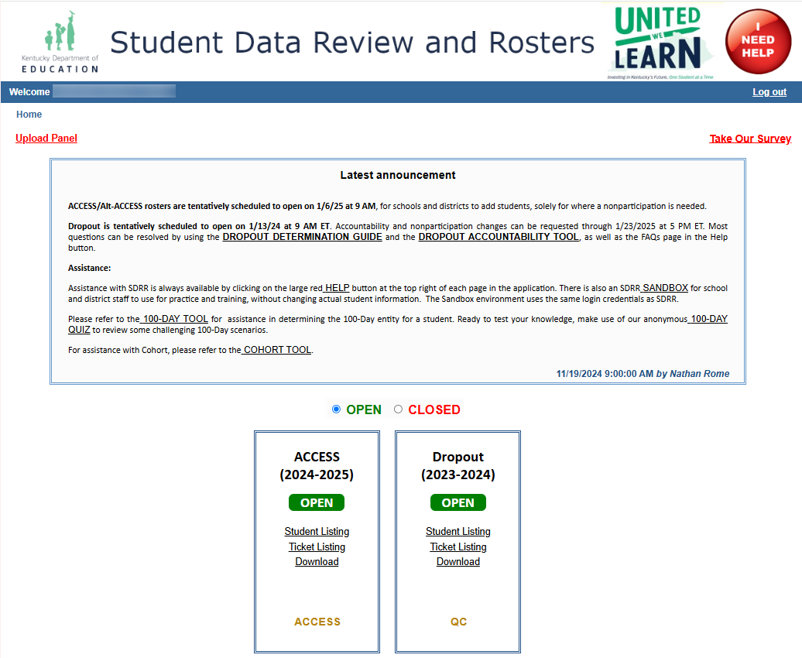
Welcome/Home Page

Slide 8
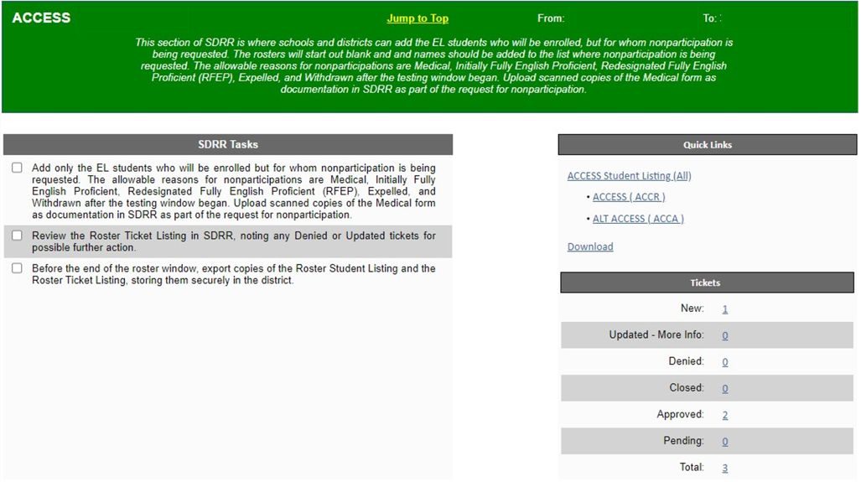
ACCESS- SDRR Tasks, Quick Links and Tickets

Slide 9
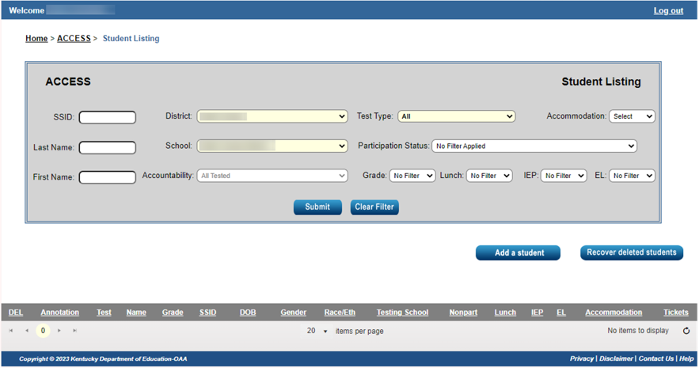
Student Listing Page
Student Listing will be blank until students who need a nonparticipation for ACCESS/WIDA Alternate ACCESS are added.

Slide 10
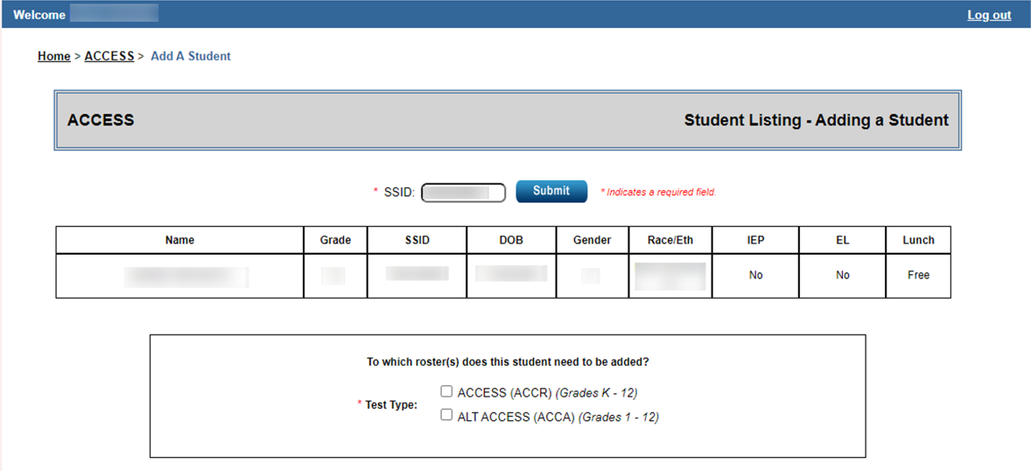
Adding a Student - Need SSID
10

Slide 11
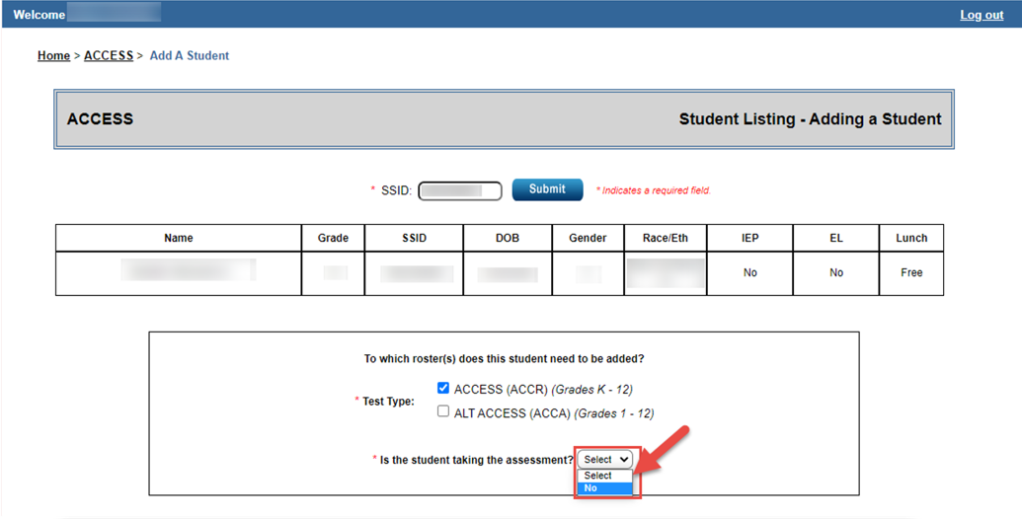
Adding a Student - Not Taking the Assessment
11

Slide 12
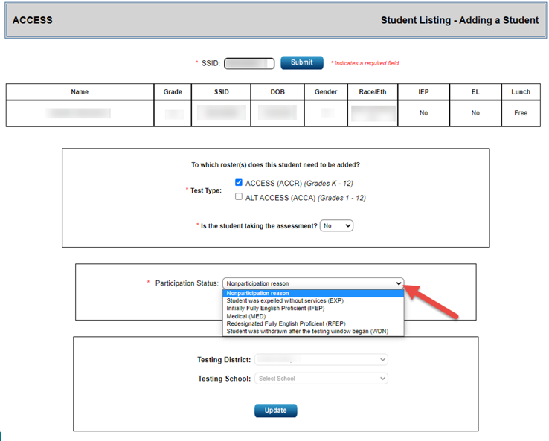
Adding a Student – Nonparticipation
12

Slide 13
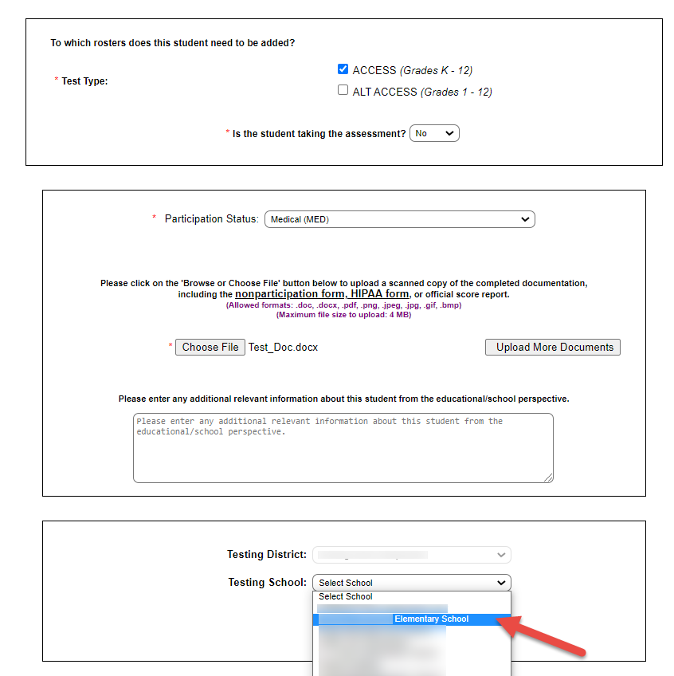
Adding a Student-Testing School and Update
13

Slide 14
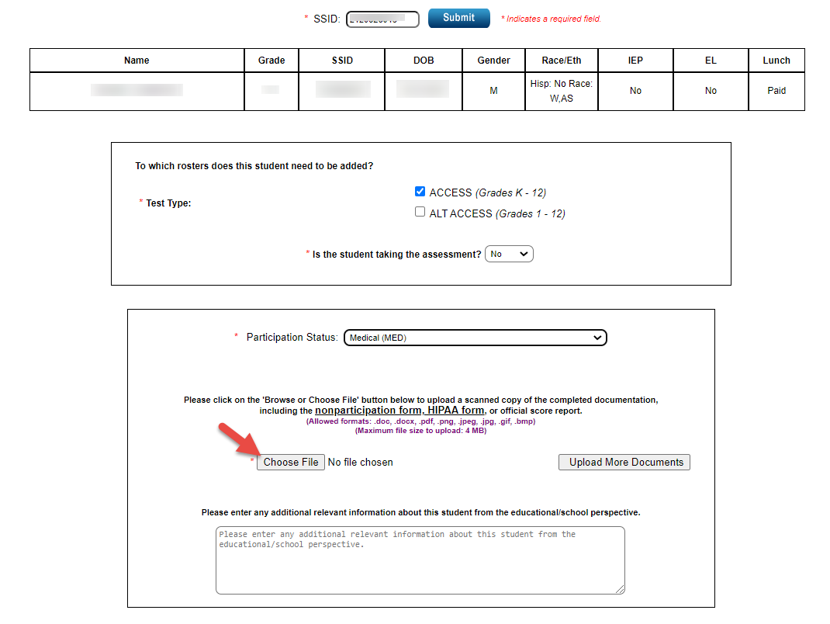
Adding a Student-Uploading the Nonparticipation Document
14

Slide 15
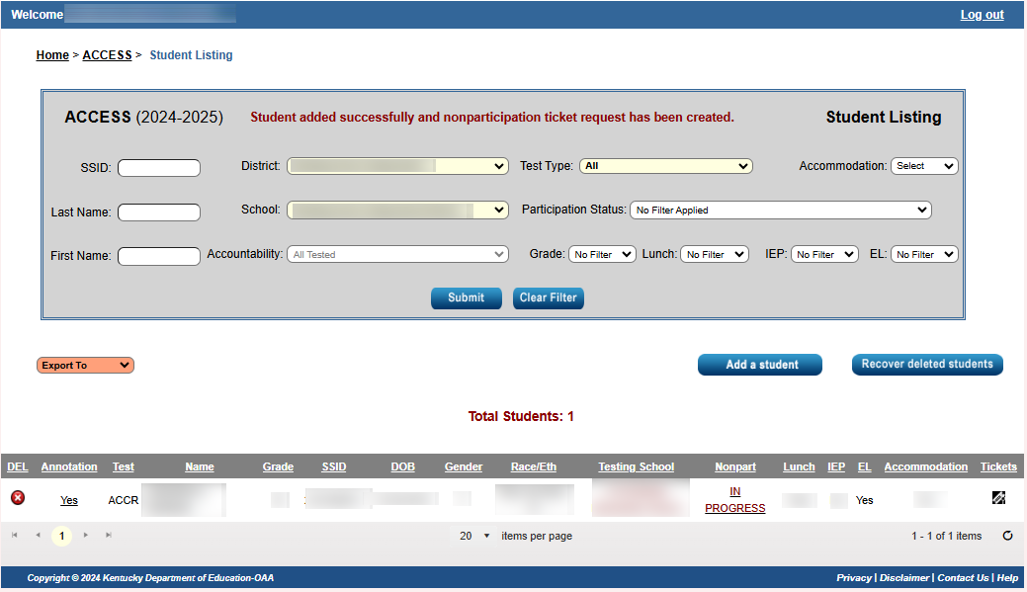
Student Listing with Nonparticipations
15

Slide 16
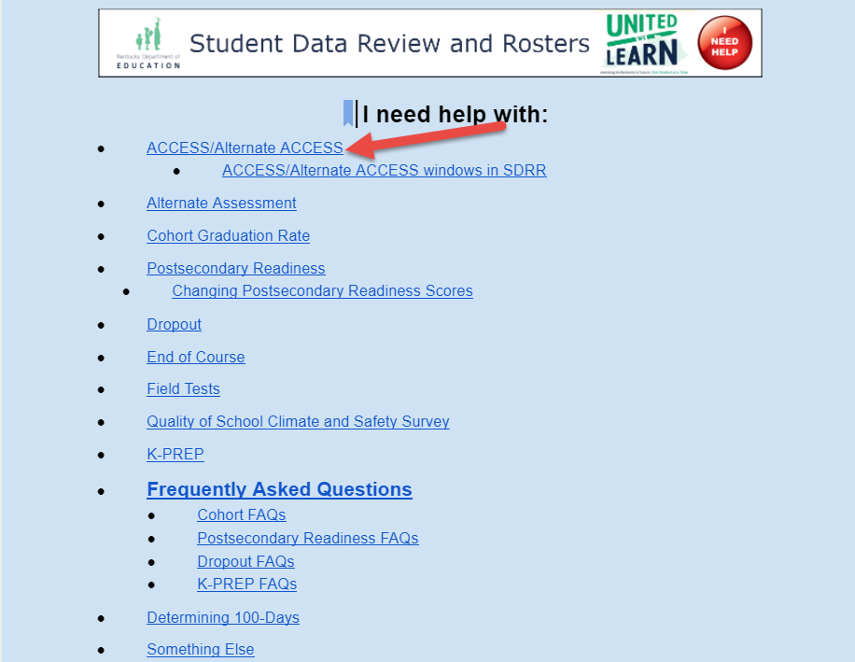
Resources for ACCESS for ELLs: (Online Help Button)

Slide 17
Resources and Reminders
SDRR

Slide 18
Student Transfers Out of State Before Testing Window
Annotate where the student transferred and date of withdrawal; then delete the student from the ACCESS roster in the spring if the student is on the roster.
Do not assign the student a test booklet or put the student in a test registration in WIDA Assessment Management System (AMS).
If a pre-id label was applied to the test booklet, affix a “Do Not Process” label over top of the pre-id label and send back with non-scorable materials.

Slide 19
SDRR Resources
Local WAAPOC for access to SDRR
100-Day Tool
https://bit.ly/100-Day Tool
Help Button
100-Day Quiz/Scenarios http://bit.ly/100-Day-Quiz.

Slide 20
2024-2025 ACCESS for ELLs (ACCESS-Kindergarten, Online, Paper, WIDA Alternate ACCESS)Testing Schedule
 | Start Date | End Date
Online Test Setup for Registrations | 11/27/2024 | 2/14/2025
Districts Receive Test Material | 12/3/2024 | 12/3/2024
Additional Test Material Window | 12/3/2024 | 2/7/2025
Test Window | 1/6/2025 | 2/14/2025
All Test Material Received at DRC | 2/28/2025 | 2/28/2025
Pre-Reporting Data Validation Window | 3/19/2025 | 4/2/2025
Districts Receive Reports | 4/28/2025 (online) | 5/7-5/8/2025 (printed)
Score Correction Window | 5/8/2025 | 5/22/2025

Slide 21
Kentucky ACCESS Trainings
User Accounts
Materials Ordering
Test Setup
Writing Tier Placement
Overview
ACCESS Roster Training in SDRR
The Kentucky ACCESS Trainings are located on the KDE website.
21

Slide 22
ACCESS for ELLs® Exit Criteria
ACCESS
Overall composite of a 4.5 on a Tier B/C.
Kindergarten ACCESS
Overall composite of a 4.5.

Slide 23
Contact Information for ACCESS and WIDA Alternate ACCESS Rosters:
Chris Williams​
502-564-4394 ext. 4750​

