Slide 1
ACCESS For ELLs® Overview
Paper/Pencil and Online Testing
Chris Williams, Program Consultant
Division of Assessment and Accountability Support
KDE:OAA:DAAS:hj 1/29/2021

Slide 2
Training Agenda
Policy and Guidance
Testing Schedule
Preparation
New for ACCESS
ACCESS Paper-Kindergarten, Alternate
Accommodations
ACCESS Online Administration and Logistics
Seating Charts
Test Security and Monitoring
Resources
Packing
Shipping
Roster
2

Slide 3
Policy and Guidance
WIDA Screeners (Kindergarten and Online) and ACCESS for ELLs (ACCESS-Online and Paper, Kindergarten and WIDA Alternate ACCESS)

Slide 4
Kentucky Department of Education Health and Safety
Staff must follow all local health departments and state government safety guidelines when administering the in-person ACCESS for ELLs and the WIDA screeners.
Adjustments may be needed as COVID-19 outbreak conditions change.
Notes:
During administration, school and district staff must follow all state and local safety guidelines. These decisions should be made in accordance with local health department and state government guidelines at the time of testing. Testing plans may be modified given the changing circumstances of the pandemic. Adjustments may be needed as COVID-19 outbreak conditions change.

Slide 5
Policy for Ordering and Testing
English Learner (EL) students in Kindergarten who need to take the WIDA Alternate ACCESS will take it this year since it is operational.
Districts who have Kindergarten English Learner (EL) students participating in the WIDA Alternate ACCESS this year will need to order Kindergarten WIDA Alternate ACCESS materials in the new K-2 cluster.
There will not be any nonparticipations for Kindergarten Alternate students unless the student is medically not able to test during the entire window.
Students are screened for EL identification prior to testing the students with WIDA Alternate ACCESS. The IEP team determines whether the EL student will take the regular ACCESS with accommodations or will take the WIDA Alternate ACCESS with accommodations.
5

Slide 6
Guidance for the WIDA Screener for Kindergarten and WIDA Online Screener and ACCESS for ELLs Testing
The WIDA screeners and ACCESS for ELLs testing can be administered to students who are attending in-person schooling or to students who are enrolled in virtual learning. The schools will arrange a time with the parents for the screener to be administered in-person this school year.
The WIDA online screener, the WIDA Screener for Kindergarten and ACCESS for ELLs cannot be administered remotely.
6

Slide 7
Background
Test Vendor, Testing Schedule, Testing Domains, Standards Framework

Slide 8

Test Vendor
  Data Recognition Corporation® (DRC) serves as the operational test vendor for ACCESS for ELLs®, both online and paper.
Notes:
Data Recognition Corporation serves as the operational test vendor for ACCESS for ELLs, both online and paper (including Kindergarten and Alternate ACCESS for ELLs).

Slide 9
ACCESS for ELLs Suite of Assessments
The following assessments are used to satisfy state and federal requirements for the annual assessment of the English language proficiency of English Language Learners (ELLs):
  ACCESS for ELLs, an online and paper-based assessment for Grades 1–12,
  Kindergarten ACCESS for ELLs, a paper-based assessment for Kindergarten,
  WIDA Alternate ACCESS, a paper-based assessment for ELLs in Grades 1–12 who have significant cognitive disabilities.
Notes:
The ACCESS for ELLs assessments are a tool to measure English Language Learners proficiency in English. The ACCESS for ELLs suite of assessments includes:
ACCESS for ELLs, an online and paper-based assessment for students in Grades 1–12
Kindergarten ACCESS for ELLs, a paper-based assessment for Kindergarten students
Alternate ACCESS for ELLs, a paper-based assessment for students in Grades 1–12 who have significant cognitive disabilities
More information about Alternate ACCESS for ELLs and Kindergarten ACCESS for ELLs can be found in other presentations available on the WIDA website.

Slide 10
2023-2024 ACCESS for ELLs (ACCESS-Kindergarten, Online, Paper) Tentative Testing Schedule
 | Start Date | End Date
Online Test Setup for Registrations | 11/30/2023 | 2/16/2024
Districts Receive Test Material | 12/5/2023 | 12/5/2023
Additional Test Material Window | 12/5/2023 | 2/9/2024
Test Window | 1/4/2024 | 2/16/2023
All Test Material Received at DRC | 3/1/2024 | 3/1/2024
Pre-Reporting Data Validation Window | 3/20/2024 | 4/3/2024
Districts Receive Reports | 4/26/2024 (online) | 5/08/2024 (printed)
Score Correction Window | 5/7/2024 | 5/21/2024
Notes:
The ACCESS testing window is scheduled to begin on Jan. 4 and will end on Feb. 16 this year. KDE will be monitoring the health crisis and will let the DACs know if there are any
change to the schedule in a Monday DAC email.
12/1/22-2/17/23 WIDA AMS test setup available for test sessions
Data Recognition Corporation (DRC) prints, scores, houses the online system and ships the test materials and reports to the districts.
DRC opens a data validation window for districts to have one last look at the demographic data before the reports are printed and sent to the districts.
Kindergarten, Alternate ACCESS and Accommodated (Braille and Large print) are paper/pencil assessments.

Slide 11
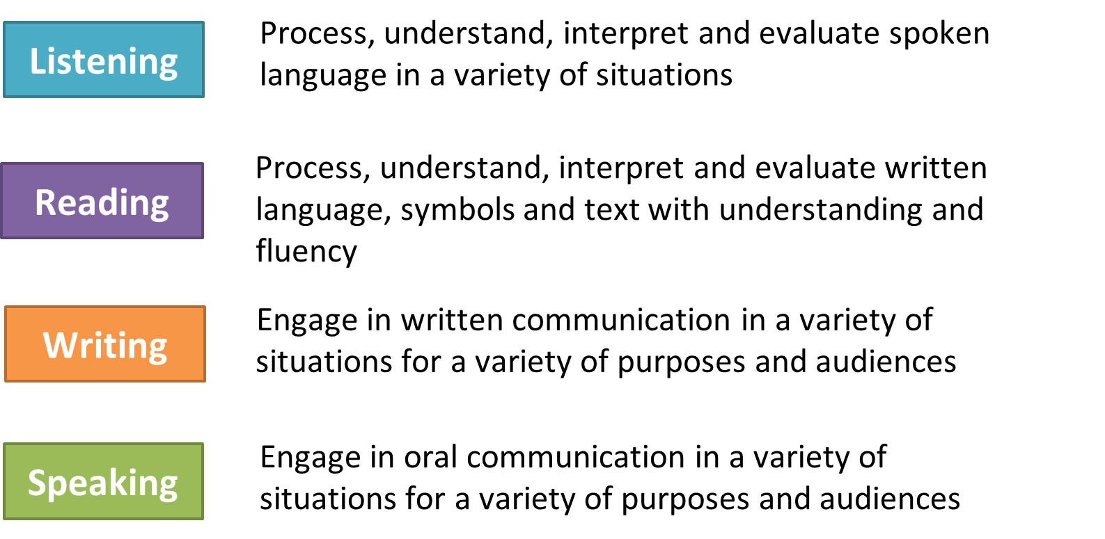
ACCESS for ELLs Language Domains
Assessing students' academic language abilities in English include:
Notes:
ACCESS for ELLs is aligned with the WIDA English Language Development Standards and to assess the four language domains of Listening, Speaking, Reading, and Writing. For both the paper and online tests, the Listening test and the Reading test consist of multiple-choice questions. The Writing test and the Speaking test involve open-ended tasks allowing students to show the language they can produce in English.
Listening and Reading are the domains for processing language. They measure students’ ability to comprehend English. Writing and Speaking are the domains for producing language. They measure students’ ability to communicate in English.

Slide 12
Connections to the Framework
ACCESS for ELLs
Guiding Principles of Language Development
Foundation for all products and services
Can Do Philosophy
Test is adaptive to allow students to show what they can do
Features of Academic Language
Foundational basis of the scoring scales
ELD Standards
Test items topics based on WIDA standards
Performance Definitions
Provides expectations for test items targeting different proficiency levels
Standards Matrix
Model Performance Indicators used to create test items
Can Do Descriptors
Key Uses
Test folders target specific Key Uses
Notes:
ACCESS for ELLs connects to all the components of the WIDA Standards and Assessment System. For example, The Guiding Principles of Language Development is a set of principles that describe the foundation for all of WIDA’s products and services. The Can Do Philosophy demonstrates that ACCESS for ELLs is a tiered and adaptive assessment that allows students to show what they can do with English. The Features of Academic Language are the foundational basis of the scoring scales. The ELD Standards are the basis of the test items. The Performance Definitions provide expectations for test items targeting different proficiency levels. The Standards Matrix with their Model Performance Indicators are the template for creating test items. The communicative purposes of language, as demonstrated in the Can Do Descriptors, Key Uses Edition, are included in the test item specifications for each test folder.

Slide 13
Academic Language Relationship with Content Standards and Language Development Standards
Content Standards
Content instruction through language
Language Development
Standards
Language instruction through content
Academic Language
13
13
Notes:
Academic language can be difficult to measure because it is both related to and distinct from content knowledge
Academic language is at the center of all of our WIDA assessments. This is represented by the overlap of our language development standards and the content standards. For our content standards, we have content instruction through language. For our language development standards, we have language instruction through content.
Our goal is to measure a student’s ability to speak and write within the content areas of the WIDA ELD Standards: math, science, social studies, and language arts. It is not to assess whether the content of the response is factually correct or incorrect. Therefore, a student can answer a question regarding content incorrectly, but the answer may be marked correct on the assessment, because the student understood the language of the question and used the appropriate language for a response. For example, if a student is asked, “what is 2 plus 2,” and the student answers, “2 plus 2 is five,” the answer would be marked correct. The reason for this is that the student demonstrated that they understood what was being asked and then produced the proper language to answer that question for the content area of math.

Slide 14
Preparation for ACCESS
Websites-WIDA Secure Portal and WIDA AMS, Training Courses, Quizzes, Roles and What's New

Slide 15
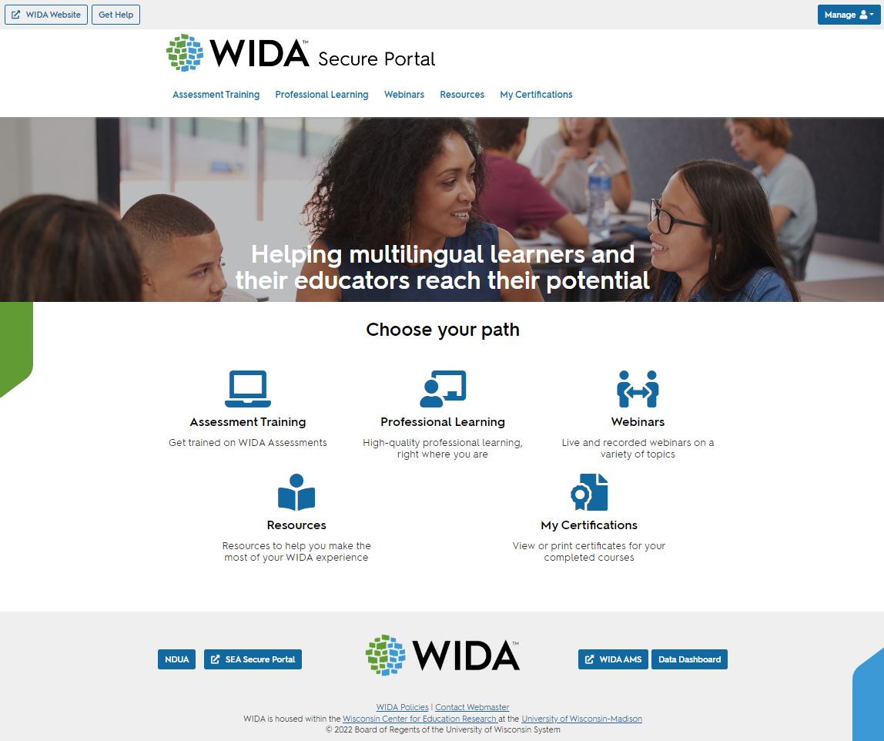
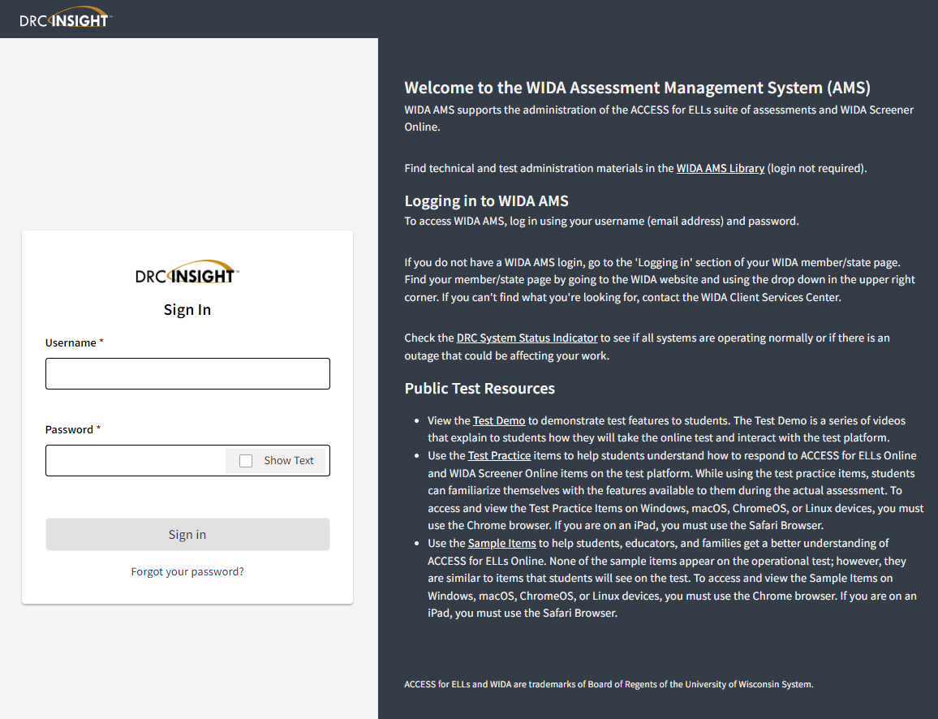
Websites for ACCESS for ELLs
WIDA Secure Portal
https://portal.wida.us/
WIDA AMS
https://www.wida-ams.us
15
Notes:
You will use these two websites while you prepare for and administer ACCESS for ELLs. Even though both websites have “WIDA” in their name, they each serve a different purpose.
The WIDA Secure portal is where you will locate the training courses for Test Administrators, take the quizzes, get the professional development, see resources like manuals, etc and to get to the recorded and live webinars.
WIDA AMS, short for WIDA Assessment Management System, is managed by DRC. This is where your technology coordinator will download the testing software and manage you school’s connection to the online test content. The paper testing materials are ordered here, as well as managing the online testing process with printing test tickets, managing roles and staff, setting student registrations and monitoring students during testing.

Slide 16
Preparation for ACCESS
Make sure all staff are trained to administer ACCESS for ELLs assessments on the WIDA website, which include:
  The necessary quizzes embedded within the training courses on the WIDA secure portal and passed with 80% accuracy.
  Administration Code Training and Inclusion of Special Populations Training.
  Reviewed ACCESS paper and online checklists on the Kentucky page of the WIDA website.
  Review all ACCESS trainings.
  Read all manuals.
  Creating testing schedules, check-in and check-out materials procedures and seating charts for students to test in-person. No remote-testing of ACCESS or WIDA Alternate ACCESS.

Slide 17
Test Administration Roles
Test Coordinator is the individual responsible for facilitating overall test administration from start to finish. This includes managing logistics and supporting others’ roles. Some places have District Test Coordinators (DACs), and others have School Test Coordinators (BACs) – and some have both.
Test Administrator gives the assessment and monitors the students while they complete it.
Technology Coordinator provides technology support prior to and during test administration (for ACCESS for ELLs Online only).
Notes:
WIDA defines the three main testing roles.
Each role’s training requirements are defined on the following slides.

Slide 18
Test Coordinator (District and School)
Annual Training Requirements:
View training tutorials for the tasks listed in state checklist
Complete the knowledge checks at the end of each training tutorial
Recommended to complete the trainings and quizzes for Test Administrators that are appropriate
Provide Administration Code and Inclusion of Special Populations training for all test administrators
Make sure all test administrators have completed the quizzes prior to the ACCESS for ELLs Testing window and have a record of the certifications on file in the district.
Make sure that all nondisclosure agreements are signed before the testing window begins.
Notes:
Step 1: Test Coordinators need to view training tutorials that are pertinent to the test coordination. The training tutorials are short presentations designed to teach you about a specific aspect of training. The state checklist should define these tasks.
Step 2: Complete the knowledge checks at the end of each training tutorial. These activities help Test Coordinators review key concepts and prepare for test coordination.
Step 3: Take appropriate quizzes
Kindergarten ACCESS for ELLs
Grades 1–12 Online Administration
Grades 1–12 Paper Administration
Grades 1–5 Paper Speaking (locally scored)
Grades 6–12 Paper Speaking (locally scored)
Alternate ACCESS for ELLs
WIDA recommends that coordinators do the training for Test Administrators to familiarize themselves with all aspects of the administrators responsibilities.

Slide 19
Test Administrator
Annual Training Requirements:
View training tutorials for the tasks listed in the state checklist.
Complete the knowledge checks at the end of each training tutorial.
Complete the appropriate quizzes.
Complete Administration Code and Inclusion of Special Populations Trainings.
Review all the trainings on the ACCESS for ELLs page of the KDE website and WIDA Trainings for Kindergarten and Alternate ACCESS (if administering these assessments) on the WIDA Secure Portal.
Notes:
Step 1: Test Administrators need to view training tutorials that are pertinent to the test administration. The training tutorials are short presentations designed to teach you about a specific aspect of training. Your state checklist should define these tasks.
Step 2: Complete the knowledge checks at the end of each training tutorial. These activities help Test Administrators review key concepts and prepare for the test administration quiz.
Step 3: Take appropriate Quizzes
Kindergarten ACCESS for ELLs
Grades 1–12 Online Administration
Grades 1–12 Paper Administration
Grades 1–5 Paper Speaking (locally scored)
Grades 6–12 Paper Speaking (locally scored)
Alternate ACCESS for ELLs
The next slides define the quizzes in more detail.

Slide 20
Technology Coordinator
Annual Training Requirements:
  Read DRC INSIGHT Technology User Guide.
  Complete Technology Readiness Checklist.
  Make sure all devices in the district are updated with software for Central Office Service (COS) for screeners and ACCESS.
  Review the WIDA Webinar Trainings for Technology Coordinators- schedule, login, and recorded trainings is accessible in WIDA AMS.
Notes:
For Online Testing, Technology Coordinators should read the DRC INSIGHT Technology User Guide, complete the Technology Readiness Checklist., make sure all devices used for testing are updated and review the WIDA trainings for Technology Coordinators. They should work with the Test Coordinator to ensure completion of all tasks.

Slide 21
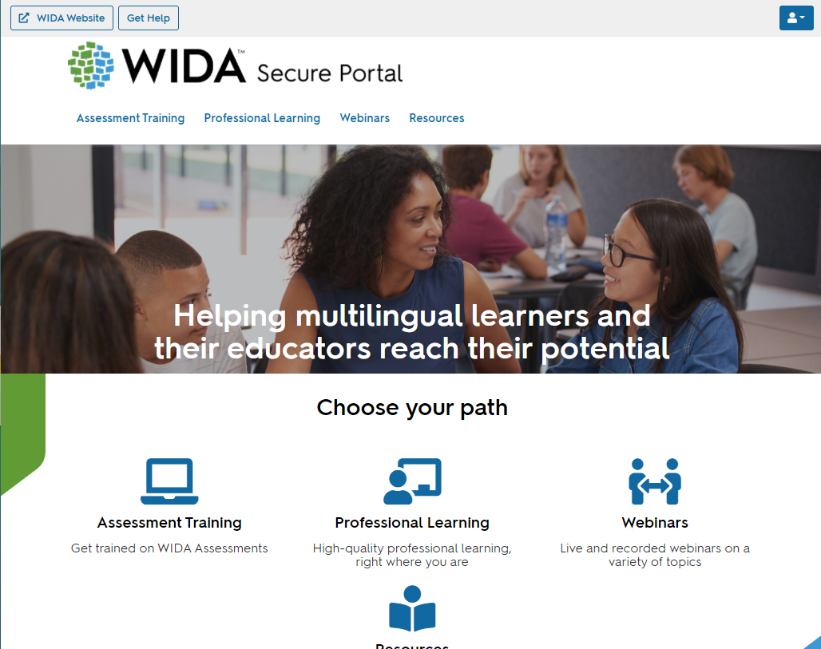
WIDA Secure Portal
Assessment Training
Professional Learning
Webinars
Resources
Users will continue to see courses, webinars, and resources based on permissions.
If a user has been given access to professional learning courses only, they will not see the assessment training category— nor any resources tagged solely to assessment training.
Users will be able to update their own personal information.
Test Administrators are provided a login to the WIDA Secure Portal (must be added to the google form that the District Assessment Coordinator (DAC) has) to:
Access the training course and quiz specific to the assessment(s)
Manage User Account
21

Slide 22
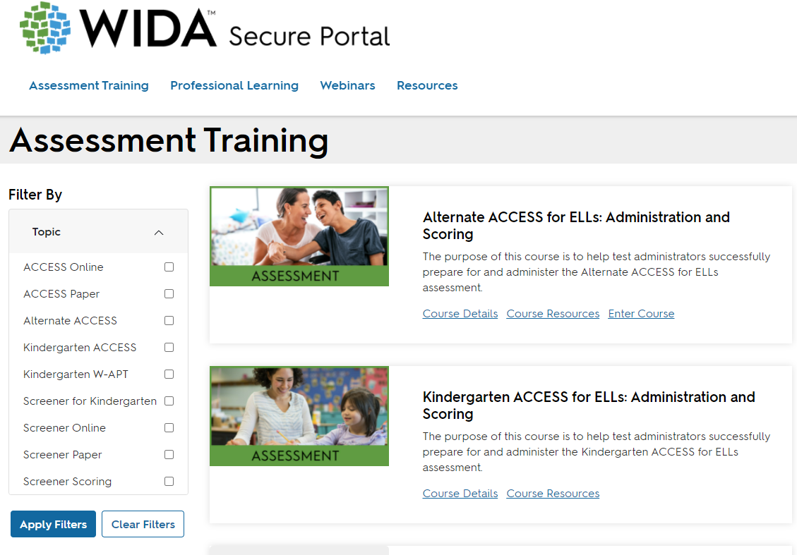
Assessment Training
22
Notes:
Alternate ACCESS for ELLs: Administration and Scoring is the first course listed under Assessment Training. Select “Course Details.”
Then click the button for “enroll now.” Then you will see a pop-up asking if your want to be enrolled in the course. Please select “Confirm.”
After you have enrolled, then you will see the option of Enter Course on this page.

Slide 23
Certification Quizzes for ACCESS for ELLs Online and Paper
If you are administering… | Then you must take…
ACCESS for ELLs Online | Online ACCESS for ELLs: Administration
ACCESS for ELLs Paper: Listening, Reading, and Writing | Paper ACCESS for ELLs: Administration
ACCESS for ELLs Paper: Speaking | Speaking for Grades 1-5: Scoring ACCESS Paper and WIDA Screener Speaking For Grades 6-12: Scoring ACCESS Paper and WIDA Screener Note: Only complete the grade level assessing
23
Notes:
Each assessment in the ACCESS for ELLs suite of assessments has a general administration quiz, which educators must pass with a score of 80% of higher in order to become certified to administer the assessment.
WIDA recommends taking the quiz immediately after completing the training. Once you have passed an administration quiz, your training certificates within the WIDA Secure Portal will be updated to reflect your status as a certified Test Administrator for that component of the assessment suite.
Because the Speaking section of ACCESS for ELLs is locally scored, there is also a Speaking training component & Speaking certification quizzes.

Slide 24
Certification Quizzes for ACCESS for ELLs Kindergarten and Alternate
If you are administering… | Then you must take…
Kindergarten ACCESS for ELLs | Kindergarten ACCESS for ELLs: Administration and Scoring
Alternate ACCESS for ELLs | Alternate ACCESS for ELLs: Administration and Scoring for Operational Test
24
Notes:
These trainings are under the assessment training when you log in to the WIDA Secure Portal.

Slide 25
Preparation for ACCESS in WIDA AMS
Make sure District Technology Coordinators (DTCs) have updated all required testing devices with the latest updates for ACCESS testing.
Make sure the DTC has completed the Technology Checklist.
Inventory all testing materials and file any discrepancies on the Accountability Form in WIDA Assessment Management System (AMS).
Reviewed all pre-populated online test sessions and added any new grades 1-12 students into test sessions. Do not add Kindergarten, Alternate ACCESS or Accommodated students to WIDA AMS, they take paper/pencil.

Slide 26
Initial Materials Order for ACCESS- DRC Calculations
Manuals: 1 for every district, 1 for every school
District/School labels: A minimum of 5 sheets to every site that receives a packing list
Test Administrator Scripts (Paper and Online): 1 for every 8 students
Student Test Booklets (Paper): 1 for every student
Speaking Test Booklets (Paper): 1 for every 8 students
Listening and Speaking CDs (Paper): 1 for every 8 students
Kindergarten Kit (Kindergarten): 1 for every 15 students
Large print and Braille kits: 1 for every student identified
Test Administrator Scripts (Alternate): 1 for every 4 students
Student Response Booklet (Alternate): 1 for every student
Student Test Booklets (Alternate): 1 for every 4 students
Districts receive a 15% overage of paper materials needed for test administration which is split between the district and the schools. If a district places an initial order for 10 or fewer tests, no overage is shipped.
26

Slide 27
Additional Materials Ordering
DACs are responsible for placing additional order(s). Please email Chris Williams for additional ordering permission.
Districts should use the “District Level Additional Orders Only Site” in WIDA AMS to order additional materials.
Most materials are available for districts to order.
Orders containing only DRC return labels or UPS return shipping labels are sent electronically to the district.
WIDA offers the following materials on the WIDA Secure Portal for districts to download and not ordered as additional materials:
  Test Administration Manual
  District and School Test Coordinator Manual
  Grade 4-12 Online Test Administrator Scripts
  Nondisclosure and User Agreement
27

Slide 28
New For ACCESS
Training Courses and quizzes are updated on the WIDA Secure Portal.
New updates to test security in the manuals with devices that can't be used during testing within the Test Administration (TA) scripts.

Slide 29
New For WIDA AMS
View all student demographic details in one tab, and quickly move to the next to add or remove accommodations in the new student management application.
Review, edit and create new registrations (the new name for “test sessions”) on a refreshed test management interface.
Easily navigate in and between applications with clearly identifiable buttons, and quickly locate options to print test tickets and run tier placement reports.
The new import management application allows district and school staff to upload a file with the students’ information and add those students to automatically generated registrations at the same time. The new application also identifies any errors in the import file for correction.
29

Slide 30
No Changes to Tasks in WIDA AMS
Creating user accounts
Ordering materials
Scoring WIDA Screener responses
Conducting data validation
30

Slide 31
ACCESS for ELLs® Exit Criteria
Overall Composite of a 4.5 on a Tier B/C.
Notes:
EL students must meet both criteria to exit from EL program.

Slide 32
ACCESS for ELLs Paper
Paper, Kindergarten and Alternate

Slide 33
Administering Any Paper Test
Page 17
Before
Check student’s booklet for his/her name
During
Follow the TA Script exactly
Circulate & Monitor
After
Collect & Store Materials
33
Notes:
Here are some general responsibilities you have before, during, and after test administration.
Before administering the test, make sure the student has the appropriate materials and that the student’s test booklet has his/her name.
During the test administration, follow the Test Administration Script exactly. Item prompts and answer choices may not be read aloud, unless scripted or part of the audio CD. Circulate through the testing room and monitor student work: Bubble responses completely, erase changes thoroughly & make no other marks in test booklet other than in specified places.
After each test session, follow all district security guidelines for collecting and storing test materials.

Slide 34
ACCESS for ELLs Paper: Student Experience
Graphic-supported items
Audio-supported directions for Listening and Speaking domains
Narrated and guided introduction by a human voice for each domain test
Thematic folders pertaining to a unified theme
Practice items
Modeled responses for the productive domains
Notes:
The ACCESS for ELLs Paper test is designed to maximize student engagement and accessibility. Key features include graphic-supported items, audio-supported directions, narrated and guided introduction by a human voice for each domain test, thematic folders pertaining to a unified theme, practice items, and modeled responses for the productive domains.

Slide 35
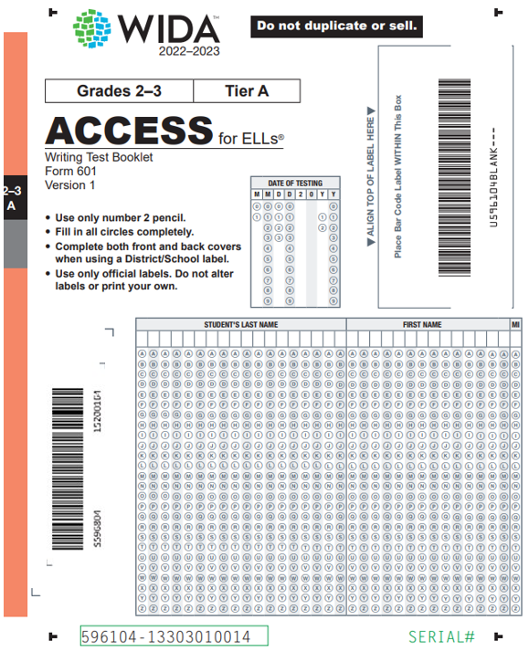
Labeling Test Booklets
Pre-ID label- apply label to box marked A and bubble the date of testing and begin testing
District School Label- is used because of No Pre-ID label, apply District/School label (yellow) to the box marked A and complete all demographic information
Do Not Process- book will not be scored and will be put in warehouse. Label goes on box marked A
35
Notes:
All labels go in the top right-hand corner in Box A
This is an animated slide. Click to show the Pre-ID Label.
A Pre ID-Label goes on, and bubble in the testing date for all students with that label.
Click to show the District School Label.
District/School Label is used when you have no Pre ID-Label for the student. It also goes in top right-hand corner and you will complete all demographic information
Click to show the Do Not Process Label.
Books with Do Not Process Labels will not be scored and will be put in warehouse.

Slide 36
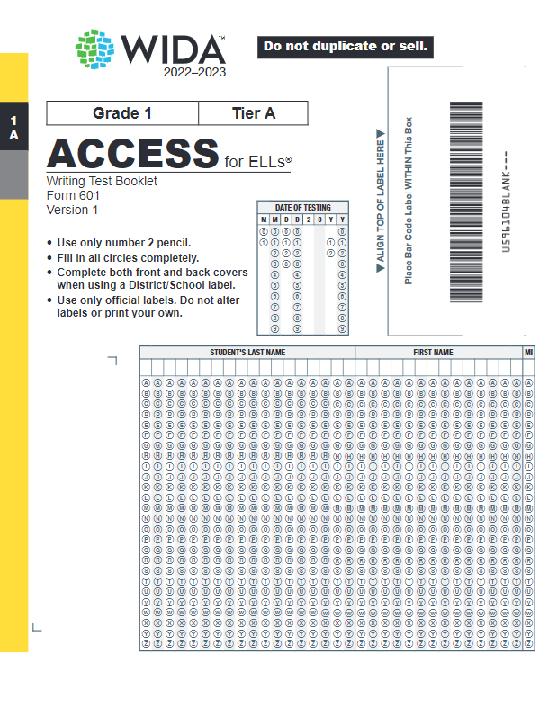
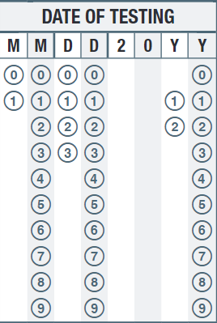
Date of Testing Field
Complete the Date of Testing Field on all test booklets
Record the date on which the student completes testing
0 | 2 | 1 | 5 | 2 | 0 | 2 | 4
36
Notes:
Complete the Date of Testing field on all test booklets, regardless of whether a Pre-ID or District/School label is used. If the student tests over multiple days, record the date on which the student completes testing. If the student has transferred out of your school or district since testing, record the last day of the school’s testing window.

Slide 37
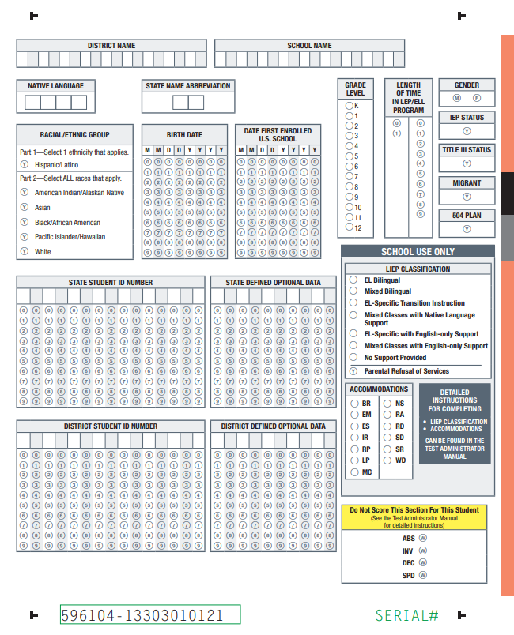
Bubbling In Student Information
No Pre ID-Label
Front and back covers
#2 pencil
Affix a School/District Information Label (yellow)
Accommodations must be documented manually without the Pre-ID label
37
Notes:
If there is no Pre-ID label and you need to complete demographic information manually on the front and back cover of the test booklet, you can find explicit directions in the Test Administration Manual. Please make sure to use a #2 pencil when completing the required fields. You also need to affix a School/District Information label in the right upper hand corner.
Remember that you must document accommodations on the test booklet if there is no Pre-ID label. Also, it is the responsibility of the testing district/school to supply the correct District Code number and School Code number to the persons who will be responsible for verifying this information on the Pre-ID Label or recording this information in the demographic section of each test booklet.

Slide 38
Paper Scheduling Support
Administer each language domain test in a single test administration session
Keep testing groups to about 15 students or fewer
Smaller groups or individually for newcomers
Keeping the same group together for all domains
Each test administration is specific to a single Grade-Level Cluster, Tier, and Domain
The Speaking test is always delivered individually
You can schedule more than one domain test on one day
Never administer different domain tests to a single testing group
38
Notes:
You will need to schedule test sessions for each tier within each grade-level cluster. Only schedule one grade-level cluster, one tier, and one domain of the test at a time. When scheduling your test sessions, you should complete and retain the Test Session Master Schedule. It allows you to view all group administered test sessions for all grade-level clusters and tiers.
WIDA recommends having no more than 15 students per administered test session, based on the testing room. There should be enough space for all students to work independently and without major distraction.
Although it is not required, students with very limited English proficiency may benefit from having you test them in smaller groups. For example, you may test Tier A fourth graders separately from Tier A fifth graders, and Tier A sixth graders separately from Tier A seventh and eighth graders. However, if this is not possible, you may test all Tier A students within a grade-level cluster together.
Whenever possible, test the same students together across both test sessions, Session 1: Listening/Reading and Session 2: Writing. That is, do not change the roster of students from one session to another, as this will require reorganizing stacks of test booklets.

Slide 39
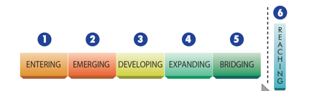


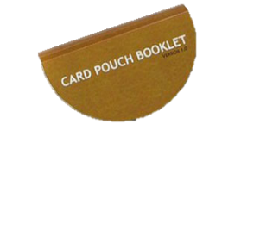
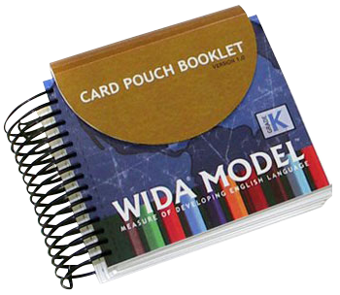





Kindergarten ACCESS for ELLs
Individually Administered-all four domains
Completely Adaptive
Test materials—cards and card pouch booklet, story book, student activity board, TA script, and student response booklet
All components are scored by the Test Administrator (TA) during test administration
Kindergarten - Adaptive
Notes:
Kindergarten ACCESS for ELLs is designed to be interactive, child-friendly, and age-appropriate. This test has three unique features. One of these is the manipulatives. Much of Kindergarten learning is hands-on. The test incorporates picture cards and an activity board with various matching, identifying, and describing activities. Additionally, the tests are interactive and task-based, with a variety of activities for the student to demonstrate his or her language proficiency. In this way, the test is similar to a kindergartener’s classroom experience.
Another feature is that the test is organized in themes. Students in Kindergarten do not respond well to cognitive leaps and disconnect between questions. Each test form allows students to experience both a narrative text and an informational/expository test centered around two central themes.
Also, following the kindergarten classroom experiences the test includes interactive writing. A “Writing Experience,” associated with the narrative story, allows whatever the students are able to produce in writing to be scored with a rubric as a Level 0–6, depending on the performance of the students. In the second folder, students begin the writing tasks based on their previous performance.

Slide 40
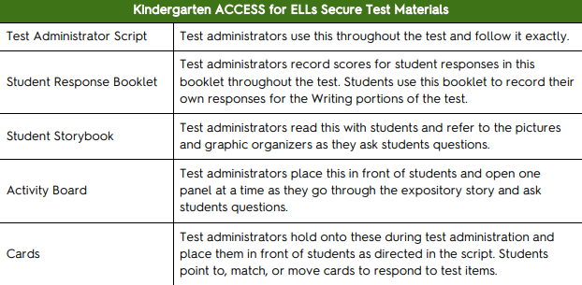
Secure Test Materials for Kindergarten
40

Slide 41
ACCESS for ELLs Kindergarten
Page 3
Administration Format | Administration Time* | Recommended Scheduled Testing Time
Individual | 45 minutes | 60 minutes
Due to the adaptive nature of the test, high proficiency students will likely take longer and beginning proficiency students might need significantly less time.
* Time needed to answer test questions
41
Notes:
Administering Kindergarten ACCESS for ELLs usually takes about 45 minutes. However, due to the adaptive nature of the test, high proficiency students will likely take longer and beginning proficiency students might need significantly less time. Breaks during the test administration session are appropriate for kindergarten students, and these pauses can increase the time you’ll need for testing. Adding breaks should extend the testing time to no more than 60 minutes.
If test administrators must divide a test administration into two sessions, they can use the planned break after Part C as the stopping and starting point. There can be no more than two consecutive school days between testing sessions.

Slide 42
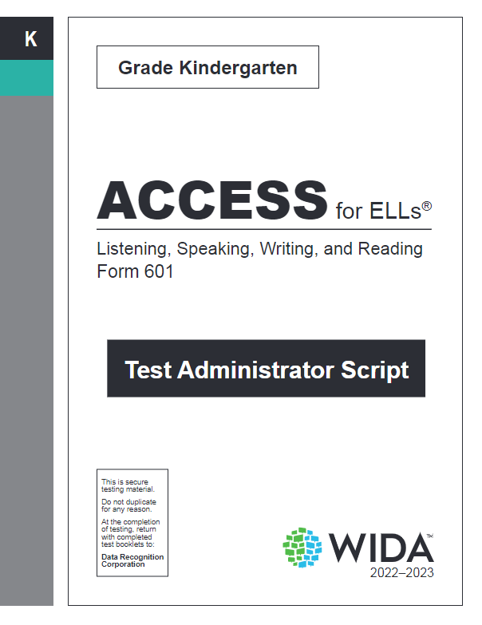
Preparing for Test Administration
Familiarize yourself with the Test Administrator Script and materials
Please note that TAs can look over the manuals and scripts in advance of the testing day but not the testing materials.
Administer test in a quiet room
#2 sharpened pencils
42
Notes:
Prior to testing, you should become familiar with the Test Administrator’s Script for each portion of the Kindergarten test.
As you know, Kindergarten children may or may not be comfortable with an unfamiliar adult. It is important to build rapport with the child if the child does not know you. You want to make sure the child is comfortable to engage in conversation with you. Therefore, having a quiet room all set up and ready to go minimizes your distractions from making the child feel comfortable.

Slide 43
Exit Criteria for Kindergarten ACCESS for ELLs
Overall Composite Proficiency Level 4.5 is the exit criteria for Kindergarten ACCESS for ELLs.
43

Slide 44
Alternate ACCESS for ELLs
A paper-pencil test for grades 1-12, all four domains (Listening, Speaking, Reading and Writing) test in the grade level clusters of 1-2, 3-5, 6-8, 9-12. Reading and Listening are multiple choice. Writing and Speaking are constructed response items.
Kindergarten students with significant cognitive disabilities will take the ACCESS for ELLs testing with accommodations.
Individualized Education Program (IEP) team (with EL specialist) determines whether the student takes Alternate ACCESS or ACCESS with accommodations.
To participate in Alternate ACCESS
    Classified as an English Learner (EL)
    Has a significant cognitive disability
    Participates or is expected to participate in the Alternate Kentucky Summative Assessment (AKSA)
    Disability precludes taking the ACCESS for ELLs® with accommodations
44
Notes:
Districts must give either the ACCESS for ELLs® or the Alternate ACCESS for ELLs® to EL students each year.
There is a Kindergarten Alternate ACCESS for ELLs®. The student cannot be exempt anymore because there is a Kindergarten Alternate available but can be if there is an approved Medical non-participation filed in Student Data Review and Rosters (SDRR) Application.
Alternate ACCESS has four language domains: listening, reading, speaking, and writing. The Reading and listening domains are multiple choice while the writing and speaking are constructed response items.
It is strongly recommended that districts carefully considered who will administer the Alternate ACCESS. Test administrators need to be familiar with the student’s communication style and the accommodations that the student receives for instruction on a day to day basis. This may mean that the test administrator is a special education teacher or perhaps a speech and language pathologist.

Slide 45
2023-2024 WIDA Alternate ACCESS Tentative Testing Schedule
 | Start Date | End Date
Online Test Setup for Registrations | 11/30/2023 | 2/16/2024
Districts Receive Test Material | 12/5/2023 | 12/5/2023
Additional Test Material Window | 12/5/2023 | 2/9/2024
Test Window | 1/4/2024 | 2/16/2023
All Test Material Received at DRC | 3/1/2024 | 3/1/2024
Pre-Reporting Data Validation Window | 3/20/2024 | 4/3/2024
Districts Receive Reports | 9/11/2024 (online)-WIDA Alternate ACCESS | 9/26/2024 (printed)-WIDA Alternate ACCESS
Notes:
The Alternate ACCESS testing window is scheduled to begin on Jan. 4 and will end on Feb. 16 this year. KDE will be monitoring the health crisis and will let the DACs know if there are any
change to the schedule in a Monday DAC email. The WIDA Alternate ACCESS Reports will be delayed due to WIDA standard setting that is happening this summer.
12/1/22-2/17/23 WIDA AMS test setup available for test sessions
Data Recognition Corporation (DRC) prints, scores, houses the online system and ships the test materials and reports to the districts.
DRC opens a data validation window for districts to have one last look at the demographic data before the reports are printed and sent to the districts.
Kindergarten, Alternate ACCESS and Accommodated (Braille and Large print) are paper/pencil assessments.

Slide 46
Alternate Proficiency Levels
P3
Developing
(Writing only)
P2
Emerging
A1
Initiating
A2
Exploring
A3
Engaging
P1
Entering
INTERPRETIVE &
PRODUCTIVE
46
Notes:
There is also an Alternate form of the ACCESS for ELLs test so that ELLs in grades 1-12 with the most significant cognitive disabilities can show what they can do and understand. Alternate ACCESS for ELLs aligns with the WIDA Alternate English Language Proficiency levels. These levels were designed to expand upon Level P1 - Entering, by increasing the sensitivity of the measure for students who have the most significant cognitive disabilities. The alternate ELP levels give students a chance to demonstrate progress within Level P1. Information about participation criteria and test administration of the Alternate ACCESS test can be found on the WIDA website under the Assessment tab.
The test is intended to measure proficiency levels at the lower end of the WIDA proficiency level continuum. This assessment provides ELLs with the most significant cognitive disabilities an opportunity to demonstrate their English language proficiency. A1 Level, Initiating: Establishing the student’s communication system is “in process.” The student will have inconsistent responses and may use eye gaze, or varied body movements to communicate. A2 Level, Exploring: The communication system is established with pictures, objects, AAC, etc. The student delivers consistent responses with supports and recognizes spoken words associated with familiar people, daily routines, and the environment. A3 Level, Engaging: The student is connecting to basic language skills like familiar expressions or statements and uses symbols, letters, and/or numbers for communicating. P1 Level, Entering: The student uses general content related words, everyday social and instructional words, and chunks of language. P2 Level, Emerging: The student uses general content words and expressions across content areas, as well as social and instructional words and expressions. Grammatical structures are formulaic and sentence patterns and expressions are repetitive. P3 Level, Developing: this level is only obtainable in Writing Domain.
IMPORTANT COMMENT: Please note that although the P1 and P2 levels look like replicas of ACCESS proficiency levels, there is not a correspondence because the two tests are scaled differently. That means that a student who scores a P1 on the Alternate is not necessarily at the entering level on the ACCESS.

Slide 47
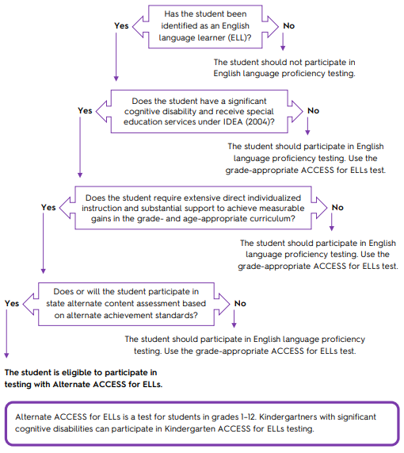
Participation Decision Tree
Page 2
47
Notes:
State and federal laws require that all ELLs participate in annual English language proficiency assessments. The WIDA Accessibility/Accommodations Framework provides support for all ELLs, as well as targeted accommodations for students with Individual Education Plans (known as IEPs) or 504 plans. These supports will help all ELLs to better access the test. Some ELLs with significant cognitive disabilities will still be unable to take ACCESS for ELLs, even with supports and accommodations. These students may be eligible to participate in Alternate ACCESS for ELLs, but only if they meet specific participation criteria. WIDA’s guidance for participation on Alternate ACCESS for ELLs is found in Appendix A of the Manual. Check with your state education agency for your state’s specific participation criteria for alternate assessment.
As the Alternate ACCESS for ELLs Participation Criteria Decision Tree illustrates, there are several criteria that a student must meet to be eligible to participate in the Alternate ACCESS for ELLs assessment. Again, it is recommended that the IEP Team makes this determination. Even if all of the criteria are met, it still may be more appropriate for an English language learner with significant cognitive disabilities to take the standard ACCESS for ELLs assessment based on their language proficiency.

Slide 48
WIDA Alternate ACCESS-Operational
When school and districts test English learners with the most significant cognitive disabilities during the 2023–24 school year, the operational test will:
Incorporate the WIDA ELD Standards Framework, 2020 Edition
Cover kindergarten, which is part of the new K–2 grade-level cluster
Include brand-new test content and a new test item type
Contain an Individual Characteristics Questionnaire (ICQ), which prompts test administrators to answer questions about students (ICQ information will be reported on the individual student score report to help educators make reclassification decisions about students taking Alternate ACCESS)
Have a new look: Candoo, the Alternate ACCESS dog, adorns test materials and we carry over the field test color scheme
Have a redesigned training course, which has new content and a new look and feel
Have scores delayed after WIDA standard setting in late fall of 2024 and not in late April
48

Slide 49
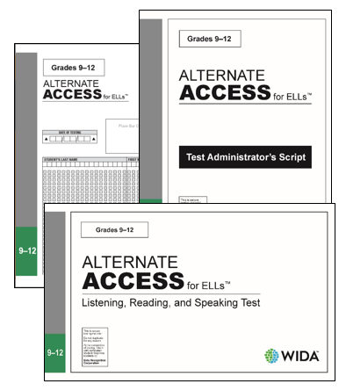
Alternate ACCESS for ELLs Administration
Paper and pencil test
Individually administered
  4 sections (Domains)
  8 - 10 Tasks in each domain
  20 minutes each (Approximately)
Test format
  Selected response: listening and reading
  Constructed response: speaking and writing
All sections are hand-scored by test administrator
49
Notes:
The Alternate ACCESS for ELLS is an individually administered, paper and pencil assessment. It contains both selected response items ( or multiple-choice items) and constructive response ( or open-ended) items. All sections of the test are scored locally by the test administrator at the time of testing. Test booklets are then returned to DRC for data collection and development of the individual score reports.
There are unique features of this test: simplified language, repetition of questions, increased graphic support and larger testing materials and graphics.
Complete the first two pages in the Student Response Booklet. This information is reported on the second page of the individual student score report. If more than one disability is bubbled in either the Primary or Secondary disability column, the individual student score report will indicate “multiple disabilities.”

Slide 50
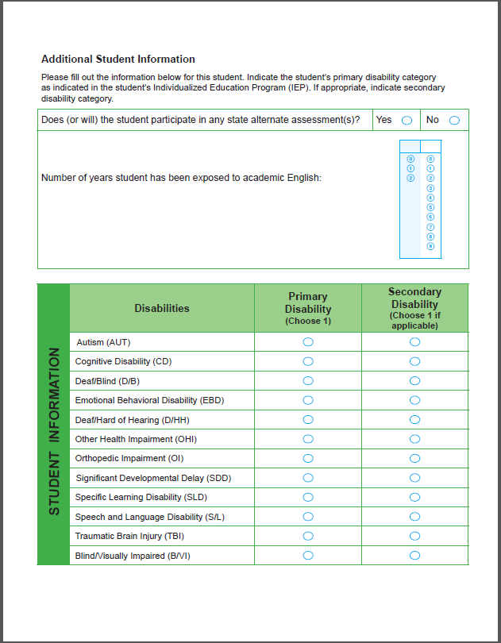
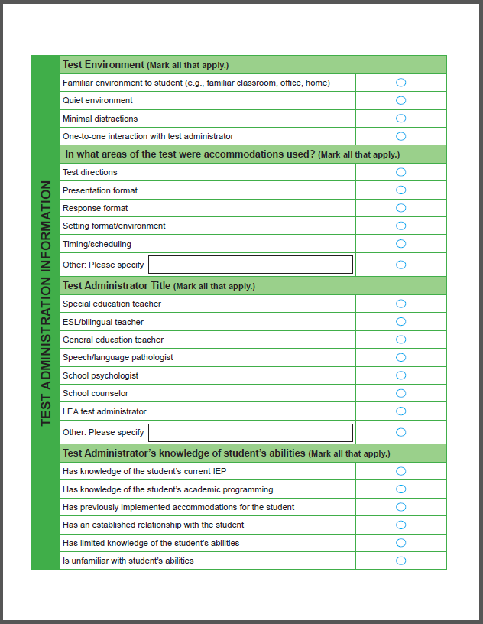
Complete First Two Pages in Student Response Booklet
Additional Student Information
  Disability
Test Administration Information
50
Notes:
Complete the first two pages in the Student Response Booklet. This information is reported on the second page of the individual student score report. If more than one disability is bubbled in either the Primary or Secondary disability column, the individual student score report will indicate “multiple disabilities.”

Slide 51
Test Administrators
Licensed/certified teacher and staff familiar with:
Student
Typical response and communication style used by the student during daily instruction
Application of all accommodations allowed in the WIDA Accommodations and Supplement Manual for WIDA Alternate ACCESS
51
Notes:
It is strongly recommended that districts carefully considered who will administer the Alternate ACCESS. Test administrators need to be familiar with the student’s communication style and the accommodations that the student receives for instruction on a day to day basis. This may mean that the test administrator is a special education teacher or perhaps a speech and language pathologist.
Following the recommendations provided by WIDA, it is important to help the student have their best opportunity to show what they know and can do in English.

Slide 52
Unique Features of this Test
Simplified Language
Repetition of Questions
Increased Graphic Support
Larger Testing Materials and Graphics
52
Notes:
This assessment is designed specifically for students with the most significant cognitive disabilities. Alternate ACCESS for ELLs includes simplified language, multiple opportunities to hear questions and respond for each item, increased graphic support, larger testing materials. Additionally, in the writing domain tasks are modeled for students. Although there are larger testing materials and graphics than for ACCESS for ELLs. It may be determined that additional changes are needed to the assessment. For example, if the student responds with eye gaze, it may be appropriate to cut apart answer pages to allow space between items. Again, these materials would be returned to DRC. Additionally, make sure that the booklet scan codes are kept in tact and returned. One way to hand this would be by putting all the pieces into a manila envelope. Further guidance can be found in the Accessibility and Accommodations Manual.

Slide 53
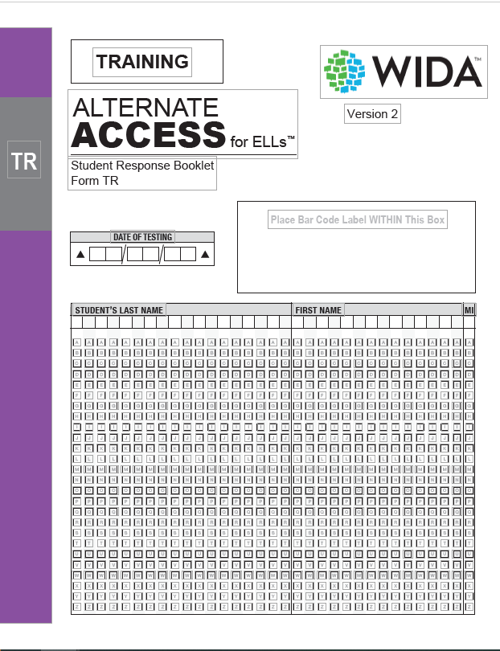
Test Administration Paths: Possible Repetitions Before “Moving On”
Listening: Cues
A, A, B, C
Reading: Cues
A, A, B, C
Speaking: Questions
1, 1, 2, 2, 3, 3
Writing: Progress through each task until meet “Moving On” criteria
53
Notes:
Image of Training Materials
This is an overview of the repetition that you may encounter in each of the language domains of this assessment. The Tasks in the Listening and Reading sections are separated as cues. Within each task, cue A can be repeated, then cue B and cue C are given depending on the criteria for moving on. The Tasks in Speaking are separated as questions. Within each task, each question can be repeated once. The Tasks in Writing prompt the Test Administrator to work through each task until the student being assessed meets the moving on criteria.

Slide 54
Test Components and Sequence
Language Domain | Number of Tasks | Time | Range of Proficiency Levels | Standards Assessed
Listening | 9 | 20 minutes | A1-P2 | Social & Instructional Mathematics Science Language Arts
Reading | 9 | 20 minutes | A1-P2 | Social & Instructional Mathematics Science Language Arts
Speaking | 8 | 20 minutes | A1-P2 | Mathematics Science
Writing | 10 | 20 minutes | A1-P3 | Social & Instructional Science Language Arts
Notes:
The components and sequence of the assessment, is given in the order of listening, followed by reading, speaking and writing. There are nine to ten questions or task in each domain and we give an approximate time of 20 minutes per domain. Depending on the student and the student’s processing time, it may take more or less time. It also depends on how many times a student goes though the item. This is an adaptive test with a ceiling, so after students take a certain number, they could stop testing, or they may be continuing on.
*******
The order of the test is listening, reading, speaking, and writing. The administration of one domain section should not begin before finishing the administration of the previous one.
Times provided are for scheduling purposes. Breaks are allowable.
The recommended schedule is each domain be administered in separate sessions. Please plan the individual administration times according to the needs of each individual student. Try to complete each test section in one session.
SIL = Social and Instructional Language
LoMA = Language of Mathematics
LoSC = Language of Science
LoLA = Language of Language Arts
Alternate ACCESS for ELLs does not assess the language of social studies.

Slide 55
Accommodations and Forms
ACCESS for ELLs (Online and Paper), WIDA Alternate ACCESS, Kindergarten
Accommodated Forms-Large Print and Braille

Slide 56
Exit Criteria for Alternate ACCESS for ELLs
Overall Composite Proficiency Level (PL) 2 is the exit criteria for Alternate ACCESS for ELLs.

Slide 57
ACCESS (Online and Paper), Kindergarten, Alternate ACCESS Accommodations
Only applies to ELs with Disabilities.
Must have an Individualized Education Plan (IEP) or 504 Plan.
The accommodation must be stated in the IEP or 504 Plan and marked yes or no, and in what domain on the ACCESS roster. In WIDA AMS if testing online and on the test booklet if testing paper/pencil.
Test Booklets are available in large print and Braille.
Hearing impaired students only take the reading and writing parts of the ACCESS for ELLs online or paper if needed.
List of appropriate accommodations is located on the WIDA website.
  Accessibility and Accommodations
  Accessibility and Accommodations Manual
Notes:
Remember that this means accommodations based on a disability, not based on the child’s EL status.
Districts will need to annotate on ACCESS rosters in the spring that the students who are hearing impaired.
Need to mark yes or no and in what domain for accommodations on the ACCESS roster.

Slide 58
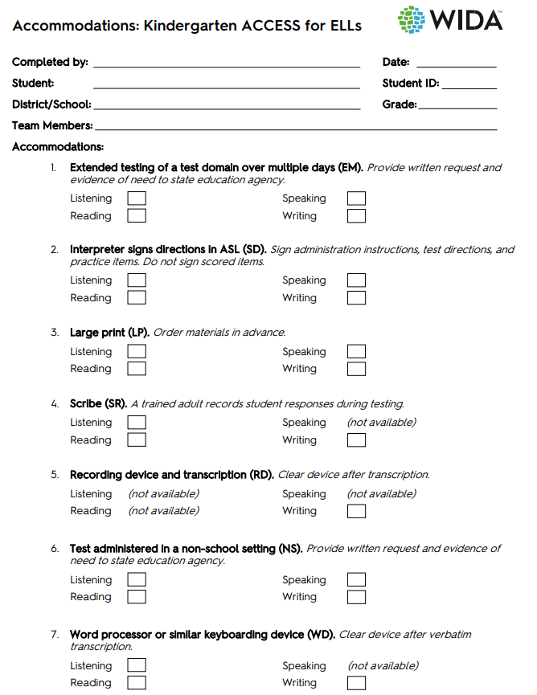
Accommodations Form-Kindergarten ACCESS for ELLs
Please see p.31 of the 2022-2023 Accessibility and Accommodations Manual for a copy with IEP and 504 Plan only students.
58

Slide 59
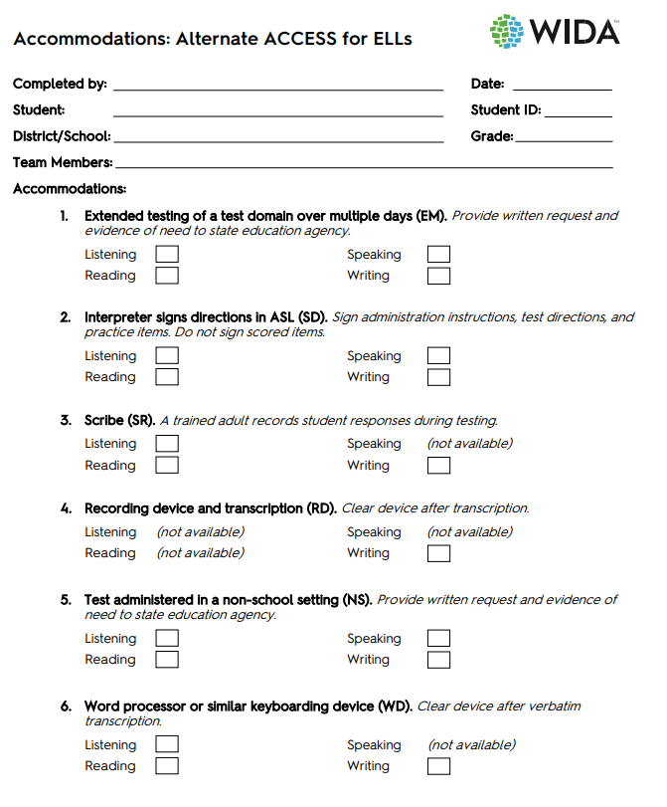
Accommodations Form- WIDA Alternate ACCESS
Please see p.36 of the 2023-2024 Accessibility and Accommodations Manual for a copy with IEP and 504 Plan only students.
59

Slide 60
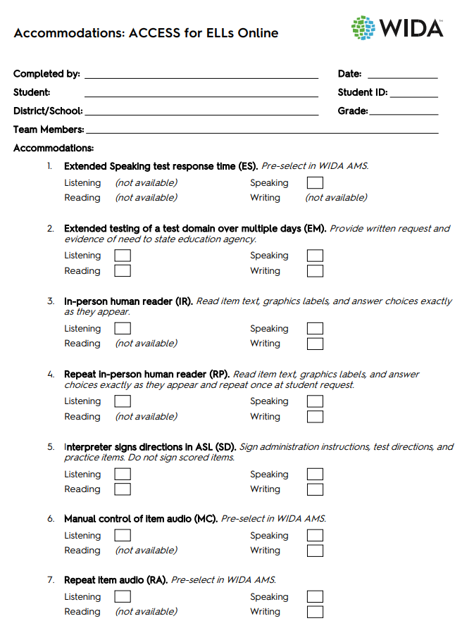
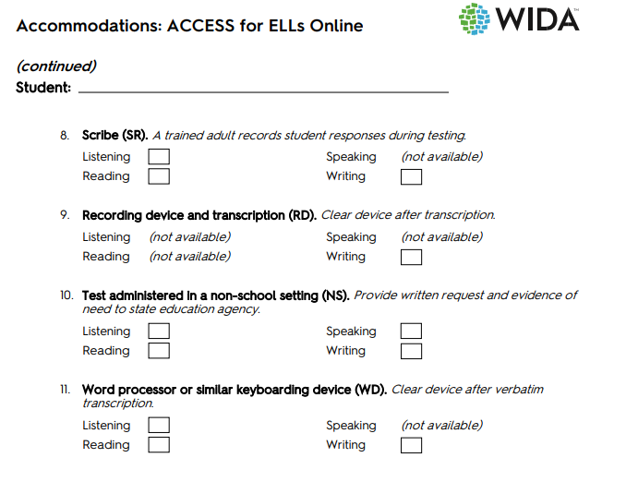
Accommodations Form-ACCESS for ELLs Online
Please see pp. 34-35 of the 2023-2024 Accessibility and Accommodations Manual for a copy with IEP and 504 Plan only students.
60

Slide 61
Testing with Accommodations
If an EL student with IEP or 504 Plan cannot take domain(s) of an ACCESS for ELLs suite of assessments
Online
Student will take reading and writing online
OAA will force submit the listening and speaking domains online to get an overall score if the student has attempted the test first
Paper
Test administrator will mark the domains that the student could not take on the back of the test form
Notes:
Before OAA can force submit the domain for the student, the domains of listening and speaking must be attempted first.

Slide 62
Transcribing Student Responses
Student responses must be transcribed verbatim on screen or in a test booklets by the test administrator
Two people-Transcriber and the BAC- must be present during this process. One will be the transcriber and the other will be the observer confirming the accuracy of transcription
Individuals who provide transcription must:
  Be trained
  Sign WIDA’s non-disclosure agreement
  Be proficient in written English
  Be able to decode the student’s writing
Braille transcribers must be proficient in braille code used by the student for writing

Slide 63
Examples of Accommodations-Invalidate Test Validity
Reading aloud items on the Reading domain test
Providing oral or written translations of items into a language other than English
Signing items, passages or response options
Allowing use of a bilingual word-to-word dictionary
These are useful for classroom instruction but never allowed during ACCESS for ELLs (ACCESS, Alternate ACCESS, Kindergarten, etc. or WIDA Screener (Online and Kindergarten)

Slide 64
WIDA Accessibility and Accommodations Framework
64
Notes:
Here is the new graphic for the WIDA Accessibility and Accommodations Framework.
As you can see from the graphic, the Framework provides support for all ELLs, as well as more targeted accommodations for students' individual education plan, IEP. These supports will help all ELLs to better access the test.
Now let’s go the key elements of the supports shown in the Accessibility and Accommodations Framework step by step.

Slide 65
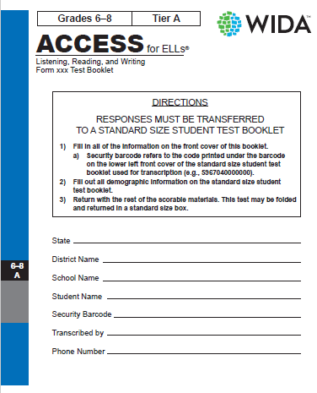
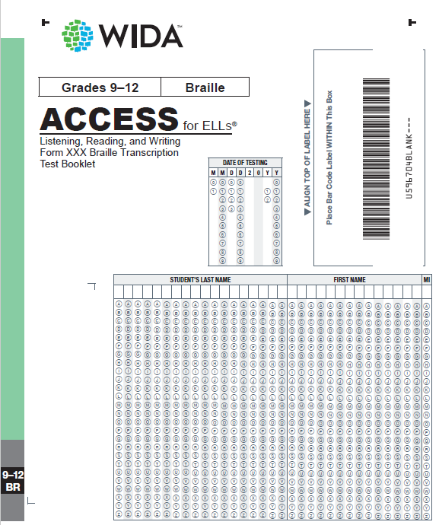
Accommodated Forms
Large Print
Braille
65
Notes:
WIDA offers two accommodated forms of ACCESS for ELLs Paper: Large Print and Braille.
The Brailled format will include Listening, in addition to Writing and Reading.

Slide 66
ACCESS for ELLs Online
Administration and WIDA AMS

Slide 67
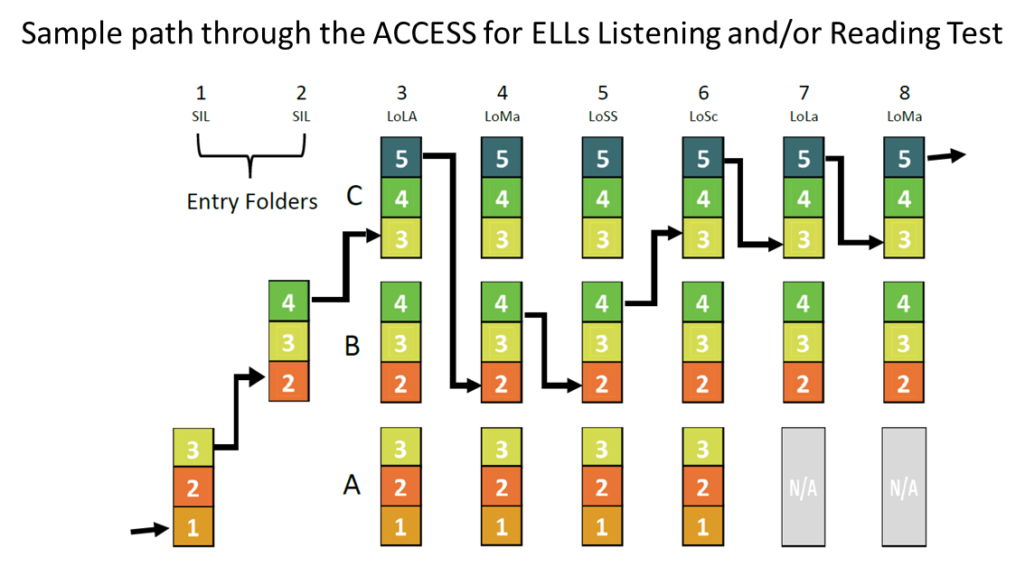
Adaptive Testing Online
67
Notes:
Here’s a visual to help you understand how the adaptivity in the online test works.
The Listening and Reading tests adjust to the students’ performance in order to provide items that are appropriately challenging. In other words, the INSIGHT test engine determines the next set of questions the student will see, based on performance on previous folders.
All students complete two entry folders that assess Social and Instructional language. The first folder is at Tier A and has test items addressing Proficiency Levels 1, 2, and 3. The second entry folder is at Tier B, with tasks at Proficiency Levels 2, 3, and 4.
As students respond after the second folder, the INSIGHT test engine scores the responses and determines which tier level folder the student will receive next. Students who progress through only Tier A folders are assessed in folders for the Language Of Language Arts, Language of Mathematics, Language of Science, and the Language of Social Studies. Students progressing through Tier B/C Folders have an additional folder for the Language of Language Arts and the Language of Mathematics.
As the student progresses through the test, the test platform captures and scores student responses for Listening and Reading, which then determine the student’s tier placement for Speaking and Writing Because the computer takes care of this, there is no need for the Test Coordinator or the Test Administrator to assign the appropriate tier for the online test.

Slide 68

ACCESS for ELLs Online Administration
Grade Clusters
Adaptive Listening and Reading test performance determines placement in Speaking and Writing
All test items scored centrally at DRC
Notes:
ACCESS for ELLs Online is administered by grade-level or grade-level clusters. Grade 1 is a separate test cluster. It provides a developmentally appropriate testing experience for students. Other grades are clustered as follows: Grades 2 and 3, Grades 4 and 5, Grades 6 through 8, and Grades 9 through 12. The test platform captures and scores student responses for the Listening and Reading domains.
The Speaking and Writing tests are scored centrally at DRC by trained raters. Training is task-specific, in order to ensure that raters understand the nuances of each unique Writing or Speaking task. Raters are instructed to not score for accent and regionalisms but to consider the fluency and clarity of speech of students’ responses in regard to the Speaking task. They also do not score for mechanics, punctuation, and spelling in Writing.
The keyboarded responses are sent automatically to DRC to be scored, and handwritten responses need to be mailed to DRC. For the Speaking test, students speak into a headset to record their answers.

Slide 69
Benefits of the Online Test
Increased student engagement through a more dynamic testing experience
Built-in accommodations and accessibility features appropriate for a range of student needs
Staged adaptivity targets students’ individual range of language skills
Increased ease for test administrators
  Logistical flexibility as a result of being able to simultaneously administer multiple grades and proficiency levels
  Central scoring by DRC for all four domains
  Test Administrators will not determine tier levels
Notes:
The online format increases student engagement by offering a more dynamic and interactive testing experience. The online test offers built-in accommodations and accessibility features that will be appropriate for a range of student needs. The online test is also staged adaptive, which means students will progress through the test based on their performance on previous folders. Due to this adaptability, educators will not need to select tiers for the online test.
Another benefit of the online test is increased ease for test administrators. The online test will offer more logistical flexibility because students of multiple grades and proficiency levels will be able to take the test in the same computer lab, at the same time. It will also be centrally scored by DRC for all domains, so test administrators will no longer need to score any portion of the test. More information about these changes will be provided later in the presentation.

Slide 70
ACCESS for ELLs Online: Student Experience
Graphic-supported items
Audio-supported directions
Narrated and guided introduction by a human voice for each domain test
Thematic folders pertaining to a unified theme
Practice items
Modeled responses for the productive domains
Simple navigation
Uncluttered and streamlined interface
Embedded accessibility features, such as:
  Magnification
  Highlighter
  Writing tools (e.g., cut and paste, copy, underline)
Notes:
The ACCESS for ELLs test has been designed to maximize student engagement and accessibility. Key features include graphic-supported items, audio-supported directions, narrated and guided introduction by a human voice for each domain test, thematic folders pertaining to a unified theme, practice items, and modeled responses for the productive domains.
Additional features unique to the online test include simple navigation and an uncluttered and streamlined interface. In addition, the new assessment will offer embedded accessibility features such as magnification/enlargement, highlighter, and writing tools that may include cut and paste, copy, and underline, as possible options.

Slide 71
ACCESS for ELLs Online
Administration Format | Administration Time* | Recommended Scheduled Testing Time
Group | Listening: 35-50 minutes Reading: 45 minutes Writing: 50–75 minutes Speaking: 35 minutes | Listening: 65 minutes Reading: 60 minutes Writing: 70–90 minutes Speaking: 50 minutes
* Time needed to answer test questions
71
Notes:
These recommended scheduled testing time are provided for scheduling and planning purposes, and they include time for tasks like seating students, distributing and collecting test materials, and going over test directions.

Slide 72
Online Testing Scheduling Support
In general, testing groups can include multiple grade-level clusters and tiers
TA needs to be able to monitor all students and assist as needed
Administer each language domain test in a single test administration session
You can schedule more than one domain test on one day
WIDA does not recommend a student completing all testing in one day
Never administer different domain tests to a single testing group
Keep group testing groups to about 15 students or fewer
Grades 1–3 students use Writing Test Booklets and must be separated by Grade Cluster & Domain
72
Notes:
Here is a list of things that you will need to think about as you schedule for your ACCESS for ELLs Online administration. Additional this and more information is also in the District and School Test Coordinator Manual

Slide 73
ACCESS for ELLs Online: Administration Considerations
Order of Administration: Students’ performance on the Entry Tasks for the Listening and Reading tests will determine their placement for Writing and Speaking.
  Listening then Reading: will be administered first. They may be administered together or separately.
  Writing and Speaking: can be administered in either order, after the Listening and Reading tests.
Notes:
Remember that the order of administration for the online test is tied to the staged adaptive nature of the test. Students’ performance on the Listening then Reading tests will determine their placement for Speaking and Writing. Students will first take the Listening test and then the Reading test. They may be administered together or separately. Next, students will take Writing and Speaking. They may be administered in either order and may be administered together or separately.

Slide 74
Getting Ready for Testing
A week prior to testing, districts will need to have the students do a practice test to become familiar with the online testing format.
The day before testing in the district, print out the tickets online for the students in grades 1-12. Kindergarten, Alternate, Braille and Large print take the paper-pencil ACCESS.
Online Test Setup Window is Nov. 30, 2023- Feb. 16, 2024
Testing Window is Jan. 4- Feb. 16, 2024

Slide 75
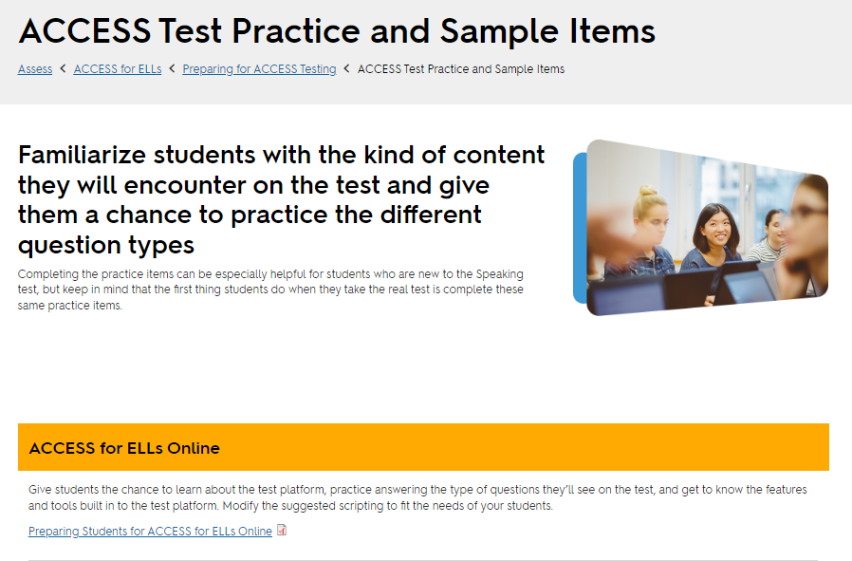
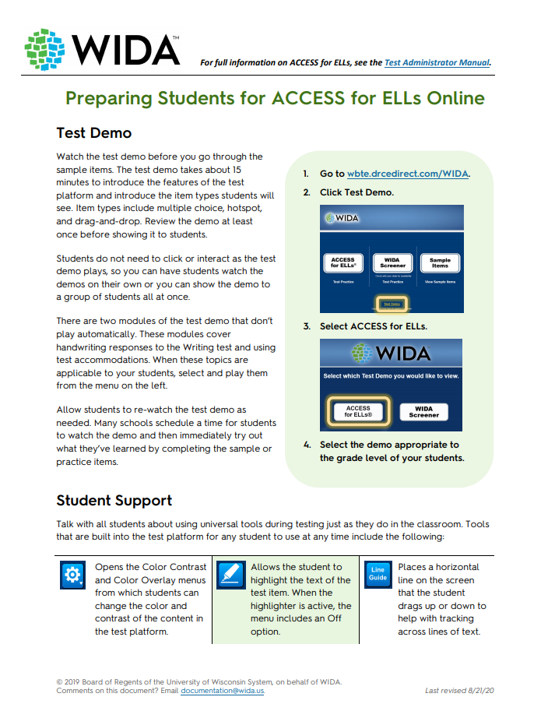
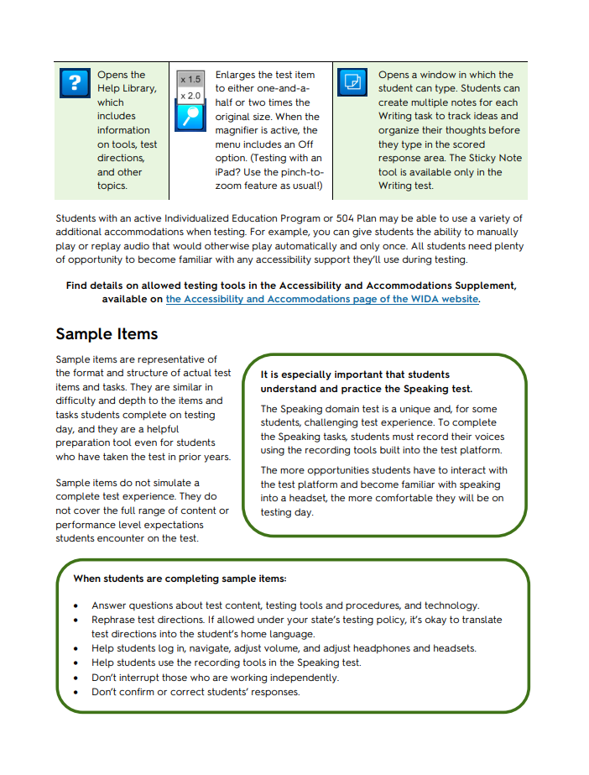
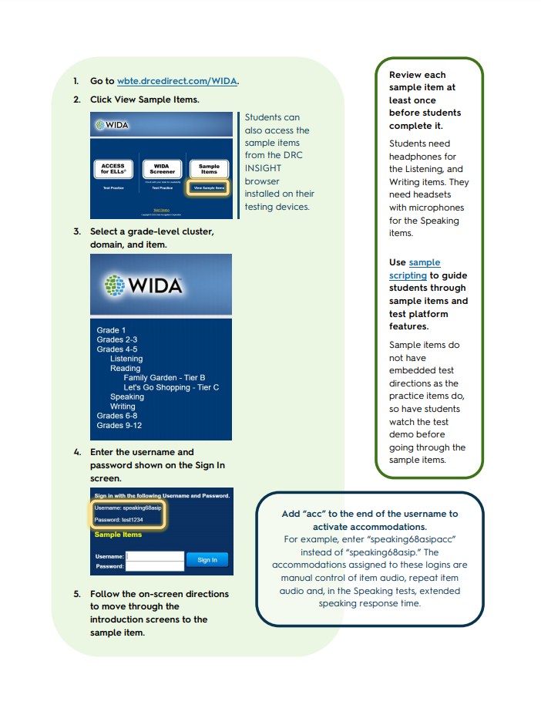
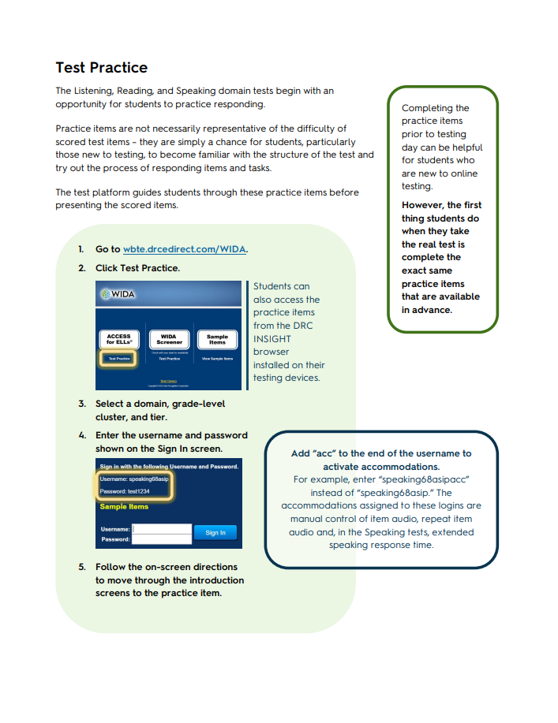
Preparing Students with the Test Practice and Sample Items
Preparing Students for ACCESS for ELLs Online.
75
Notes:
Give students the chance to learn about the test platform, practice answering the type of questions they’ll see on the test and get to know the features and tools built into the test platform. Modify the suggested scripting to fit the needs of your students. There is a link to the Preparing Students for ACCESS for ELLs Online document that will provide you will guidance and support with the test demo, sample items, and test practice items.
This slide is animated. Click to show images.
This 4-page document will walk you step-by-step through the preparation process for students taking ACCESS for ELLs Online.

Slide 76
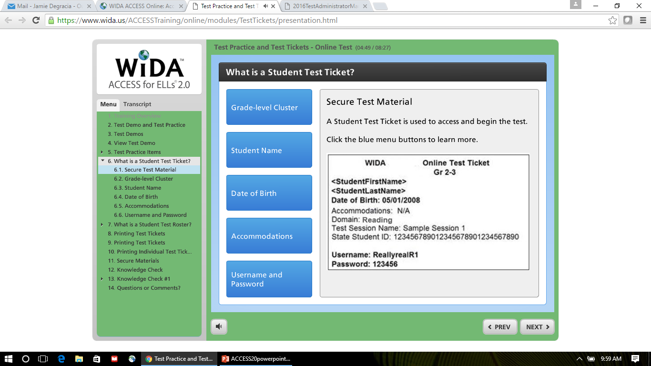
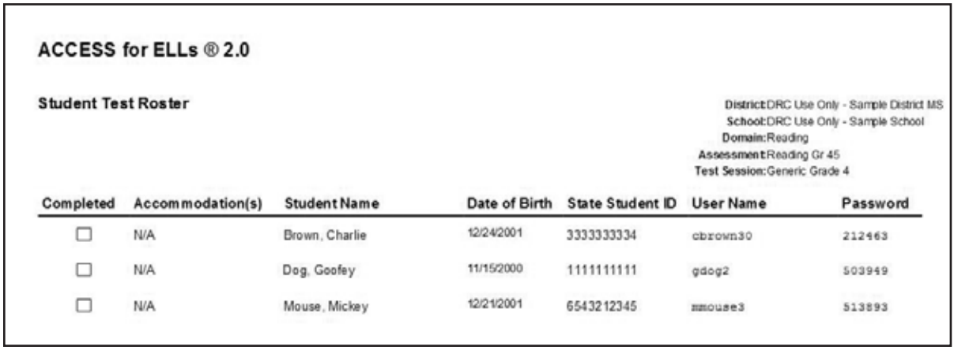
ACCESS for ELLs Online: Student Test Tickets & Rosters
Notes:
In order to test, each student will need a unique test ticket that contains student specific login credentials he or she must use to access and begin the test. These tickets are secure materials and must be treated as such. The test tickets for a given test session are part of the Student Test Roster. The Student Test Roster summarizes test session information such as the test name, test session name, and the district and school.
These may be provided to you by your test coordinator, or you may need to print these yourself from WIDA AMS depending on your school’s policy. We will discuss WIDA AMS later in this presentation. For detailed information about WIDA AMS see the WIDA AMS User Guide, available in the training course.

Slide 77
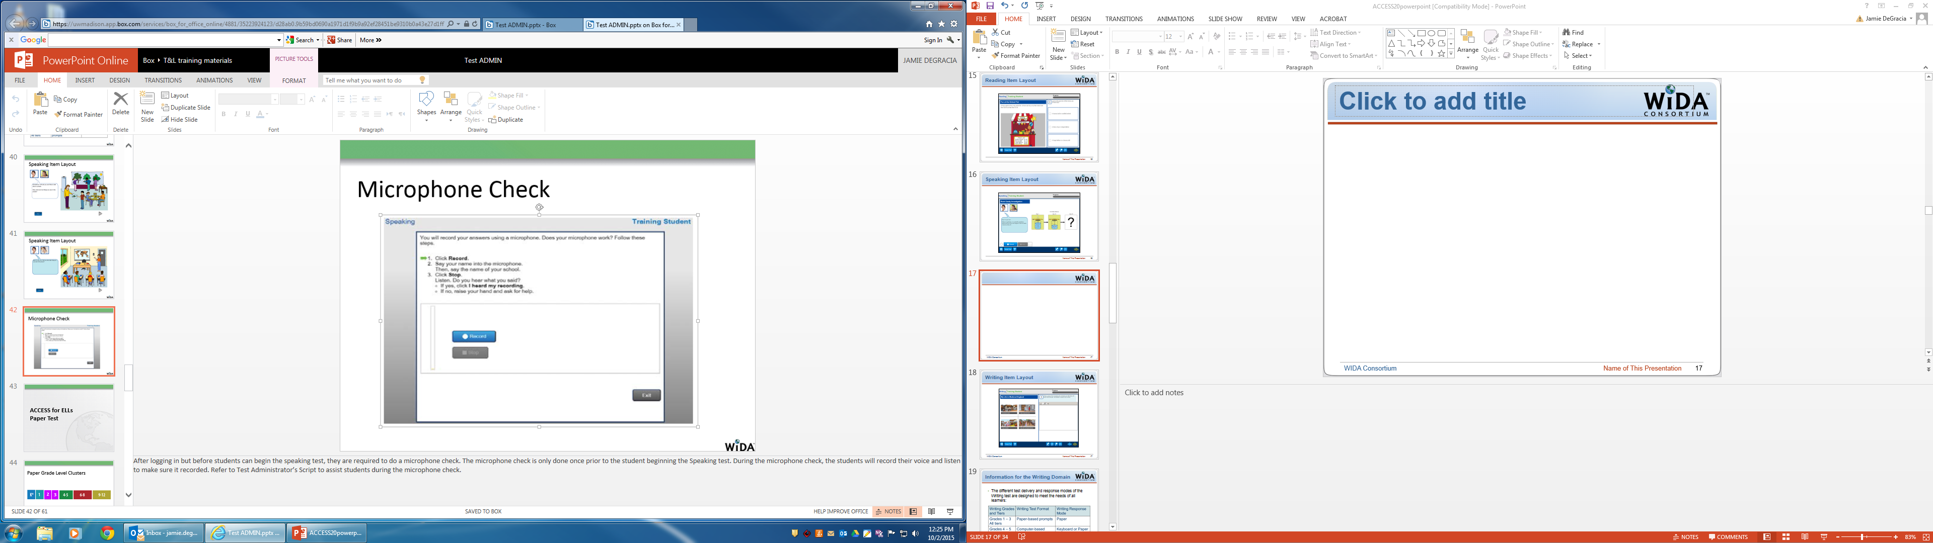
ACCESS for ELLs Online: Microphone Check
77
Notes:
Because it is essential that each student Speaking response is correctly captured, after logging in and before beginning the Speaking test, students are required to do a microphone check. The microphone check is only done once prior to the student beginning the Speaking test. During the microphone check, the students will record their voice and listen to make sure it recorded. Refer to Test Administrator’s Script to assist students during the microphone check. Please refer to the Test Administrator Manual for more information.

Slide 78
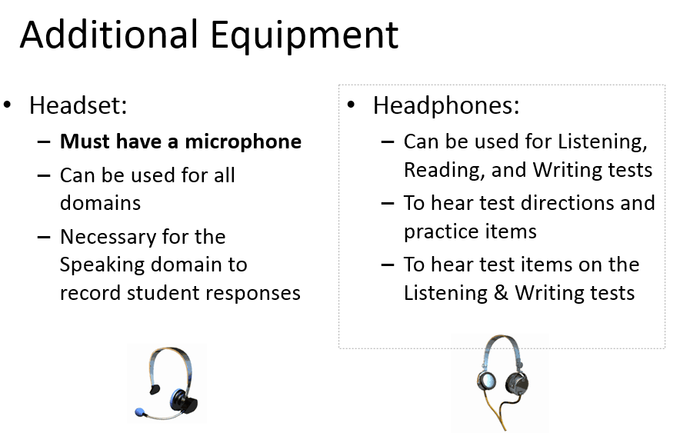
ACCESS for ELLs Online: Additional Equipment
78
Notes:
Given the online format of the ACCESS for ELLs , there are specific equipment requirements for students to hear any audio and record their speaking. If you have headsets, you will not need to also have headphones.

Slide 79
During the Test
Make sure each student has his or her own test ticket
Read the introductory TA’s Script
Assist the students through the test practice section
Students proceed to the test
Circulate through the room and monitor students
79
Notes:
Test administrators begin by reading the introductory Test Administrator’s Script for that domain test.
This slide is animated. Click to show text.
Then you monitor and assist the students while going through the test practice section.
Click to show text.
After the test practice items or tasks have been completed, the students proceed directly to the test by clicking the Next button. It is not necessary for the test administrator to do anything at that point, unless a student is having difficulty.
Click to show text.
While students are completing the test, the test administrator should circulate through the room making sure that the students are completing the test. During this time, test tickets should also be collected and kept in the test administrator’s possession for the duration of the test.
Makes sure each student has his or her own test ticket.

Slide 80
ACCESS for ELLs® Administration
New personnel to your district will need their own ACCESS Training password. Do not share your ACCESS passwords.
DACs will need to contact Chris Williams for ACCESS passwords.
It is a secure test.
Test booklets may not be distributed to teachers and administrators prior to the testing dates.
Seating charts and rosters are required for all state-required assessments.
Notes:
Test administrators need to take the quizzes annually year.
Test administrators will need to:
review all the manuals and ACCESS trainings on the KDE website,
go online to the ACCESS training and take all the necessary quizzes before ACCESS ,
have both the Administration Code Training and Inclusion of Special Populations Training.

Slide 81
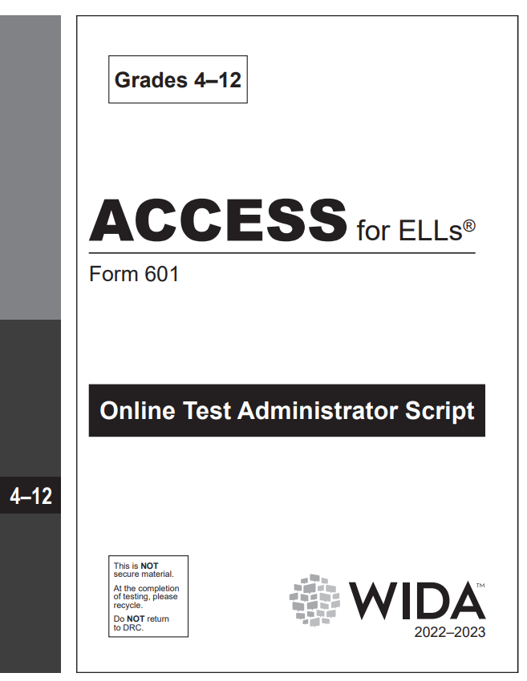
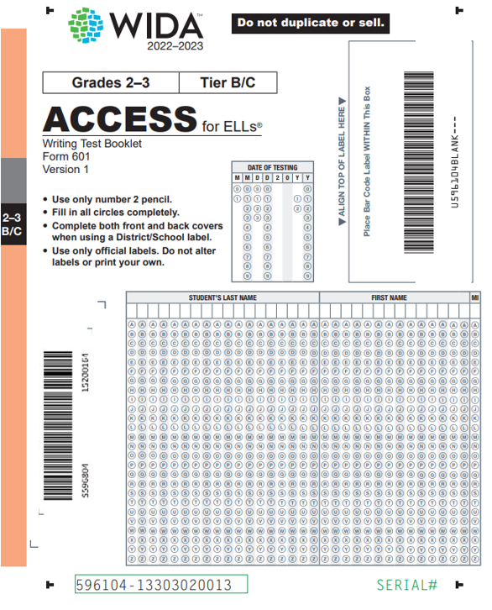
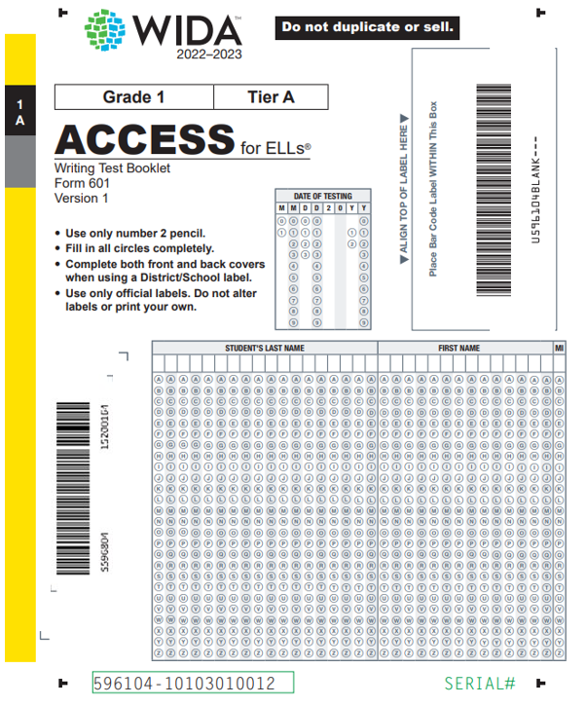
ACCESS for ELLs Online Materials
81
Notes:
ACCESS for ELLs Online Materials include the Test Administrator’s Script which is used by the Test Administrator for giving instructions for the Listening, Reading, Writing, and Speaking test administrations. There are separate scripts for Grades 1, 2-3, and 4-12. You will also have Grades 1-3 Writing Test Booklets for students to record Writing test responses. Even though this is an online test, all students in Grades 1-3 will complete the ACCESS for ELLs Writing test in test booklets, Test Coordinators will need to order these as Additional Materials in WIDA AMS. Please refer to the state’s ACCESS for ELLs Checklist for more information.

Slide 82
Student Transfers Out of State Before Testing Window
Annotate where the student transferred and date of withdrawal, then delete the student from the ACCESS roster in the spring.
Do not assign the student a test booklet.
If a pre-id label was applied to the test booklet, affix a do not process label over top of the pre-id label and send back with non-scorable materials.

Slide 83
Monitoring and Test Security
Review the testing procedures prior to testing. As always, students must do their own work on ACCESS for ELLs. To help ensure this is the case, it is required that districts do not allow students to take any Internet-connected devices, such as cell phones, smartwatches, or Bluetooth headsets, into the testing room unless a student has a medical issue that requires it. For medical reasons, if it could be left on the teacher’s desk close to the student.
Monitor the room to ensure students are working independently and not using cell phones or other devices during testing.
Watch for students who pause for a long time and encourage those students to move on.
Watch for students who click through the test rapidly and encourage those students to do their best on each item.
Copied or plagiarized responses will result in a student’s score being invalidated.
Notes:
It is the test administrator’s responsibility to monitor testing and ensure students do their own work. Reliance on others or use of devices like smartwatches or cell phones will invalidate test scores! As you monitor the test, watch for students who tire of testing and begin selecting answers at random just to finish. Encourage these students to take their time and do their best!

Slide 84
Student Transfers Districts During Testing Window
Paper-Pencil Testing:
Send the test booklet by certified mail or hand deliver to new district.
Complete testing the student in the new district.
Send the test booklet back by certified mail or hand deliver so it can be shipped back with previous district’s test materials.
Online Testing:
Complete the transfer form in WIDA AMS.
Records will be merged for the new district.

Slide 85
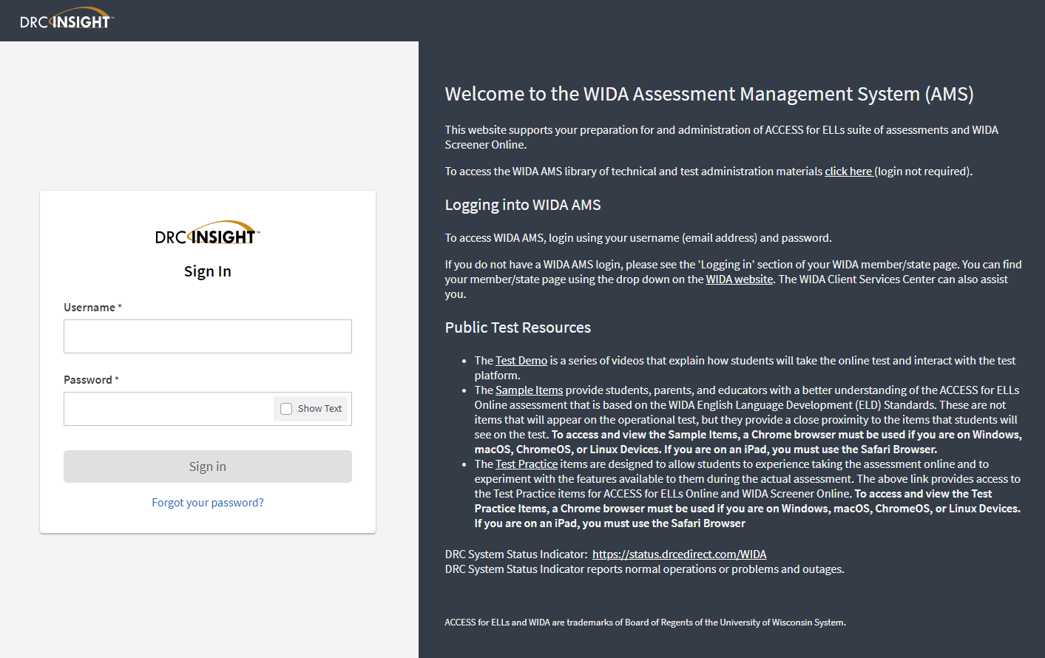


WIDA Assessment Management System
(WIDA AMS)
User Management
Materials
Student Management
Test Management
Report Delivery
Notes:
The WIDA Assessment Management System (WIDA AMS) is the administrative portal for all preparation and testing materials using DRC’s system. Designated staff will use the WIDA Assessment Management System to access needed downloads, prepare test sessions, as well as order any needed paper materials. The WIDA AMS User Guide provides detailed instructions for how to complete different functions in WIDA AMS
Mozilla Firefox, Google Chrome, Safari, and Microsoft Edge are the preferred browser for accessing WIDA AMS.

Slide 86
WIDA Assessment Management System (WIDA AMS)
Designated staff may also order any needed paper materials:
  Kindergarten ACCESS for ELLs
  Alternate ACCESS for ELLs
  Braille (Grades 1-12 only)
  Large Print (Grades K-12)
  ACCESS for ELLs Online Writing Test Booklets (Grades 1-3)
  ACCESS for ELLs Paper 1-12 Test Materials

Slide 87
WIDA Assessment Management System Tasks (WIDA AMS)
  Within the system, designated staff may:
  Access any needed technology-related user guides or software downloads
  Add students
  Designate accommodations
  Create test registrations
  Print test tickets
  Monitor student progress
  View/print reports
Notes:
On this slide are examples of some of the tasks that will be possible within the WIDA AMS. Designated district staff may view technology-related user guides and access the two downloads needed for the online testing system. The majority of students will initially be entered into the system via a pre-ID file at the state level in a generic test session, however, if needed, district staff may also add or edit students. District staff may also create test sessions, select needed accommodations, print test tickets, and monitor student progress. Post testing, district staff may view or print reports.
As with the current test, overage will be built into all orders.

Slide 88
ACCESS Writing Online
Writing is the only domain, when testing ACCESS for ELLs online, that has a writing test booklet for grades 1-3.
Reading, Listening and Speaking domains are all tested online.
Data Recognition (DRC) will only ship a certain amount of Tier A or Tier B/C level booklets based off the initial order placed in Oct.
If districts need more tier level booklets, order during the Additional Materials Window (12/5/2022- 2/17/2023) for ACCESS in WIDA AMS.

Slide 89
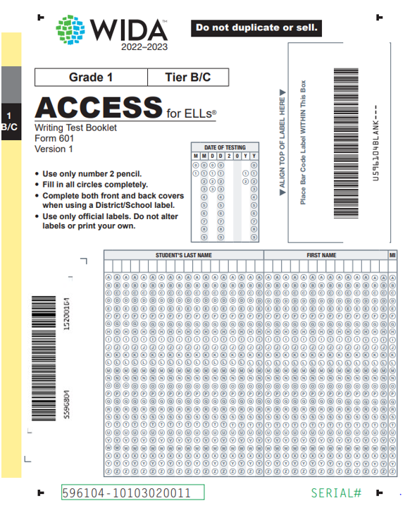
Writing Grades 1-3
All students in Grades 1-3 will complete the ACCESS for ELLs Writing test in a grade cluster and tier specific writing booklet.
The test is group-administered
89
Notes:
All Grades 1–3 online testers will hand-write their responses in a Writing Test booklet. Even though their writing response is handwritten in a booklet, these students are still considered online test takers. These test booklets are available in two tiers: A or B/C.
DRC will use the total number of Grades 1–3 student counts provided in WIDA AMS to determine how many Writing test booklets to provide for each district. For ordering purposes, DRC will use a calculated ratio to determine the number of Tier A and Tier B/C writing booklets to provide at each grade-level cluster.

Slide 90
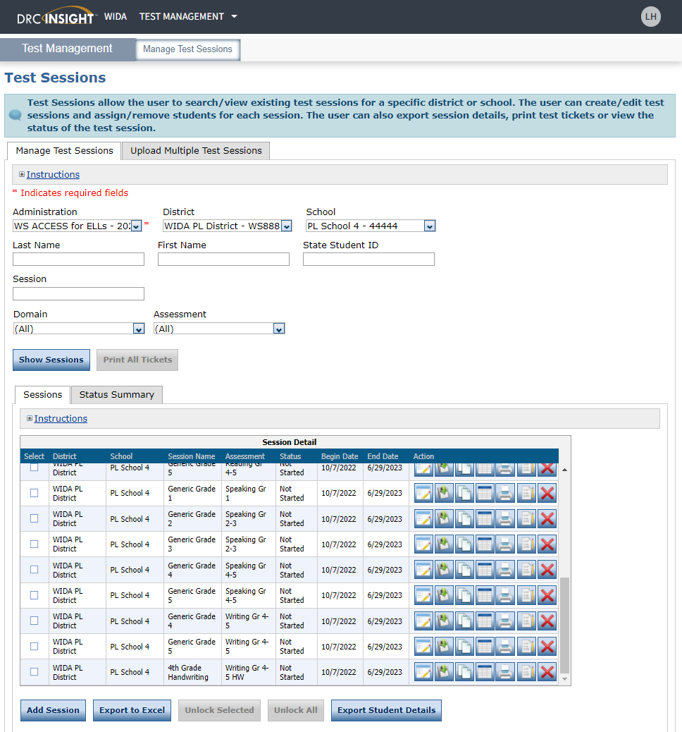
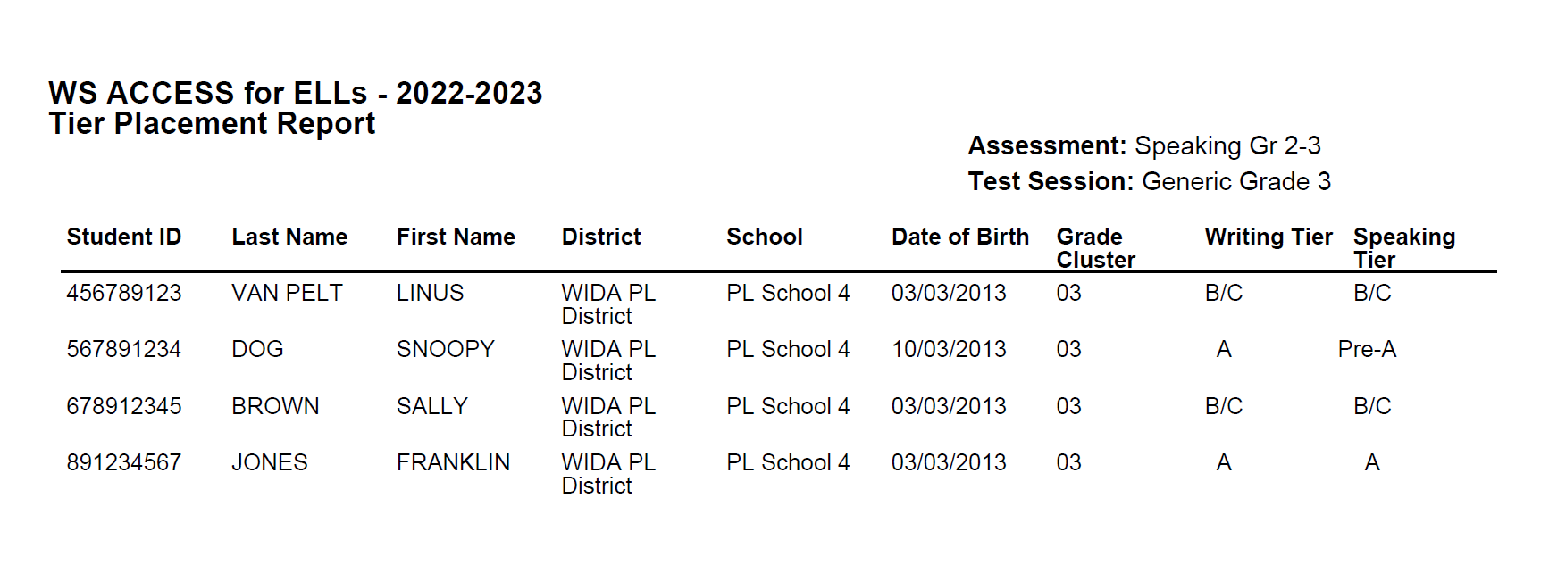
Writing Tier Report
Generate a Writing Tier report after Listening & Reading tests in WIDA AMS
Click on the Print Tier Placement Action Button.
90
Notes:
Once students have completed the Listening and Reading tests, you must run a Writing and Speaking Tier Placement Report that will identify the tier each student is assigned to take. The WIDA AMS User Guide contains instructions for running the Tier Placement Report.
This slide is animated. Click to show the Tier report.
The Tier Placement Report displays both the writing tier and the speaking tier placement for the students included in the report.

Slide 91
Writing Grades 4-12
All students in grades 4-12 will complete the ACCESS for ELLs using the keyboard to type in the responses online with computer-based prompts in WIDA AMS.
No test booklets are used for grades 4-12 online.

Slide 92
Technology Requirements
Technology requirements for the online test are listed on the ACCESS for ELLs Technology Page
Tech Readiness Checklist and Technology User Guide are in WIDA AMS
Headphones are necessary for all domains
  Headsets/headphones with built in microphones are an additional requirement for the Speaking test
Notes:
Technology Readiness: Work with LEAs to ensure tech readiness. Tech-related resources, such as the Tech Readiness Checklist and the Technology User Guide are available in the General Information Documents under All Applications in WIDA AMS.
On the WIDA website, you will find a complete list of the technology requirements for the operational test. This can be found by visiting the Technology Requirements page, which lists detailed information about technology requirements and recommendations.
WIDA emphasizes that headsets with microphones are necessary for the Speaking test and that headphones are necessary for all domains.
Headsets with audio adjustments are also recommended. Information on iPads, Chromebooks, and tablets is also available on the technology page.

Slide 93
Tips for Online Testing
Actively monitor students while testing
Maintain test security
Need technology staff for troubleshooting
Print student testing tickets prior to test day
Test tickets must be always kept secure during the testing window
Read the manual prior to testing
No electronic devices

Slide 94
ACCESS for ELLs-Paper and Online
Reminders, Test Security, Seating Charts, Parent Refusal, Screening During Testing

Slide 95
Reminders For Students
Review with students the Administration Code rules, especially around use of electronic devices.
Social media of all types: Facebook, Twitter, Instagram, Snapchat, Vine, YouTube, Reddit, Tik Tok, etc. and email are not secure, and any inappropriate posting can lead to disciplinary issues.

Slide 96
Test Security Incident
Any unauthorized exposure of secure test content on any platform including but not restricted to:
Paper materials
•Digital media (e.g., texts or instant messages, email, micro-SD cards, flash drives, audio recording, video recording, photos, screenshots)
•Internet platforms (e.g., blogs, websites, cloud-based storage, servers)
•Social media platforms (e.g., Twitter, Facebook, Pinterest, Instagram, YouTube, Reddit, TikTok, Snapchat

Slide 97
Test Security-Example One
When going to lunch, an educator leaves secure test materials unattended on their desk. A student comes into the room and flips through a test booklet while waiting for the teacher.
This is a test security incident because unauthorized individuals could gain access to test materials and possibly expose test content. Always keep test materials in a secure location before and after test sessions.
97

Slide 98
Test Security-Example Two
An administrator takes a photo of students taking ACCESS for ELLs, to share and celebrate the students’ hard work on social media. Test items can be seen in the photo.
Even with the best of intentions, posting photos of test content online means many unauthorized individuals can access and share that content. Never take photos of test content for any reason!
98

Slide 99
Test Security-Example Three
A student does not complete a test session before the end of the day, and plans are made to continue the test the following morning. The student decides to finish the test at home that night, so they don’t miss any more class.
Only in rare circumstances should a student complete a test session over multiple days. WIDA tests should be administered in person, by a certified test administrator. If the test is accessed outside of school, unauthorized individuals could access and share test content. Always collect test tickets as soon as a student logs in. Configuring testing devices so that a student may not log in to the test away from the school. Do not let students take home testing devices such as chromebooks, or use them during class, etc.
99

Slide 100
Consequences of Test Security Incidents and Test Practices and Policies
Anyone accessing or handling WIDA secure test materials agrees to WIDA’s Non-Disclosure and User Agreement (NDUA). Violations of that agreement may lead to investigation and action taken.
Find the NDUA at portal.wida.us/ndua
Violation of Administration Code and Inclusion of Special Populations along with test practices and policies will lead the DAC to file allegations through Caveon.
100

Slide 101
WIDA is Responsible for with Test Security
Using best practice test development protocols to ensure test content is kept secure and using secure test designs.
Making sure our partners and vendors follow test security best practices.
Ensuring security of physical and online test materials as they are created, shipped, and delivered.
Working with OAA and allegation coordinator when a potential test security incident is reported.
101

Slide 102
Follow Test Security Policies
Keep personal information and test material secure.
Track all booklets using the ACCESS for ELLs Security Checklist. Keep track of all test tickets and testing devices.
Collect test material from TAs as soon as possible after testing and keep it in locked storage.
Do not destroy any secure test material. The only exception is soiled materials that cannot be returned.
Distribute needed test materials and equipment.
Ensure TAs follow procedures and scripts exactly.
102
Notes:
It is important to take the appropriate measures to maintain confidentiality of all testing materials. District and school personnel carrying out their roles in the delivery of this assessment must follow specific guidelines to maintain test security. Please remember to adhere to any state specific test security policies. Be aware that any breaches of test security or problems with test administration may result in the invalidation of student scores. If test security has been compromised in any way, please contact your state testing representative to determine remediation steps.

Slide 103
Test Coordinators are Responsible for with Test Security
Receiving, inventorying, and distributing physical test materials and tickets to test administrators.
Working with the technology coordinator to configure devices for testing, including setting up the Central Office Services Service Device (COS-SD) for ACCESS and WIDA Screener Online.
Communicating state and local policies around test security to test administrators.
Ensuring the secure storage of all secure test materials.
Checking in secure materials and returning them to DRC (for ACCESS for ELLs).
Completing the materials accountability form in WIDA AMS for ACCESS materials that cannot be returned to DRC.
Reporting potential test security incidents to OAA, according to state policy.
103

Slide 104
Test Administrators are Responsible for with Test Security
Keeping track of test materials in their possession and securely storing them in between test sessions.
Communicating test security policies to students (i.e., electronic devices other than the testing device are not allowed in the testing room).
Reporting any potential test security incidents to their test coordinator.
Ensuring that students are not using electronic devices other than the testing device while in the testing room.
104

Slide 105
Preventing Test Security Incidents
Follow the state and local policies related to handling of materials and setting up a secure test environment in the Administration Code and in the district.
Actively monitor students during testing. Make sure students aren’t using phones or other electronic devices that could be used to capture or save test content.
Make sure to collect all materials at the end of testing, including test tickets and scratch paper. Return to your Test Coordinator or dispose of securely as needed.
Don’t take photos of test content for any reason!
Don’t let unauthorized students or families have access to secure test materials. Staff assisting with test administration or handling materials should review and sign WIDA’s NDUA.
105

Slide 106
Handling Test Security Incidents
What should you do if you suspect there has been a test security incident?
  If you are a test administrator: report it to your school test coordinator (BAC)
  If you are a test coordinator (DAC): report it to OAA
OAA has a process to follow
OAA will work with WIDA to investigate and resolve the issue
106

Slide 107
Seating Charts
Seating charts are required for both individual and group testing for all state-required assessments.
A single chart can be used for multiple sessions; if seating arrangement and room location do not change, mark the date for each session.
Templates are available on the Forms page of the KDE website. A customized form may be created to reflect the room arrangement.
Keep a copy on file for one year. (If allegation or irregularity, keep until resolved.)
Notes:
Printed or electronic seating charts should be maintained in the district for one year.

Slide 108
During ACCESS for ELLs Testing Window
Districts must screen all new EL students with the WIDA Screener for Kindergarten or WIDA Online Screener.
If the student qualifies for English Language services by scoring less than an overall composite of a 4.5, then ACCESS for ELLs assessments are administered during the testing window.
Notes:
1st semester Kindergarten- test administrator will give the screener in two domains: listening and speaking.
2nd semester Kindergarten- test administrator will give all four domains of the screener: listening, speaking, reading and writing.
For Kindergarten ACCESS – all four domains (listening, speaking, reading and writing) are given for the assessment.

Slide 109
Parent Refusal of EL Services
Parents can refuse EL services but the student:
  Is still EL until the exit criteria is met
  Will have a current PSP with EL accommodations in IC and be provided EL instruction in the regular classroom
  Will have another EL Services type needs to be marked in addition to declined services in IC.
  Will take ACCESS for ELLs® in January.
109

Slide 110
Resources to Assist with Administration of ACCESS for ELLs Suite of Assessments
Websites, WIDA Professional Development, Trainings, Manuals and Shipping Information

Slide 111
Kentucky ACCESS Trainings on KDE Website
User Accounts
Materials Ordering
Test Setup
Writing Tier Placement
Overview
ACCESS Roster Training in SDRR (coming soon)
Notes:
Each of the Kentucky ACCESS trainings are required along with the WIDA online training and quizzes.

Slide 112
State-Specific Guidelines on WIDA Website
Visit Kentucky’s member state page for information related to:
Contacting State Educational Agency’s Representatives
Assessment Materials and Training
ACCESS for ELLs Testing Schedules
State-Specific guidance for ACCESS for ELLs
ACCESS for ELLs Online and Paper Checklist
Identification and Placement Guidance
Professional Development Opportunities
Notes:
Kentucky has its own specific guidance related to this information. Be sure to click on members/states and select Kentucky at wida.wisc.edu to see any specific guidelines and policies.
In 2021-2022, WIDA continues to offer the resource of state specific checklists. State checklists are available as a tool for you to assign and document the tasks that are required to administer ACCESS for ELLs. The state checklist indicates who typically handles each task in our state, along with any state-specific guidance. These are each customized for our state.

Slide 113
WIDA Professional Learning
PD opportunity from WIDA
For EL and Content Teachers, some for Administrators
Self-paced e-Learning workshops
Available Sept. 1, 2023-Aug. 31, 2024, new ones added, and some removed from last year
Sent information through the Monday DAC email, DAC calendar and flyer on Kentucky’s WIDA website member page

Slide 114
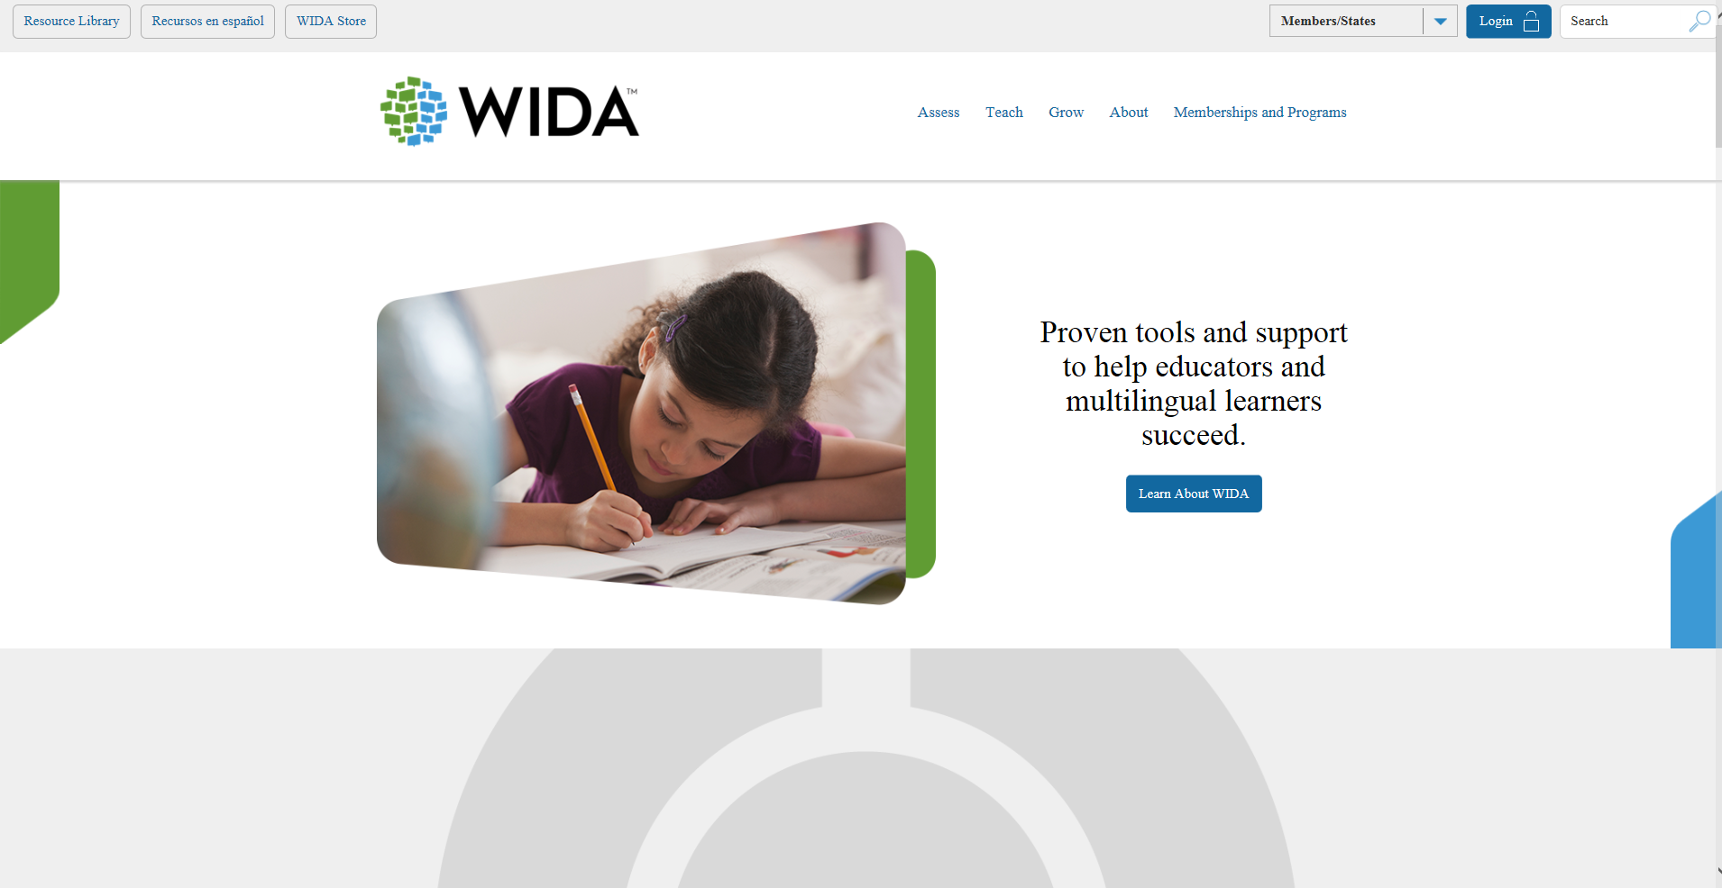
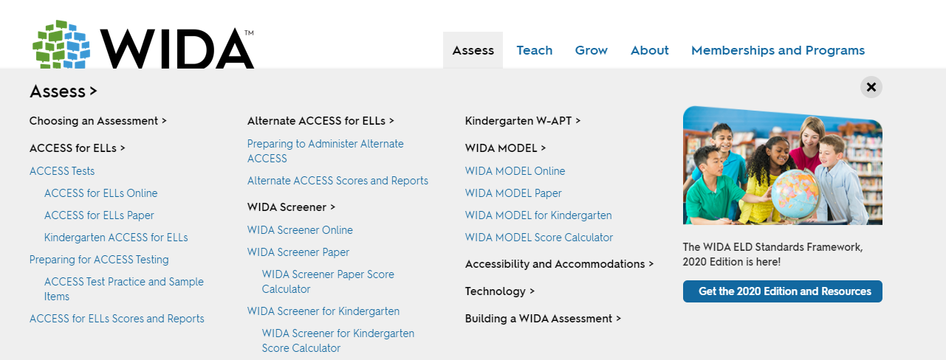
ACCESS for ELLs® Suite of Assessments
Notes:
The WIDA public website also has a lot of information about the ACCESS for ELLs suite of assessments. For more information regarding each assessment, please visit the WIDA website, click on “Assess” and select the assessment you would like to learn about.
Quick Start Guides: Remind District Test Coordinators (DTCs) and Test Administrators (TAs) of WIDA's new Preparing and Administering ACCESS for ELLs QuickStart Guide and Preparing Students QuickStart Guide available on the WIDA website. These guides are designed to help educators understand the preparation process and what they'll need to get started to ensure everyone is ready for testing!
Training Completion: Monitor TA completion of training in the WIDA Secure Portal. View the Secure Portal User Guide for step-by-step instructions on how to review training scores..
Technology Readiness: Work with Technology Coordinators (TCs) to ensure tech readiness. Tech-related resources, such as the Tech Readiness Checklist and the Technology User Guide are available in the Technology Coordinators tile in WIDA Secure Portal and in the General Information Documents under All Applications in WIDA AMS.
All preparation materials for the ACCESS for ELLs Operational Test are posted to the ACCESS for ELLs section of the WIDA website.
Some other key resources include:
Sample Items for the Public
Recorded webinars for district staff by role
Test Demos/Test Practice

Slide 115
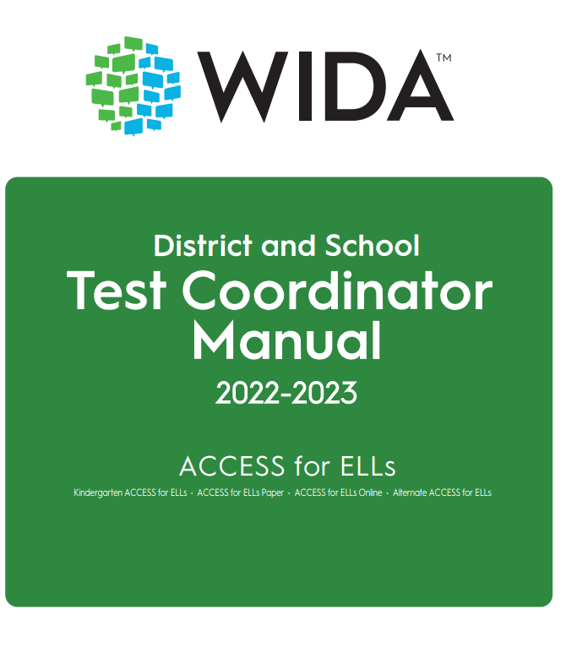
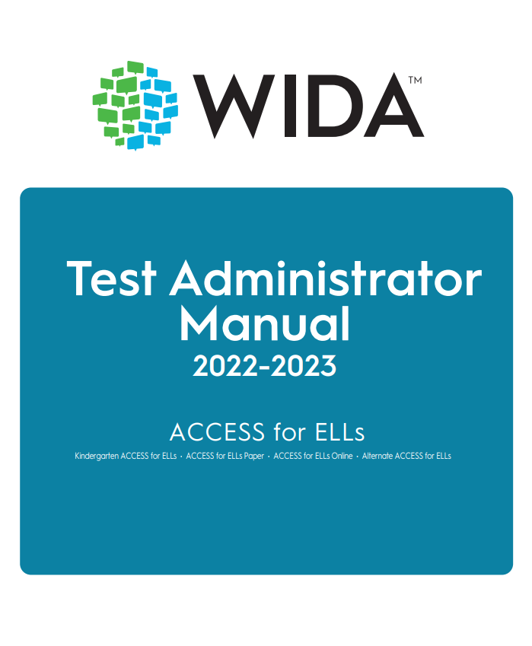
Manuals Reflecting Roles
District and School Test Coordinator Manual
For Test Coordinators
Test Administrator Manual (TAM)
For Test Administrators
Notes:
Test Administrator Manual
One document that includes K, Paper, Online, and Alt ACCESS.
The Test Administrator Manual focuses on all tasks and responsibilities Test Administrators oversee immediately before, during, and immediately after testing for all assessments in the ACCESS for ELLs suite of assessments.
The District and School Test Coordinator Manual (for Test Coordinators) explains all coordination responsibilities and tasks related to the implementation of all the assessments in the ACCESS for ELLs suite.

Slide 116
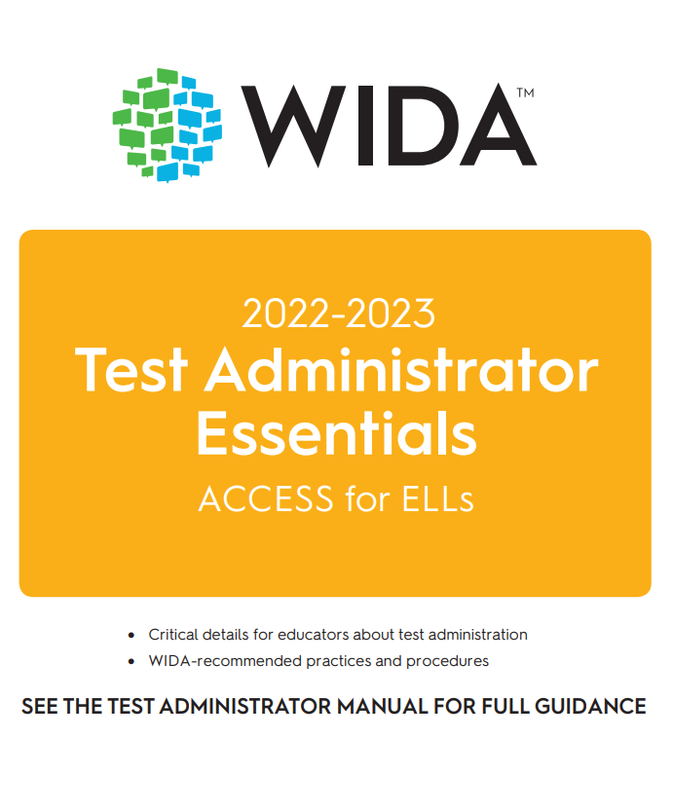
Test Administrator Essentials

Slide 117
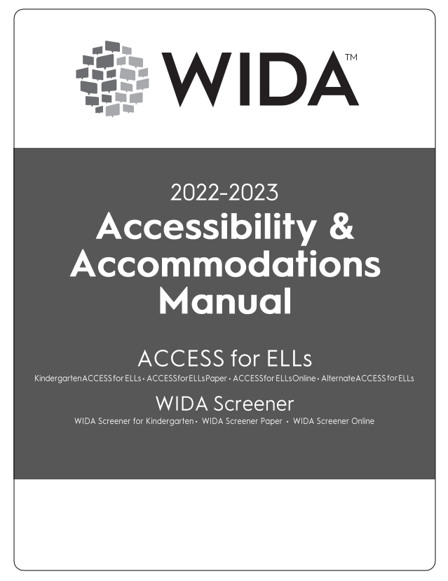
Accessibility and Accommodations Manual
Participation guidance
Framework
Types of supports
Alternate ACCESS for ELLs criteria
Keyboard shortcuts
Scribe and Transcription guidance
Accommodation checklists ACCESS online and paper, Kindergarten and Alternate ACCESS

Slide 118
Resource in WIDA AMS
WIDA AMS User Guide- a guide for how to use WIDA AMS to complete administrative functions for testing with DRC INSIGHT
  Log into WIDA AMS
  Click on View Documentation
  Under Document Type-Select Manuals from the drop-down menu
  Open or Save WIDA AMS

Slide 119
Forms Shipped to District
District Packing List (white)
School Box Range Sheet (white)
School Packing Lists–District Set (white)
District Security Checklist (white)
Copy of School Security Checklists (white)

Slide 120
Materials Shipped to District
Plastic Bags and Ties for Materials Return
Return Materials Instruction Packet
Student Labels (Pre-ID, District/School, and Do Not Process)
Testing Materials including Overage (as applicable)

Slide 121
Materials Arrive
All materials shipped are securely and must be signed for upon delivery
Use the boxes to return materials when testing is finished
121
Notes:
Testing materials are delivered either to districts or schools, depending on arrangements made with your state. Be sure to save the box/boxes for return shipment. Materials lists are included in the Test Administration Manual and are often organized and referred to by the color paper used for printing.
The shipment arrives two weeks prior to your testing window. Locate the last/highest numbered box of the shipment. This box contains necessary paperwork for test administration and return of test materials at the district and/or school level. Inventory the test materials.

Slide 122
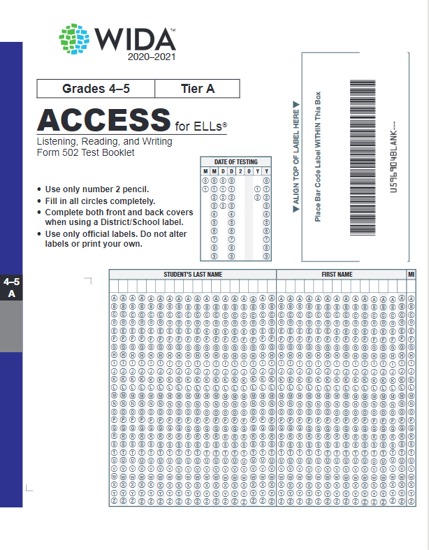

Inventory/Check Range Numbers
Security barcode range on a packing list and packages.
Verify this information matches the range sheet or individual materials.
Security barcode on test booklet.
122
Notes:
Check to ensure that the first number on the range sheet (security checklist) matches the security code in the book. Verify that the packing list security barcode ranges match those on the testing material. A range sheet is used to inventory packages without opening shrink-wrapped materials inside.
Books will be signed out by range number to test administrators.

Slide 123
Test Administration Conclusion Activities
Packing
Shipping
Rosters
Receive materials from BACs
Verify materials
Contact UPS
Ship to DRC all Testing and Secure Materials
Make certain that rosters are completed in the Student Data Review and Roster (SDRR) application prior to the close of the testing window
File Nonparticipation Forms in SDRR and keep on-file in district
Test Irregularities, if needed
Gather statements and data
Enter information into online allegation reporting system
Detailed instructions in the manual and in shipping instructions
Notes:
KDE/CORE Allegation Reporting

Slide 124

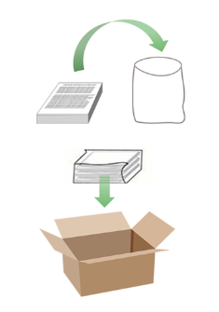
Returning Test Materials For Paper Testing-Kindergarten, Alternate ACCESS and Accommodations Forms of Braille and Large Print
Return Window:
Mar. 1, 2024
Explicit Return Instructions in District and School Test Coordinator Manual
124
Notes:
Materials are to be returned via UPS using prepaid return labels.
All used and unused test materials, including Kindergarten and Alternate ACCESS for ELLs materials must be shipped to DRC by your state’s deadline. Do not wait until the deadline to ship materials back. As soon as the majority of a school’s or district testing population has completed the assessment, prepare, box, and return the materials. Only enough materials should be retained to account for make-ups and new enrollments. These materials should be returned via a second shipment.
If the site does not have a daily scheduled UPS pickup, call UPS to arrange for materials pickup. Specify that you are using pre-paid, UPS return labels.

Slide 125
Shipping Materials
Ship Back to DRC
Keep in the District
  Plastic Bags for Material Return
  All Test Administrator‘s Scripts
  Student Storybook, Activity Board, Card and Pouch (Kindergarten)
  All Student Response Booklets
  Listening and Speaking CDs
  Speaking Booklets
  All Form 601 Test Booklets
  Recording Script
  Large Print Test Materials
  Braille Test Materials
  Grade 1-3 Test Booklets (Writing Online)
Packing List (white sheet)
Security Checklist (white sheet)
Student Booklet Labels – Pre-ID, District/School Labels , Do Not Process Labels (extra)-destroy securely
District and School Test Coordinator Manual
Test Administrator Manual
School Box Range Sheet (white sheet)
Test Tickets (online)-destroy securely
Scratch Paper- destroy securely
Return Materials Instruction Packet
Notes:
Return Materials Instruction Packet:
Return Pack and Ship Instructions
DRC Return Shipping Labels
UPS Return Shipping Labels
Anything with a barcode needs to be returned to DRC.

Slide 126
Contact Information
KDE:
Chris Williams
502-564-4394 ext. 4750
WIDA:
WIDA Client Services Center
866-276-7735
DRC:
DRC Customer Support
855-787-9615

