Slide 1
Ordering Materials: ACCESS for ELLs® Online, Large Print, Braille, Kindergarten ACCESS for ELLs® and WIDA Alternate ACCESS
Chris Williams, Program Consultant
Office of Assessment and Accountability

Slide 2
Ordering Materials
The ordering window for ACCESS for ELLs® is Sept. 27–Oct. 23.
Data Recognition Corporation (DRC) will send every District Assessment Coordinator (DAC) an email on Sept. 20 with instructions for ordering ACCESS and WIDA Alternate ACCESS materials in the WIDA Assessment Management System (AMS).
DACs will need to log into WIDA AMS with the password. Contact DRC if it has expired or click forgot username or password and it will be re-sent.
DACs must go to the WIDA AMS site to order ACCESS materials. If the DAC has set up the Building Assessment Coordinators (BACs) in the WIDA AMS system, then the BACs can order for their school only. Please do not place any ACCESS or Alternate ACCESS orders now for the District-Level Additional Orders Only Site-WWW.

Slide 3
Policy for Ordering and Testing
English Learner (EL) students in Kindergarten through grade 12 will take the ACCESS or the WIDA Alternate ACCESS.
Districts who have Kindergarten EL students participating in the WIDA Alternate ACCESS this year will need to order Kindergarten WIDA Alternate ACCESS materials in the K-2 cluster.
There will not be any nonparticipations for Kindergarten Alternate students unless the student is medically not able to test during the entire window.
Students are screened for EL identification prior to testing the students with WIDA Alternate ACCESS. The Individual Education Program (IEP) team determines whether the EL student will take the regular ACCESS with accommodations or will take the WIDA Alternate ACCESS with accommodations.

Slide 4
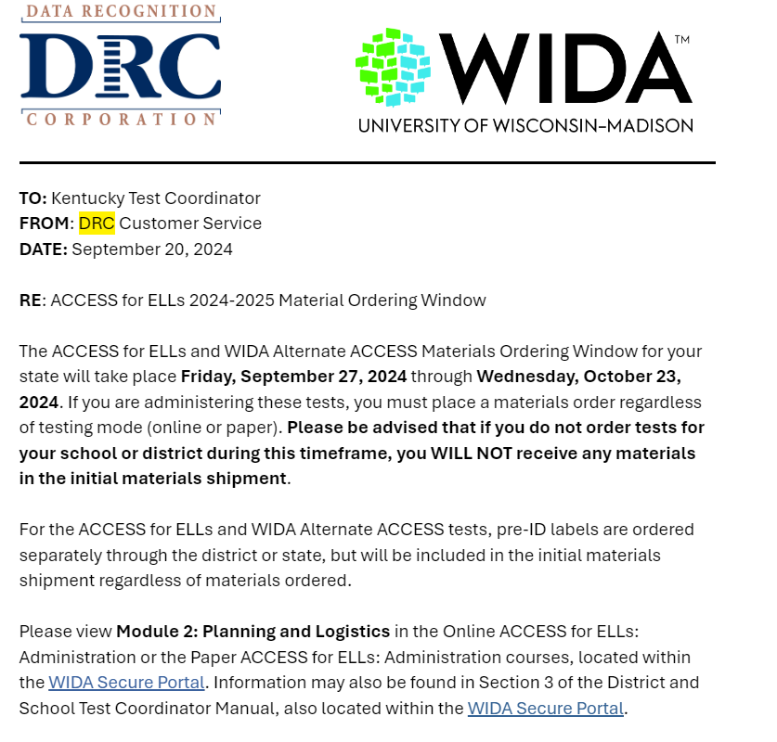
ACCESS Ordering Email
DACs will receive this email from DRC as the District Testing Coordinator on Friday, Sept. 20. If DACs did not receive the email, contact DRC Customer Service.

Slide 5
Ordering Materials Reminders
For best results use Google Chrome, Mozilla Firefox, Microsoft Edge or Apple Safari as the most current production release version of the browsers when ordering materials.
Districts will receive a 15% (7.5% for school and 7.5% for the district) overage of ACCESS for ELLs® materials from DRC.
Only order what the district needs. Make sure Infinite Campus (IC) reflects the number of EL students that districts order in WIDA AMS.
Districts can order additional materials starting on Dec. 3 in WIDA AMS for students that have enrolled after the initial ordering window closes on Oct. 23.
Office of Assessment and Accountability (OAA) will supply DRC with a file to create the pre-ID information after the ordering window closes on Oct. 28. The pre-ID labels will arrive to the district office with the testing materials.
Notes:
OAA will be verifying your ACCESS for ELLs order this year with DRC and verifying your EL enrollment in IC to eliminate over ordering of ACCESS for ELLs materials.

Slide 6
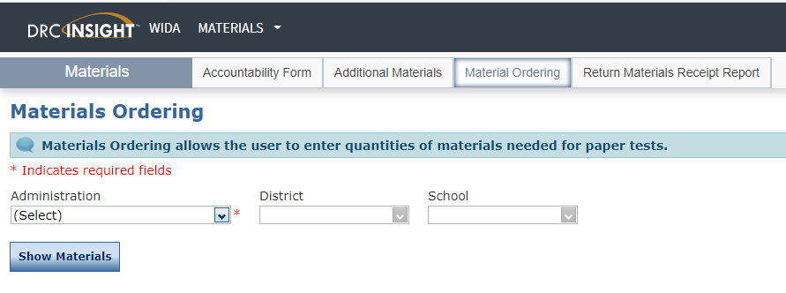
Materials Ordering in WIDA AMS
After logging into WIDA AMS, click the Order and Manage ACCESS Materials tile on the landing page, and click on Materials Ordering tab.
Choose the Administration-KY ACCESS for ELLs 2024-2025.
On the top of the Order Materials page to the right of the district name, choose the first school in which to place an order and click Show Materials.
Please do not select the District-Level Additional Orders Only Site under school when ordering materials.

Slide 7
ACCESS For ELLs Ordering Materials
DACs or designee will order the following by selecting the specific school:
Online Order
ACCESS for ELLs® Online--Enter counts by grade level cluster (1, 2-3, 4-5, 6-8 and 9-12).
ACCESS for ELLs® Writing--Grades 1-3. Enter the online counts by grade level clusters; paper materials for tier levels A, B/C will be sent by DRC for the writing domain based on the online counts. Please not order paper writing test booklets for Grades 1-3 students.
ACCESS for ELLs®--Grades 4-12 will all be online; no paper/pencil testing for the writing, speaking, reading or listening domains. Please do not order paper materials for Grades 4-12.
Kindergarten, WIDA Alternate ACCESS, Braille and Large Print Order
Enter counts for the following on each separate grid--Kindergarten, WIDA Alternate ACCESS, Braille (UEB Contracted, UEB Uncontracted and UEB with Nemeth Contracted), and Large Print (Kindergarten, Tier levels A, and B/C) will be given paper/pencil.
Notes:
ACCESS for ELLs Paper may be needed for English Learners (ELs) if:
• student’s IEP accommodations for WIDA testing require the paper ACCESS for ELLs, or
• student doesn’t have formal education with the use of technology prior to entering the U.S.

Slide 8
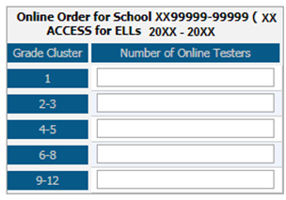
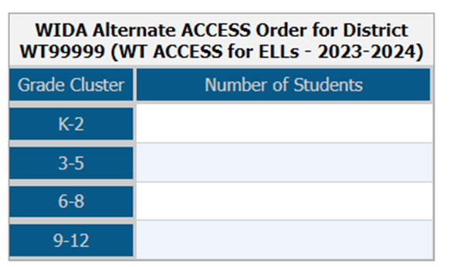
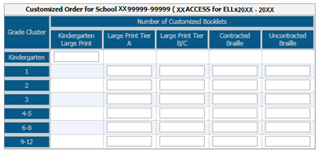
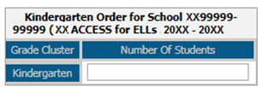
Ordering Materials in WIDA AMS
Enter student counts at each grade level as applicable. Enter counts only for the grades that have students testing.
Enter a 0 or leave blank for the grade levels with students not enrolled.
Districts just enter the online counts for writing within the grade level clusters for grades 1-3 and DRC sends tier levels automatically.
Notes:
Districts just enter the online counts for writing within the grade level clusters for grades 1-3 and DRC sends them automatically. If the districts finds they need more of a particular tier those can be ordered during the Additional Material Window.

Slide 9
Ordering Window
DACs can view the school’s order for the entire district by selecting all schools on the Summary tab. BACs can only view their school.
DACs can see which schools have not completed the orders on the Status Report tab by selecting all schools.
Click on Save at the bottom of the screen in WIDA AMS to continue the ordering process. The order will show In Progress.

Slide 10
Ordering Window Completion
Click on Complete at the bottom of the screen in WIDA AMS when all school orders have been completed. Continue to edit until the materials ordering window closes. ACCESS for ELLs orders will be read-only after the ordering window closes.
Kentucky is having DRC ship test materials to the district and not to individual schools, so the shipping address will not be visible for BACs but will be for DACs in WIDA AMS. Please verify the shipping address by checking the Contact and Addresses information for accuracy and update if needed (Test Coordinator:, Phone:, Email:, Shipping Material:).
ACCESS ordering window closes at 11:59 p.m. ET on Oct. 23.

Slide 11
Electronic Materials Available
DRC will provide the following materials electronically; the test materials will be shipped:
DRC Return Labels
UPS Return Shipping Labels
Test Administrator Manual
District and School Test Coordinator Manual
Grade 4-12 Test Administrator Online Script
State-Specific Directions (Goldenrod Sheet-electronic only)
Notes:
If more return labels are needed, those can be emailed. The manuals and scripts can be accessed on wida.wisc.edu under the WIDA Secure portal-Resources..
Only the AMS guide and Technology documents will be on WIDA AMS.

Slide 12
DACs
Ensure that initial orders are:
Placed during the statewide Materials Ordering window-Sept. 27- Oct. 23. If no order is placed in WIDA AMS, districts will only receive Pre-ID labels.
Reflect actual anticipated student counts, as overage charges may apply if orders are “padded.”
Ensure schools are aware of available materials overage.
Encourage schools to return unused materials to district as soon as possible to increase district materials overage inventory.
Encourage schools to return completed testing materials to the district office as soon as possible, so materials can be shipped to DRC in a timely fashion.
Coordinate and submit one district-wide additional materials order by selecting under School-District –Level Additional Order Only Site-WWW, only after the district and school overage inventories have been depleted.
Retain overage of materials until the end of the testing window so there is available inventory for any new students who enroll.

Slide 13
BACs
Send unused overage to district office to increase overage inventory.
If additional materials are needed, contact DAC, who will pull materials from district overage or will put in an additional order.
Return testing materials to district office promptly upon completion of testing to initiate the return of materials to DRC.

Slide 14
Resources for ACCESS for ELLs Ordering
Ordering Materials: ACCESS for ELLs® Online, Large Print, Braille, Kindergarten ACCESS for ELLs® and WIDA Alternate ACCESS PPT
Knowledge Articles in WIDA AMS
Ordering Materials in WIDA AMS webinar on Sept. 24 from 1-2 p.m. CT. The live webinar will be recorded and posted to the WIDA Secure Portal under Webinars.

Slide 15
ACCESS for ELLs Ordering Materials Office Hour
To demonstrate and assist district and school staff with ordering materials in WIDA AMS
Kindergarten ACCESS for ELLs
ACCESS for ELLs Online
WIDA Alternate ACCESS
Accommodated Materials: Large Print and Braille
Q&A Session
TEAMS Meeting on Monday, Sept. 30 from 1-2 p.m. ET
Join on the computer, mobile app or room device
Join the meeting now
Meeting ID: 228 368 735 917 Passcode: 78dCCX
Download Teams | Join on the web
Or call in (audio only)
tel: +1 502-694-1960,,333170400# United States, Louisville
Phone conference ID: 333 170 400#

Slide 16
Contact Information
KDE:
Chris Williams
502-564-4394 ext. 4750
DRC:
DRC Customer Service
855-787-9615

