Slide 1
Notes:
Greg

Slide 2
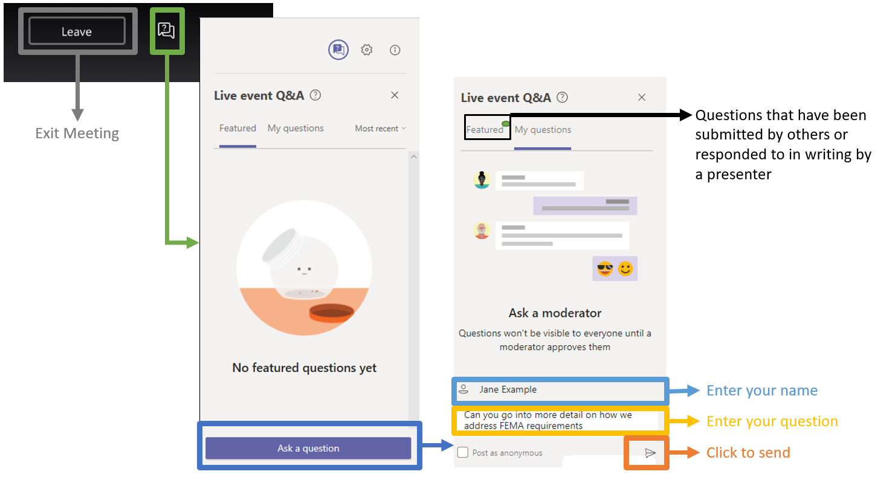
Questions & Answers Feature

Slide 3
702 KAR Capital Construction Process
Session 1
FACPAC (Phase 1) Part 1
Questions will be addressed at the end of the presentation.
Notes:
Greg

Slide 4
KRS 162.060
KRS 162.060 requires that all plans and specifications for new public school buildings contemplated by boards of education and for all additions to or alterations of old buildings be approved or disapproved in accordance with the rules and regulations of the Kentucky Board of Education.

Slide 5
KRS 162.060
KDE’s District Facilities Branch (DFB) is responsible for administering 702 KAR 4:160 Capital Construction Process which promulgates this statute. No board of education may award a contract for the erection of a new building or contract for an addition to or alteration of an old building until the plan has been approved.
DFB also administers regulations regarding district facility planning and real property.

Slide 6
Communicating with DFB
When corresponding with DFB via email please
IDENTIFY THE DISTRICT IN THE REFERENCE LINE.
DO NOT simply say “question” or “call.”

Slide 7
What is a BG-1?
An initial BG-1 is a Project Application Form submitted by a district requesting KDE approval of a capital construction project.
It contains basic information regarding the project:
The facility
The scope and estimated cost of the work and
The proposed funding source(s)
The initial BG-1 must be submitted by the District.

Slide 8
What is a BG-1?
A revised BG-1 is submitted when information provided on the initial KDE approved BG-1 or a previous KDE approved revised BG-1 changes.
Changes include the following:

Slide 9
When is a BG-1 required?
Refer to 702 KAR 4:160 Section 2. A BG-1 Project Application Form shall be submitted for each project that:
Proposes construction of a new building, addition, or alteration of an existing building that requires design by a design professional for a building or building system or
Proposes a major renovation or
Proposes a minor project or

Slide 10
When is a BG-1 required?
Proposes a guaranteed energy savings contract (to send a Letter of Intent to KDE) or
Proposes a project that is funded by restricted funds:
Support Education Excellence in Kentucky (SEEK) capital outlay funds
Building funds or
Facility Support Program of Kentucky (FSPK) funds or
School Facilities Construction Commission (SFCC) funds.
A BG-1 is requested for projects that address reported Need on the District Facility Plan (DFP).

Slide 11
When is a BG-1 NOT required?
For projects utilizing unrestricted fund sources and
Do not address reported Need (not on the district’s current DFP) and
Meet the definition of maintenance and repair as defined by KRS 322 and KRS 323 or
Do not affect model program spaces.
Note – If you have questions, we recommend that you contact the assigned architect to your district.

Slide 12
How BG-1’s are used by KDE
BG-1’s track capital construction projects and are used with the current DFP to adjust the “Unmet Need” report every odd fiscal year for delivery to the Legislature.
The Unmet Need report is used by the Legislature in the disbursement of offers of assistance from SFCC.
Data can be used to generate reports when requested by the Legislature and others, e.g., how many new Elementary Schools constructed over a particular time period.

Slide 13
What is FACPAC?
FACPAC is the acronym for Facilities Planning and Construction.
FACPAC is a Microsoft SharePoint based system used for document submittals and project accounting purposes.
FACPAC contains information regarding forms related to capital construction projects (BG-1, BG-4, BG-5, Contracts, Purchase Orders and Change Orders) to all users having access for that project.
FACPAC Project document library contains other project and construction documents.

Slide 14
Who has access to FACPAC?
District superintendents, finance officers and facility directors have access to all district information in FACPAC.
When changes to these positions occur, KDE needs to be notified. Please send us an e-mail so we can made appropriate changes.

Slide 15
Third Party Access to FACPAC
Architects, construction managers, fiscal agents and other third parties are granted access by the district on a per project basis.
New third parties can request access to be a third party in FACPAC by sending an e-mail to KDE’s FACPAC administrator.
Third Parties only have access after an initial BG-1 is approved and cannot create an initial BG-1 or a BG-5. All other activities can be performed by appropriate third parties.

Slide 16
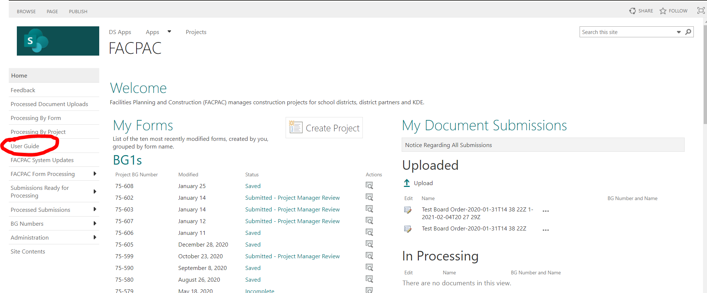
FACPAC User Guide
A detailed User Guide is located on the FACPAC home page.
Print the User Guide for reference and review before calling.

Slide 17
FACPAC communications
Communications from KDE to the district and third parties are e-mailed to users having project access as a “FACPAC System Message.”
Users are responsible for reading these communications and responding appropriately.
Users should adjust Outlook settings so that these emails do not go to Junk, Clutter, etc.

Slide 18
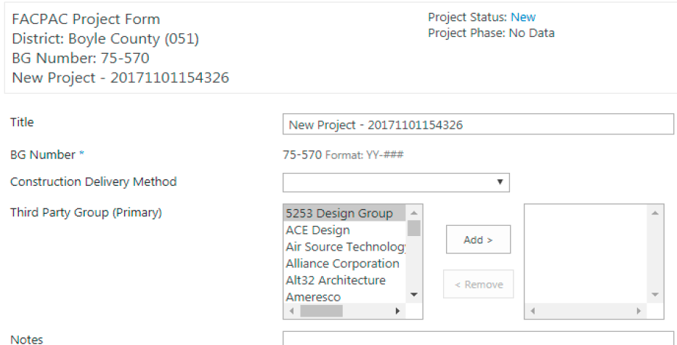
FACPAC - Creating a Project
Projects are created in FACPAC from the Home Page and BG Numbers are automatically assigned.
Enter the full facility title and accurate scope description– “Smith Co. Middle School Chiller Replacement”, not SCMS HVAC.

Slide 19
FACPAC - Creating a Project
Select the Construction Delivery Method.
Third Party Group can be selected at this time or added later.
FACPAC defaults to the appropriate procurement standard.

Slide 20
FACPAC - Creating Emergency BG-1
Refer to 702 KAR 4:160 Section 2(6) for instructions in emergency situations.
Enter all BG-1 information into FACPAC online.
BG-1 Form is printed, signed, and attached with the board order declaring the emergency as the written determination (KRS 45A.355 )

Slide 21
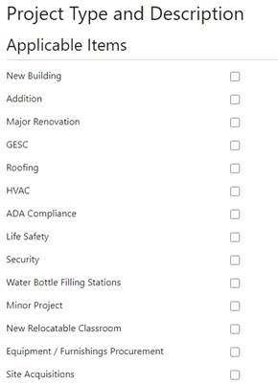
FACPAC - Creating a BG-1
BG-1 application provides check boxes for project types.
Checking boxes generally brings up description boxes allowing greater detail.
Example:

Slide 22
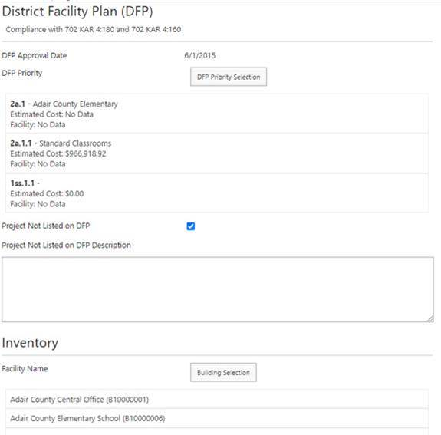
BG-1 and the DFP
BG-1 and DFP are now linked.
Select all appropriate DFP priorities and facility inventory for the project.
Selections cannot be edited after initial BG-1 approval!

Slide 23
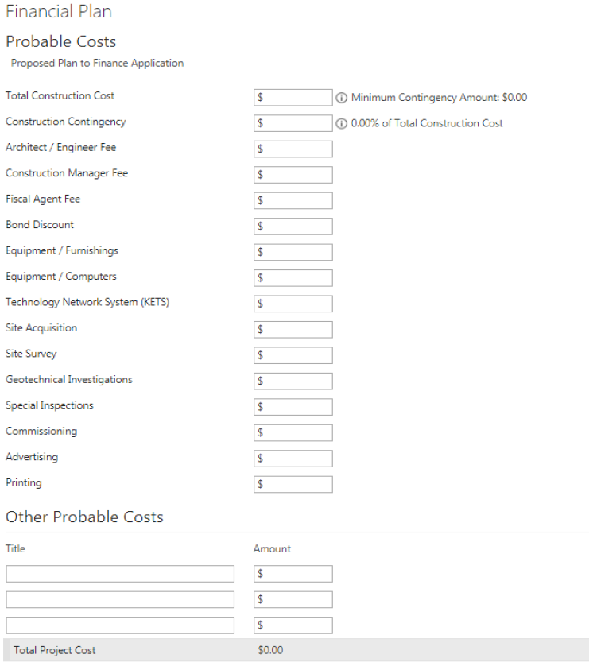
BG-1 Financial Plan - Costs
Probable Costs must equal Funds Available.
Construction Contingency- minimum of 5% is calculated - may be increased by District.

Slide 24
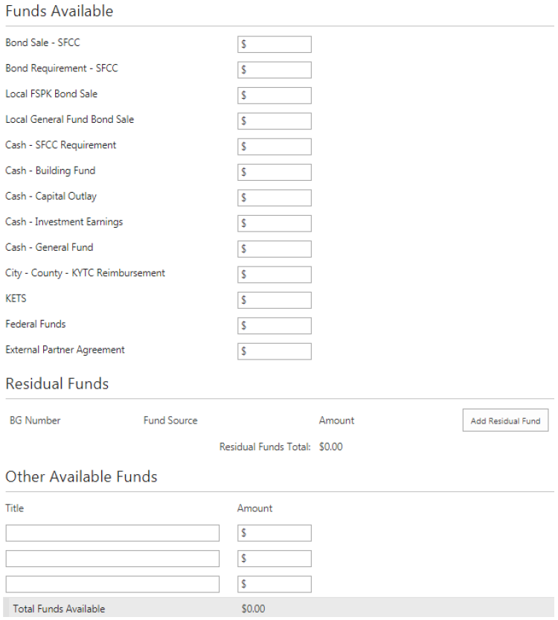
BG-1 Financial Plan - Funding
SFCC funds are to be used for projects in the highest DFP priority.
Capital Funds Requests are processed after the initial BG-1 submission.

Slide 25
BG-1 Financial Plan - Funding
Other Available Funds are those for which a dedicated line item is not provided. Appropriate documentation is to be attached to the BG-1 submitted to KDE.
Examples include:
School Security Funds (SSR Form)
ESSER II Funds (GMAP documentation)
External Partnership (such as Booster Clubs) Agreement (a shell is available on KDE Facilities webpage).

Slide 26
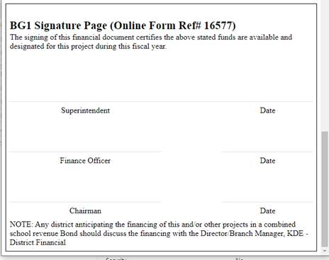
Submitting a BG-1 to KDE
Print the BG-1, receive Board approval and have it signed by the appropriate parties. All District signatures and dates are required for KDE approval.

Slide 27
Submitting a BG-1 to KDE
Scan all pages of the BG-1, save as a pdf and attach it to the online FACPAC BG-1.
Confirm that the BG-1 has been saved and submitted to KDE.
A BG-1 submitted without the above will be returned Incomplete. All parties with FACPAC access for the project will receive an email notification.
Approved initial BG-1’s will receive a procedural checklist. This will be discussed at the next training session.

Slide 28
Do
Verify the following before submission to KDE:
Project is appropriately titled.
Applicable Item checklist is correct.
DFP Priority and Facilities are listed.
Appropriate Fund Sources are used and documented as needed.
Probable Costs equal Funds Available.
FACPAC BG-1 is attached and signed by all parties.

Slide 29
Don’t
Don’t use old BG-1 forms.
Don’t round costs.
Don’t submit project documents until after an initial BG-1 has been approved by KDE.

Slide 30
Future Training Sessions
Future presentations will discuss:
The checklist sent with an approved initial BG-1 and Tiering.
Document submissions during design phases.
Post-bid revised BG-1’s and related submissions.
Submissions during the construction phase.
BG-4 construction closeout.
BG-5 project closeout.
Site acquisitions.

Slide 31
KDE Contact Information
District Facilities Branch
Greg Dunbar, Manager
greg.dunbar@education.ky.gov
Denise Hartsfield, FACPAC Administrator
denise.hartsfield@education.ky.gov

Slide 32
KDE Contact Information
District Facilities Branch
James Bauman, Project Manager
james.bauman@education.ky.gov
John Gilbert, Project Manager
john.gilbert@education.ky.gov
Marcus Highland, Project Manager
marcus.highland@education.ky.gov
Gary Leist, Project Manager
gary.leist@education.ky.gov

Slide 33
KDE Contact Information
Division of District Support
Jeff Coulter
jeffrey.coulter@education.ky.gov

Slide 34
Q&A
This presentation will be available on the KDE Facilities website.

