Slide 1
Facilities Reg Revision
Review & Feedback
February 16, 2023

Slide 2
HB 678 Introduction
Until June 30, 2024, boards may elect to operate under HB 678 provisions which eliminates certain KDE prior approvals.
153 districts currently have adopted HB 678.
Districts must still follow all applicable statutes and regulations.
Districts may commence funding, financing, design, construction, renovation, or modification of district facility projects without prior approval from KDE.
Districts may use architect or engineer to estimate the cost of the project in advance of financing.

Slide 3
HB 678 Introduction (Cont.)
KDE has 30 business days to approve:
Completed District Facility Plans (DFP), requests for acquisition of property, and requests for disposal of property.
As of January 10, 2023, 13 completed DFPs and 39 requests for acquisition or disposal of property.
On average, 8.9 days for approval of DFPs and 10.4 days for property acquisition or disposal.
KDE to provide requested technical assistance and guidance to local boards.
BG-1 Project Applications are filed with KDE for record keeping and data collection.

Slide 4
HB 678 Introduction (Cont.1)
Act is retroactive and applicable to outstanding submissions and requests made prior to the effective date.
Districts may include extracurricular facilities in any priority on a district DFP (allows restricted funds to be utilized for extracurricular facilities).
KDE prior approval still required for federal funds.

Slide 5
HB 678 Scope of Review
By June 30, 2023, KDE shall conduct a review of administrative regulations, incorporated materials, design manuals, and district guidance materials relating to the construction, renovation, and modification of school facilities to identify inefficiencies in the review and approval process.
Identify needed updates to regulations/materials due to changing trends in facilities design, construction industry and economy.
Including most commonly granted waivers and make changes to eliminate them.

Slide 6
HB 678 Scope of Review (Cont.)
Review procedures for conducting reviews and approvals related to the funding, financing, design, construction, renovation, or modification of the district's facilities to increase efficiencies.
Consult with the Department of Housing, Buildings, and Construction regarding enforcement of administrative regulations.
By September 1, 2023, KDE shall submit the results of the required review to the legislature. The report may include suggested changes to statutes for the General Assembly to consider during the 2024 Regular Session.

Slide 7
HB 678 Provisions to Retain
KDE is supportive of permanent statutory revisions to effectuate the following:
Local boards may continue to operate under provisions of HB 678 which allow them to approve their own funding, financing, design, construction, renovation, or modifications of the district's facilities without KDE prior approval with appropriate professional development of district staff.
Approval of a complete district facility plan, a request for acquisition of property, or a request for disposal of surplus property within 30 business days by KDE.
Capital funds usage being approved by local boards of education in compliance with KRS 157.420.
Continued use of restricted funds on extracurricular facilities.
Local board approval of agreements previously approved by KDE.

Slide 8
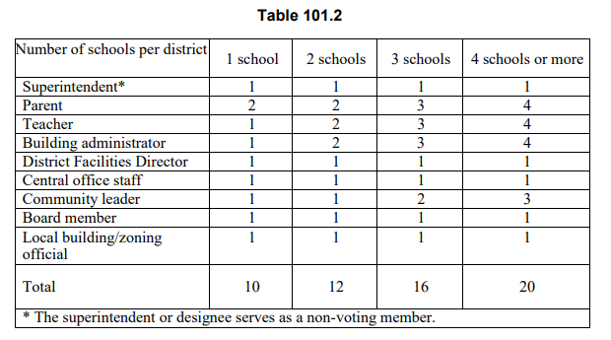
Planning Manual 702 KAR 4:180
Summary of changes:
Reduce LPC membership based on district size.
Current LPC selection.

Slide 9
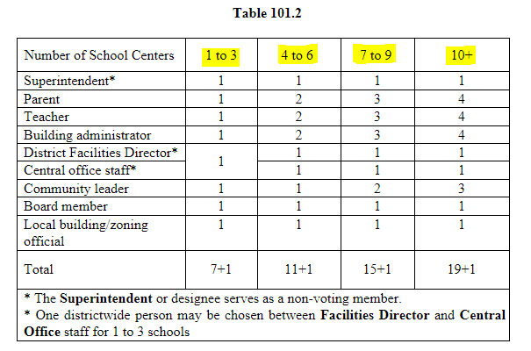
Planning Manual (Cont.) 702 KAR 4:180
Proposed LPC selection.

Slide 10
Planning Manual (Cont.1) 702 KAR 4:180
Summary of changes:
Clarify roles & responsibilities for all parties involved in the process:
Local Board of Education
Local Planning Committee
KDE & KBE
Architects and engineers
Consolidated meetings requirements.
Further defined Priority 5 projects for reporting purposes:
5(a) Additions to existing buildings exceeding 125% of the model program and/or renovation of spaces less than 30 years old.
5(b) Extracurricular facilities - Construction of field houses; stadiums; sports field facilities; or athletic facilities used for KHSAA sanctioned events.
5(c) Facilities that do not qualify in any other priorities.

Slide 11
Planning Manual (Cont.2) 702 KAR 4:180
Summary of changes:
Revise the model programs of spaces to reflect current educational practices.
Move DFP approvals to KDE with appeals to KBE.
Provide language to continue the HB678 practice of 30 business days for approval of complete submissions.
Simplify the request to extend DFP from 4 years to 8 years.
Eliminate duplication of assessments (KFICS & DFP).

Slide 12
Planning Manual 702 KAR 4:180 – Guiding Questions
Do LPC revisions allow district flexibility and efficiency while retaining transparency and public input?
Does the current definition of extracurricular facilities respond to contemporary student activities?
Should extracurricular facilities count towards unmet need?
What are your thoughts on using Capital Funds to employ a district facility administrator, design or construction professional?

Slide 13
Building Sites; Inspection & Approval | Easements 702 KAR 4:050
Provide the option for KDE to use virtual site inspections for minor acquisitions.
Address provisions for acquiring easements.
Include eminent domain and donation by definition.
Streamline property acquisition process through FACPAC.
Provide language to continue the HB678 practice of 30 business days for approval of complete submissions.
Distinguish between major acquisition & minor acquisition to expedite small property purchases.
Major Acquisition – site for a new building.
Minor Acquisition – expanding an existing site for building addition and/or site improvements.

Slide 14
Building Sites; Inspection & Approval | Easements 702 KAR 4:050 Cont.
Major Acquisition – Proposed purchase of a site for the construction of a new school, central office, bus garage or other facility.
Example: Acquisition of a site for a new school.
Minor Acquisition - Proposed purchase of a site to expand a site currently owned by a district for an addition or site improvements associated with an existing school, central office, bus garage or other facility.
Example: Acquisition of a house or small property adjacent to an existing school, upon the site inspection and discussion with the district, KDE will identify the items that are not applicable to the site.

Slide 15
Building Sites; Inspection & Approval | Easements 702 KAR 4:050 – Guiding Questions
Do you have any additional suggestions for defining Minor Acquisition?
What other issues have you encountered during the acquisition process that should be addressed?

Slide 16
Planning Manual & Facilities Analysis 702 KAR 4:180 (Chapter 3) as informed by 702 KAR 4:170
Increase Locally Identified Program Space Allowance (LIPSA).
Remove Career and Technology Education (CTE) program review from the District Support Services to the Office of Career and Technology Education (OCTE).
Remove existing Locally Identified Career and Technology Education Allowance from Model Program Spaces.

Slide 17
Planning Manual & Facilities Analysis (Cont.) 702 KAR 4:180 (Chapter 3) as informed by 702 KAR 4:170
Administration suite increases.
The Safety Resource Officer (SRO) has a defined area.
Guidance counseling changing to school counseling with 1 office per 250 students (KRS 158.4416).
For larger schools, proportional increase in square footage for administrative spaces.
Increased conference room size.
Increased size of the principal’s office.
Special Education classroom sizes have been increased.

Slide 18
Planning Manual & Facilities Analysis (Cont.1) 702 KAR 4:180 (Chapter 3) as informed by 702 KAR 4:170
Redefine and rename computer classrooms to digital labs.
Increase auditorium space to accommodate storage.
The Family Resource Center area increases from 300 nsf to 500 nsf.
Elementary school changes:
Add area to the gym space to permit bleachers for the student population to be seated without going over the playing surface.
Add the elementary science classroom in Model Programs of Spaces.

Slide 19
Planning Manual & Facilities Analysis 702 KAR 4:180 (Chapter 3) as informed by 702 KAR 4:170 Guiding Questions
Are the revisions of the model program of spaces sufficient to mitigate waiver requests?
Are there any basic curriculum requirements not addressed by the Model Programs?

Slide 20
Capital Construction Process 702 KAR 4:160
All reviews, approvals, and retention of documentation previously performed at the KDE level have been moved to the local board of education.
Emphasize local board responsibilities related to compliance with statutes, regulations, and the constitutional use of funds.
Provide separate processes for emergency projects related to temporary loss of use and permanent loss of use.
Adjust language for the procurement of architectural and construction managements services.

Slide 21
Capital Construction Process (Cont.) 702 KAR 4:160
Raise the construction cost threshold from $2M to $5M for Construction Management jobs.
Add Construction Manager as Constructor option.
Combine the Schematic Design and Design Development processes into one Design Document process.
Add a new section for Cooperative Purchase Agreement.

Slide 22
Capital Construction Process (Cont.1) 702 KAR 4:160
Update GESC section to correspond with the FACPAC process for other delivery methods.
Eliminate Letter of Intent
Require an initial BG-1 to start project.
Provide a proposed GESC Summary Form for local board review to document compliance with statutory requirements.
Adjust Change Order language to:
Provide final approval of all Change Orders at the local board level.
Add language to require revised BG-1 approval by the local board before approving Change Order in excess of remaining project contingency.
Clarify BG-5 Project Closeout Forms.
Add a requirement to update KFICS at the project closeout.

Slide 23
Capital Construction Process 702 KAR 4:160 – Guiding Questions
What would be the district concerns for KDE review and comment of initial BG-1, revised BG-1, and BG-5?
With the shift to more local autonomy, what professional development or training opportunities are necessary for local facility leaders?

