Slide 1
Epidemiology Made Simple for the SCHOOL NURSE
Angie McDonald ADN, RN, NASSNC
KDE State School Nurse Consultant
Michelle Malicote BSN, RN, NASSNC
KDPH School Health Branch Manager
2022

Slide 2
Objectives:
Understand what epidemiology is and what an epidemiologist does
Can identify the kinds of infectious diseases that might be found in schools
Understand what an "outbreak" is and how it is investigated
Identify components of the EPI-TRIANGLE
Can calculate incidence, prevalence and rate for a community
Can identify strategies for implementing primary, secondary and tertiary prevention in the school setting

Slide 3
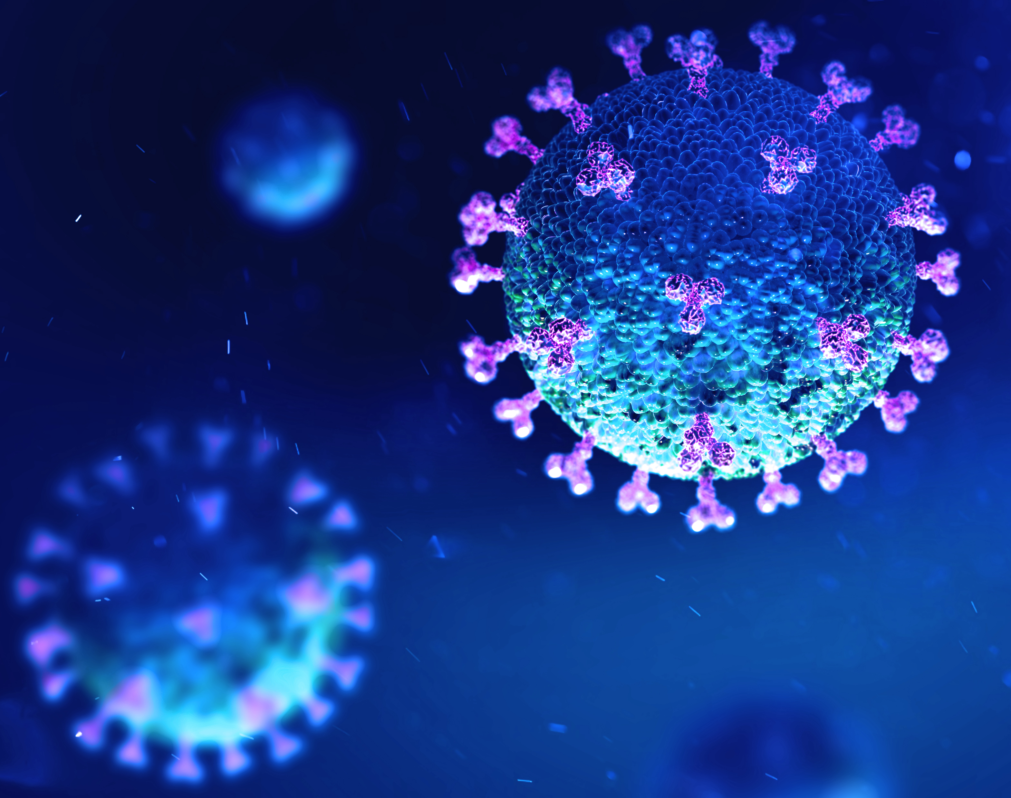
Epidemiology is:
The study of the spread, transmission and incidences of disease or injury within a population and the application of that study to the control of health problems

Slide 4
What does an epidemiologist do?
Studies disease and public health issues and tries to produce solutions on how to fix them

Slide 5
The Purpose of Epidemiology in Public Health Practice is to:
•Discover the agent, host and environmental factors that affect health
•Determine the relative importance of causes of illness, disability and death
•Identify those segments of the population that have the greatest risk from specific causes of ill health
•Evaluate the effectiveness of health programs and services in improving population health

Slide 6
Epidemiology Key Terms:
Epidemic or Outbreak: disease occurrence among a population that is in excess of what is expected in a given time and place.
Cluster: group of cases in a specific time and place that might be more than expected
Endemic: disease or condition present among a population at all times
Pandemic: a disease or condition that spreads across regions
Rate: number of cases occurring during a specific period; always dependent on the size of the population during that period

Slide 7
Infectious Diseases are:
Diseases caused by microbes and that spread. The reason for most sick days for both kids and teachers is an infectious disease. There are many from the common cold, ear infections, tonsillitis and the flu (influenza) to pneumonia and mononucleosis
Caused by microbes — organisms too small to be visible to the naked eye. The most common infectious disease-causing microbes are bacteria, viruses, fungi and protozoa (a type of parasite)
The diseases may be passed from person-to-person (for example, if someone coughs or sneezes on another person). Sometimes, the disease is passed through another medium, for example, by drinking water or eating food infected with bacteria
Some diseases, such as Lyme disease, are passed from an animal carrier (including insects and worms) to humans. Deer ticks pick up Lyme disease from small animals such as mice (who don’t even get sick from the disease), lay their eggs and travel around on deer, and sometimes end up on humans who can get sick if bitten. (Ticks, fleas, mosquitoes, flies and cockroaches all can carry disease, so it is best to protect your body, food, water and homes from them.)
Sometimes, infectious diseases develop new strains that resist older treatments. During the 1980s, tuberculosis (TB) — a disease that had nearly been eliminated in developed countries through successful treatments with antibiotics — reemerged
In some cases, the new strain of TB was drug-resistant (antibiotics that worked before now did not work)

Slide 8
An outbreak or an epidemic exists when:
There are more cases of a particular disease than expected in a given area, or among a specific group of people, over a particular period of time
Another other term you might come across is endemic, when a population has a high level of the disease all the time

Slide 9
A Model to study HEALTH PROBLEMS:
The Epidemiologic Triangle, sometimes referred to as the Epidemiologic Triad, is a tool that scientists use for addressing the three components that contribute to the spread of disease: an external agent, a susceptible host and an environment that brings the agent and host together

Slide 10
The Agent—“What”
Vertex 1. The Agent—“What”- The agent is the cause of the disease. The agent is usually a microbe, an organism too small to be seen with the naked eye. Most people call an agent a “germ”
Bacteria
Virus
Fungi
Protozoa

Slide 11
The Host — “Who”
Vertex 2. The Host — “Who”- Hosts are organisms, usually humans or animals, which have been exposed to and harbor a disease. The host can be the organism that gets sick, as well as any animal carrier (including insects and worms) that may or may not get sick. The same microbe affects different hosts in different ways
Although the host may or may not know it has the disease or have any outward signs of illness, the disease does take lodging from the host. The “host” heading also includes symptoms of the disease. Different people may have different reactions to the same agent. For example, adults infected with the virus varicella (chickenpox) are more likely than children to develop serious complications

Slide 12
The Environment—“Where”
Vertex 3. The Environment — “Where”- The environment is the favorable surroundings and conditions outside the host that cause or allow the disease to be transmitted. Some diseases live best in dirty water. Others can survive only in blood
Many infectious disease microbes live in the mucus in your nose and mouth
Still others, like E. coli, thrive in warm temperatures, but are killed by high heat. Other environment factors include the season of the year (in the U.S., the peak of the flu season is between November and March, for example)

Slide 13
TIME:
In the center of the Triangle is time. Most infectious diseases have an incubation period — the time between when the host is infected and when disease symptoms occur
Time may also describe the duration of the illness or the amount of time a person can be sick before death or recovery occurs
Time also describes the period from an infection to the threshold of an epidemic for a population

Slide 14
Slide 14
The mission of an epidemiologist is to break at least one of the sides of the triangle, disrupting the connection between the environment, the host and
the agent and stopping the continuation of disease

Slide 15
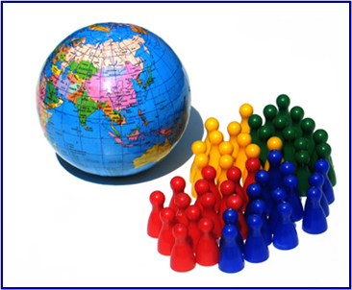
Comparing Population Characteristics:
Rates help us compare health problems among different populations that include two or more groups who differ by a selected characteristic

Slide 16
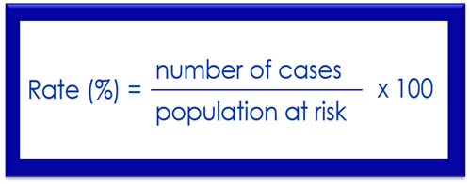
Rate Formula:
To calculate a rate, we first need to determine the frequency of disease, which includes:
•the number of cases of the illness or condition we are counting,
•the size of the population at risk, and
•the period during which we are calculating the rate.
After the frequency of disease is identified, the illness rate is calculated by dividing the number of cases of disease for the selected period by the size of the population at risk for that same period. Then, that number is multiplied by 100
This formula provides the number of cases as a percentage of the population for a given period

Slide 17
Incidence and prevalence:
Incidence:
Number of NEW cases of a disease or injury within a population during a specified amount of time
Prevalence:
Number of ALL cases of a disease or injury within a population during a specified amount of time, includes both new and pre-existing cases

Slide 18
Outbreak Investigation:
These steps include:
•establishing the existence of an outbreak
•preparing for fieldwork
•verifying the diagnosis
•defining and identifying cases
•using descriptive epidemiology
•developing hypotheses
•evaluating the hypotheses
•refining the hypotheses
•implementing control and prevention measures and communicating findings

Slide 19
Contract Tracing:
Rapid notification of exposure
Contact interview
a. Testing and Quarantine/isolation instructions
b. Assessing self-quarantine needs
3. Medical monitoring
a. Monitoring and isolation instructions
4. Contact close out
CDC Contact Tracing

Slide 20
Contact Tracing Workflow

Slide 21
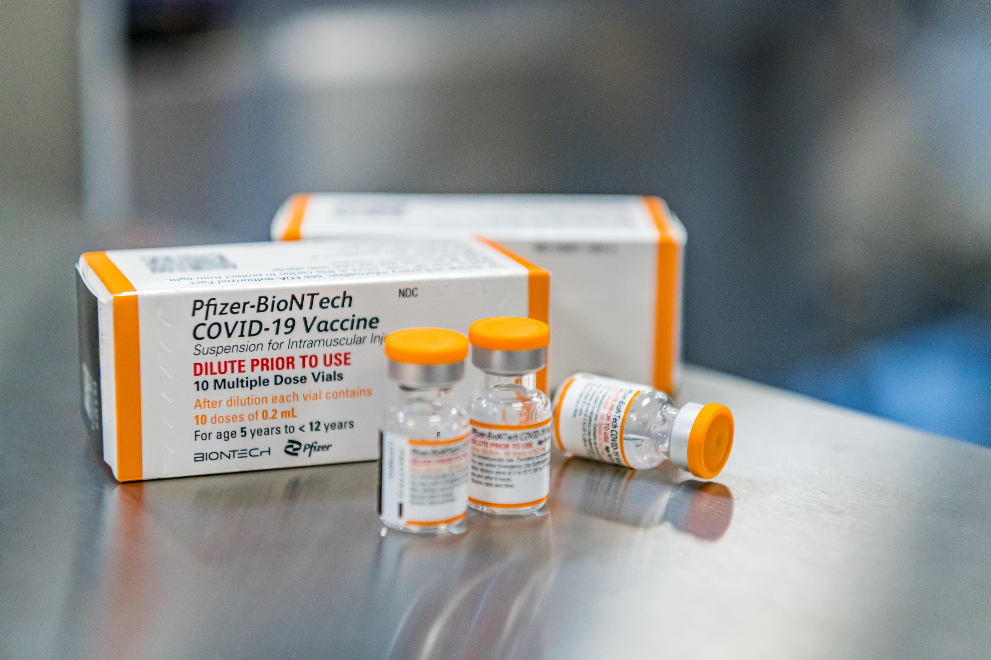
PRIMARY PREVENTION:
Is when we prevent the initial occurrence of a disease.
When we give a vaccine, the goal is to prevent that child from ever getting that disease (or a milder case if they get that disease)

Slide 22
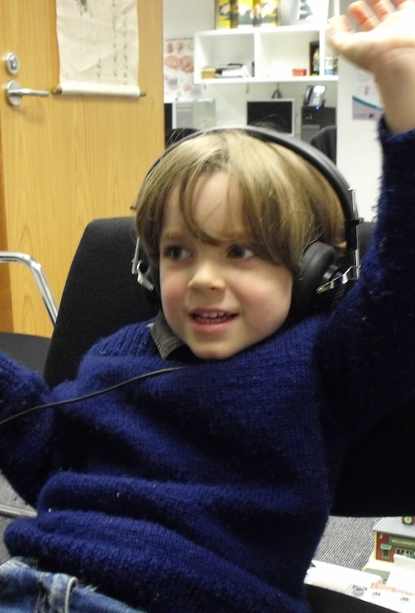
SECONDARY PREVENTION:
Focus on “early detection” of the disease so we can limit the severity of the disease
Key secondary prevention activity are SCREENINGS…………
Screening to catch early and limit the severity
This Photo by Unknown Author is licensed under CC BY

Slide 23
TERTIARY PREVENTION:
Trying to “maximize recovery” after an illness or injury
This is where a population or person has already been diagnosed with disease or illness and we are trying to maximize their recovery
Examples might include rehabilitation, physical therapy and occupational therapy, as well as support groups”

Slide 24
References:
Understanding the Epidemiologic Triangle through Infectious Disease
Epidemology, Incidence, Prevalence, Community Education and Prevention "YOU TUBE VIDEO"
CDC Introduction to Epidemology
CDC Contract Tracing for COVID-19

Slide 25
Contact Information:
Angie McDonald ADN, RN, NASSNC
KDE State School Nurse Consultant
Angela.Mcdonald@education.ky.gov
Michelle Malicote BSN, RN, NASSNC
KDPH School Health Branch Manager
Michelle.Malicote@ky.gov

