Slide 1
Roles and Responsibilities of School Councils
A three-hour training for experienced
SBDM Council Members

Slide 2
Agenda
Introductions
Session and Student Achievement Overviews
Roles & Responsibilities of Each Member
Basic Legal Functions and Limitations of a School Council
Student Achievement & the Future of Education
Successful School Councils
Transparency & Inclusivity
Closing/Evaluations/EILAS

Slide 3
Objectives
By the end of this training, participants will be able to…
Distinguish the roles and responsibilities of each school council member,
Understand the basic legal functions of a school council,
Recognize their role with student achievement, and
Analyze successful and unsuccessful practices of school councils.

Slide 4
Student Achievement
The school council’s mission is to improve student achievement (KRS 160.345(2)(c)). Each school council must create an environment in its school that will result in students achieving at high levels. All policies and decisions by the school council must contribute to achievement of the overall school’s mission.

Slide 5
Basic Legal Functions of a School Council
Curriculum, Instruction, and Assessment
Schedules, Staffing, and Safe and Healthy Facilities
Improvement Planning and Budgets
Operating Procedures

Slide 6
Council Limitations
Run the school on a day-to-day basis
Break contracts
Break state or federal statutes and regulations
Spend funds that the school does not have
Make decisions outside the areas of authority

Slide 7
Final Reflection
What did I learn about my specific role on the SBDM council?
What steps could I take today to be a more effective school council member that fulfills my responsibilities?

Slide 8
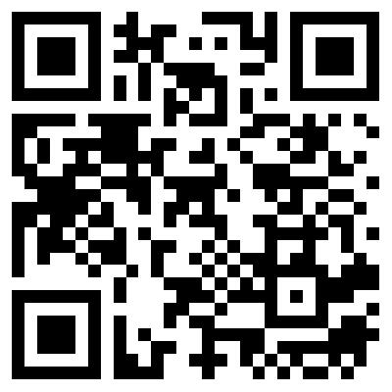
Training Evaluation
Thank you for participating in the annual school-based decision making (SBDM) training! ​
Please take the time to complete the evaluation below, which focuses on the training’s content and the delivery strategies used:​
https://forms.gle/i8o8yQMT2FwJx9gx9
If you have a device with a camera (phone, tablet, etc..), you may scan the QR Code for quick access to the evaluation:

