Slide 1
Equitable Decision-Making
A three-hour training for experienced SBDM council members

Slide 2
Agenda
Welcome & Introductions
Session Overview and Objectives
Decision Making Through Equity Lens
Why Equity Matters
Break
Perceived Benefits of Equity
School Policies vs. Decisions
Equity Evaluation
Quotable Quotes and Metaphor of a Lens
Assessment of School’s Culture
Closing

Slide 3
Objectives
After this training, council members will be able to...
Understand differences between equality and equity;
Understand how equitable decision-making impacts student achievement; and
Understand the importance of committing to equitable practices.

Slide 4
Equality vs. Equity
“Solving the Achievement Gap Through Equity, Not Equality”
https://youtu.be/nOQbu_3M0_Q

Slide 5
5
Equality
Equity

Slide 6
Equity Defined
The promotion of access, opportunity and advancement of all individuals, including those in underserved communities, in order to identify and eliminate conditions that prevent the ability of all students to reach their full potential.
The term ‘underserved communities’ refers to populations sharing a particular characteristic, as well as geographic communities, that have been systematically denied a full opportunity to participate in aspects of economic, social, and civic life.
January 2021 President Biden’s Executive Order On Advancing Racial Equity and Support for Underserved Communities Through the Federal Government

Slide 7
Why Equity Matters to SBDM Councils
SBDM councils are tasked with a variety of responsibilities related to student achievement:
Policy development, including, but not limited to the following: writing program, technology, discipline, school schedule, extracurricular and wellness
Consulting on selection of the school’s principal
Collaborating with other shareholders to develop the Comprehensive School Improvement Plan (CSIP)
Adopting a budget aligned to instructional needs
Determining the emergency plan and professional development plan
Setting targets to close the achievement gap
Annually reviewing school assessment data
Consulting with the school’s library media specialist on needs of the media center
Consulting on both certified and classified vacancies
Determining the number of positions for each job classification

Slide 8
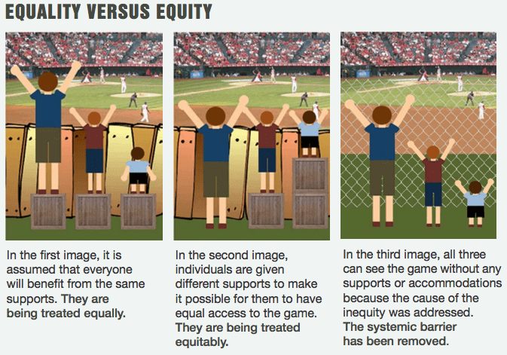
8
https://www.diffen.com/difference/Image:Equality-equity-justice-lores.png

Slide 9
9

Slide 10
Policy Considerations
Policies should be more than compliance driven and should be focused on a commitment to improving student achievement.
Policies should not be written to address a specific situation that should be handled on a more personal basis.
Policies should be proactive – not reactive!
Policies should not be written in a manner that set staff up to be in violation of the requirements of the policy.

Slide 11
Council Decisions
When the council was made aware of its allotted professional development funds, the council agreed to use all the funds on math professional development. The math scores at the school are above average. All three teachers on the council are math teachers at Wildcat High School.

Slide 12
Council Decisions
As the SBDM council at Cardinal Middle School began reviewing its budget and Section 6 funds, the council was made aware that there was a request made by the special education teachers for additional technology in their department. The current technology is outdated and not working properly. Students use the technology daily to help them read, learn to write and hone their listening skills in their classrooms. The council granted the department’s request.

Slide 13
Council Decisions
At a special meeting, the council approved a policy in which high school students would not be allowed to attend prom if they had five unexcused absences – regardless of the circumstance.

Slide 14
Council Decisions
During a regular SBDM council meeting, a parent was allowed time to voice a concern during public comment. The parent expressed the desire for the council to modify its discipline policy to include a consequence for any student not speaking in English in the hallway. Due to a surplus of jobs, the community’s English learner population has recently grown. The council altered the policy to include this caveat.

Slide 15
Council Decisions
The council recently decided to add to the list of extracurricular programs offered at the school an advocacy program geared toward mental health. The community is experiencing an increase in poverty, drug abuse and crime, so they are hoping this program helps those students whose families have fallen victim to any of the above.

Slide 16
Quotable Quotes
“We must concern ourselves with cultivating the best conditions for all students to learn at very high levels.”
Notes:
Natasha

Slide 17
Quotable Quotes
“Don’t limit a child to your own learning, for he was born in another time.”
–Tagore
Notes:
Natasha

Slide 18
Quotable Quotes
“Ethical does not simply mean keeping your nose clean. Avoiding wrong is not enough. The imperative is to do right. Making good things happen for people is ethical.”
Notes:
Natasha

Slide 19
Questions
Notes:
Ashlie

Slide 20
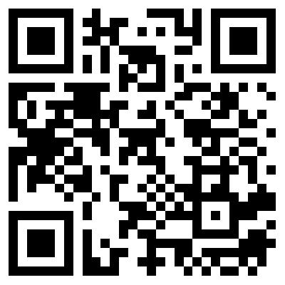
Training Evaluation
Thank you for participating in the annual school-based decision making (SBDM) training!
Please take the time to complete the evaluation below, which focuses on the training’s content and the delivery strategies used
https://forms.gle/i8o8yQMT2FwJx9gx9
If you have a device with a camera (phone, tablet, etc..), you may scan the QR Code for quick access to the evaluation:

