Slide 1
Kentucky DAC TestNav Training
Spring 2024
Image by Pearson

Slide 2
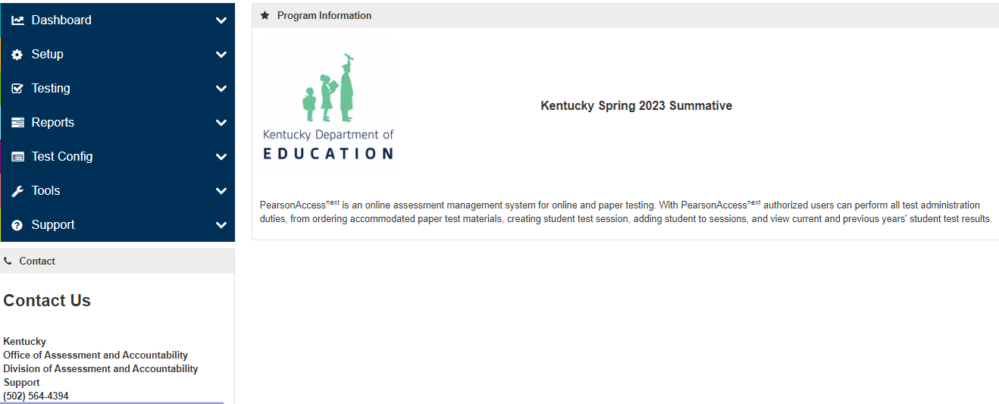
Online Testing Components
PearsonAccess^{next}
Manage student data and online test sessions
Blue Secure site and brown Training site

Slide 3
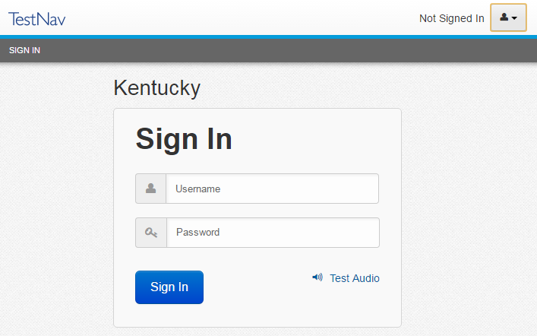
Online Testing Components (continued)
TestNav
Student test delivery engine
Technology staff will verify installation of TestNav app on student testing devices

Slide 4
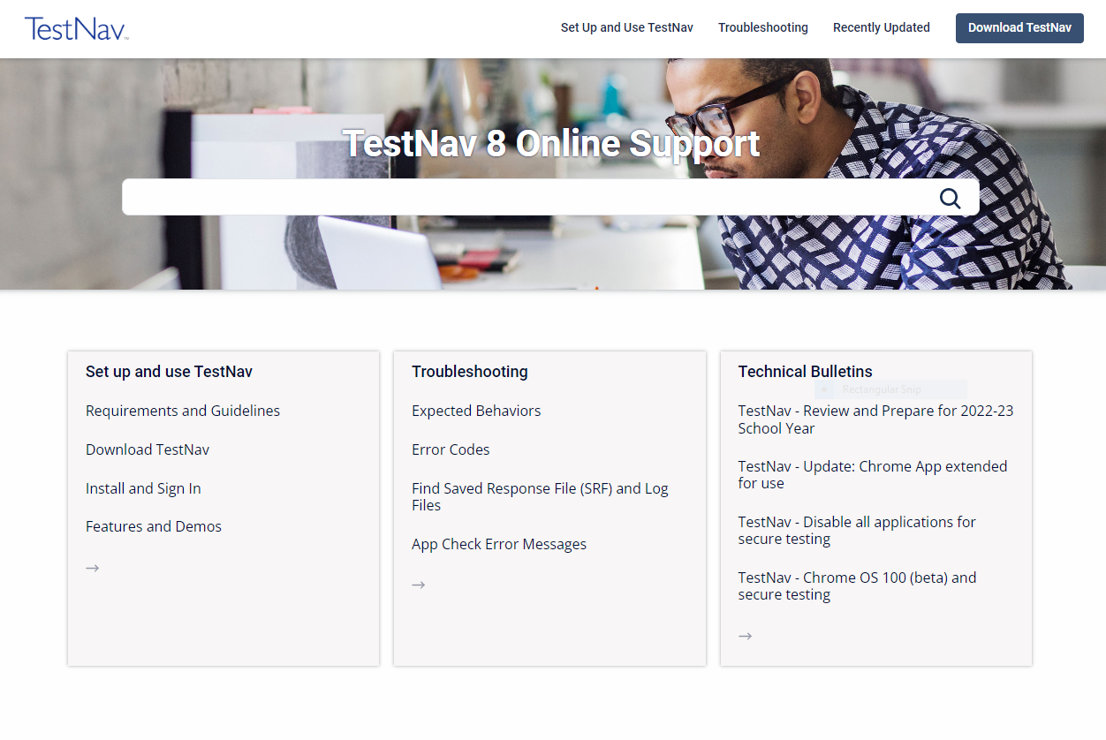
TestNav Online Support Page
Includes:
Instructions for setup
Troubleshooting steps
Technical bulletins
Recently Updated section

Slide 5
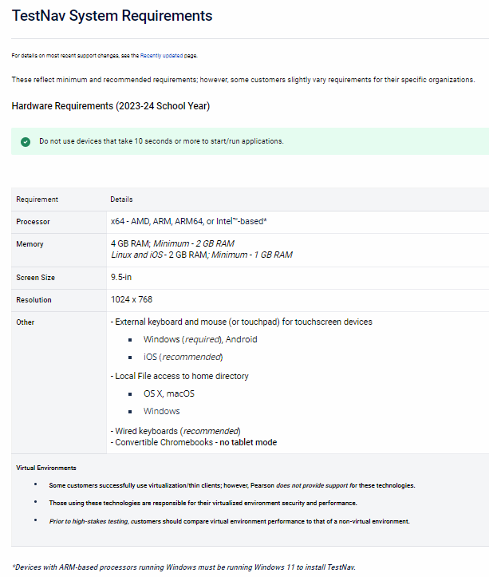
TestNav System Requirements
The Support site includes a TestNav System Requirements page.

Slide 6
Student TestNav Tutorials
Designed to help students become familiar with navigation, TestNav tools, and item types.
Tutorials are located on the Kentucky Portal.
Try It! feature allows students to perform most TestNav functions.
Students will launch the TestNav app from their testing device.

Slide 7
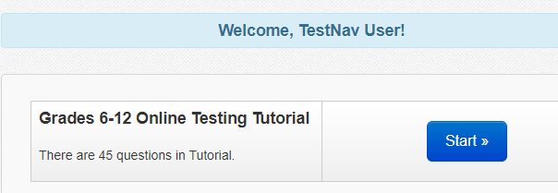
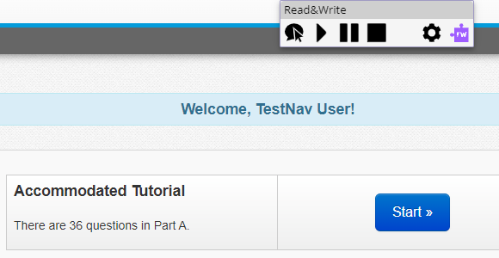
Start Tutorial
After accessing the TestNav Tutorial URL through a web browser, the TestNav screen will appear. Students will select the Start button to begin the tutorial. The student can move the Text to Speech bar from side to side across the top of their screen.

Slide 8
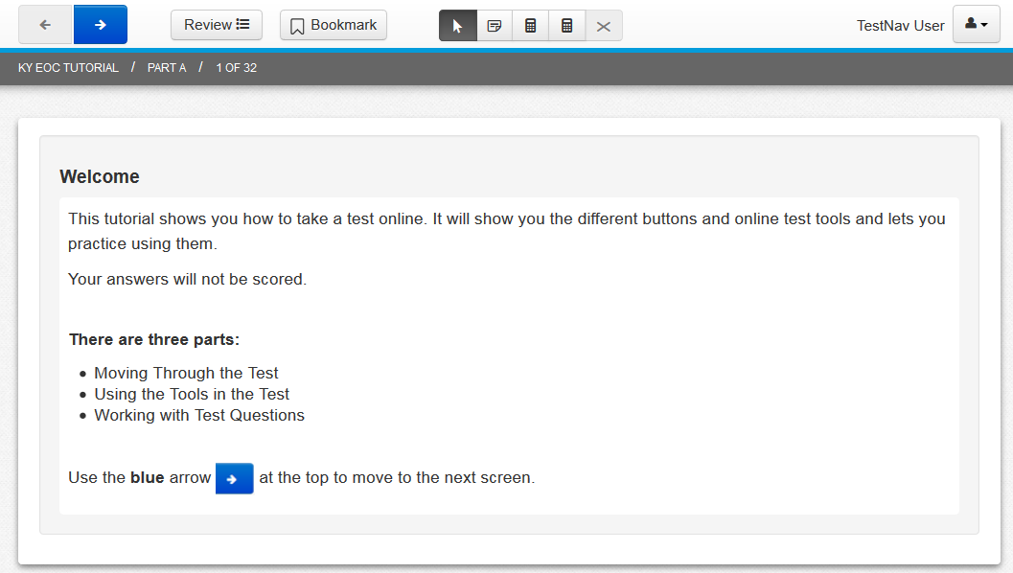
Welcome Screen
The Welcome screen introduces the tutorial and lists the three parts of the tutorial: Moving Through the Test, Using the Tools in the Test, and Working with Test Questions.

Slide 9
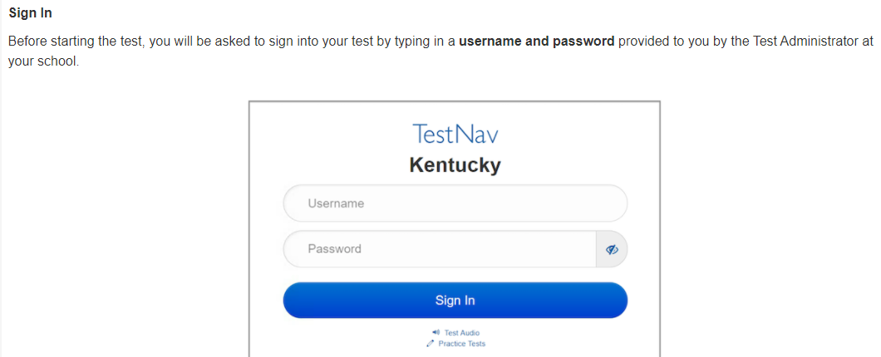
Getting Started

Slide 10
Getting Started continued

Slide 11
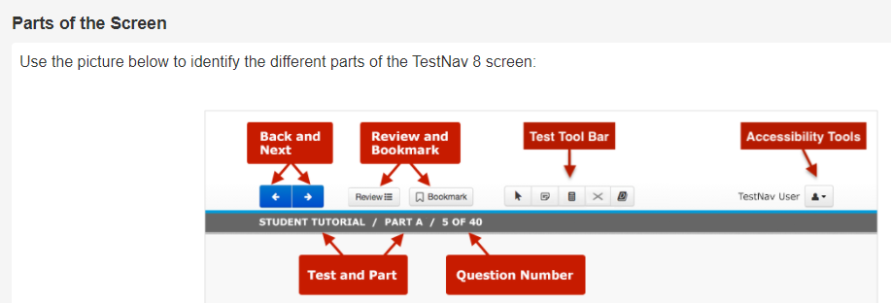
Parts of the Screen

Slide 12
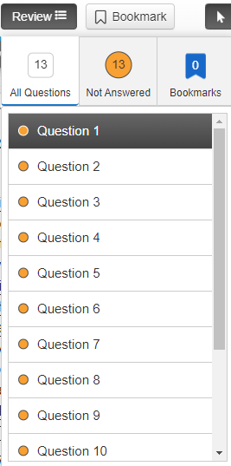
Review
The Review button lets students go back and review their answers at any time. When the Review button is selected, it shows all the questions in the part of a test.
The Review list shows the question number as well as the number of questions in the part students have not yet answered.
Bookmarked questions will also display here.

Slide 13
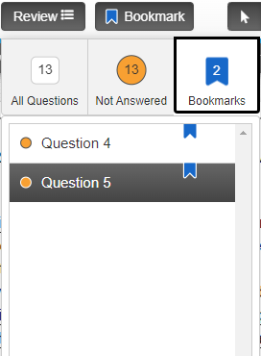
Bookmark
The Bookmark button lets students mark questions to review later.
When selected, a blue bookmark ribbon appears next to the questions on the Review list.

Slide 14
Reaching the End of a Part
When students reach the end of a part of a test, they will see the End of Part A or Part B screen.
The orange and blue section buttons tell students how many questions are not answered and how many questions are bookmarked. Students should answer all questions before they go on to the next section. Reading, Mathematics, and Social Studies will have a Part A and a Part B.

Slide 15
Submit Section
Students will select the Submit Section button to go to the next part.
A Section Exit Warning will pop up. Students will select No to go back and check their work or select Yes to complete the part. If Yes is selected, students cannot come back to this section later.

Slide 16
Exiting and Resuming the Test Later
To exit the test before completing it, students will select the button next to their name in the top right corner of the screen and then Sign out of TestNav.
Students will then select the Save and Return Later button.
Reading, Mathematics, and Social Studies will have Part A and Part B.

Slide 17
Submitting the Test
When students reach the end of the test, and are ready to submit the test for scoring, they will select the Submit Final Answers button.
They will then select Yes, Submit Final Answers. Reading, Mathematics, and Social Studies will have a Part A and Part B.

Slide 18
Using the Tools in the Test
Once in the toolbar students can select a tool button to open a tool. To close a tool, students will select the button again, or select the Pointer tool.
Students can use only one tool at a time.
Students will see tools only on questions where they are allowed to use them.

Slide 19
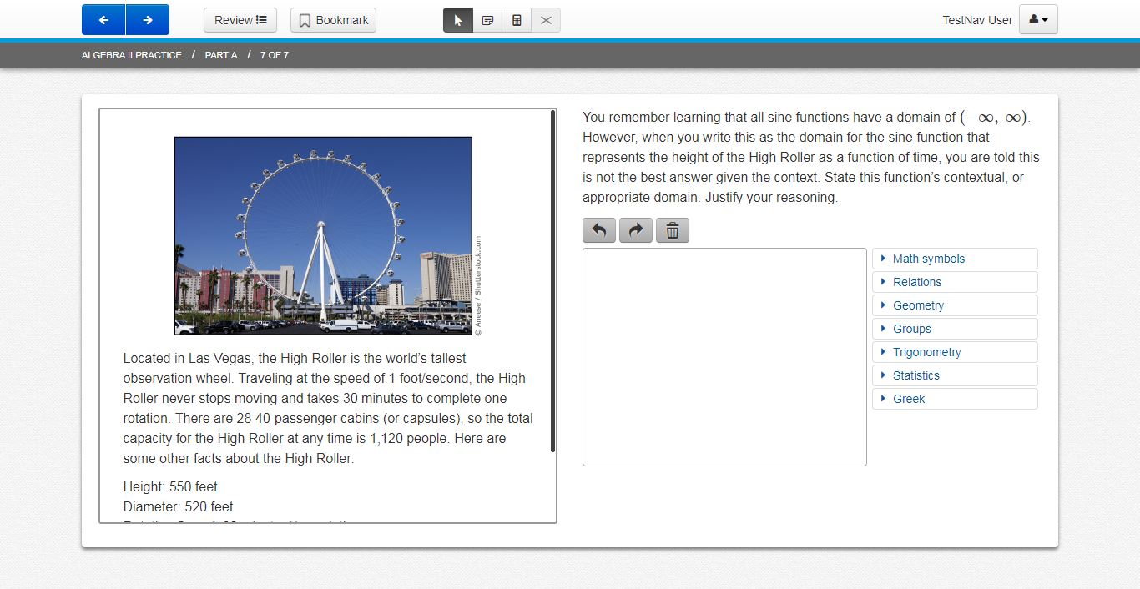
Pointer Tool
Students will use the Pointer tool to:
Select an answer
Drag an answer choice to the correct spot
Mark objects
Turn other tools on and off

Slide 20
Notepad
Students can write notes during the test using the Notepad tool.
To move the notepad screen, students will select the top of the notepad and drag it.
Selecting the Notepad button again will close the notepad.
If students return to the question later, they can see their notes again by selecting the Notepad button.
Students may copy and paste from the Notepad to their response area.
For reading, notes are saved for the whole passage. For other tests, notes are saved with each question.

Slide 21
TextHelp Text to Speech Tool
The purpose of the TextHelp Read&Write for TestNav (RW4TN) Extension is to provide a suite of access tools which can be used by students with disabilities who require testing accommodations on the secured state summative assessment. This information pertains to the text-to-speech (reading accommodation) function being used in Kentucky assessments.
Once installed, this extension creates a toolbar like the image below:

Slide 22
New TextHelp Text to Speech Tool continued
Each feature on the toolbar is discussed in the following tables:
Feature | Image | Description / Common Usage | Special Notes
Click Speech / Hover Speech |  | How this feature works can be modified in the Settings menu. Set the control to “click” if you want to click on the text to have it read. Set the control to “hover” if you want to move the mouse pointer to a location in the text and have it read without clicking. | The default setting is “click.” One benefit of the R&W “hover” speech functionality is that it can read answer selections without having to click on them (if the “hover” checkbox has been checked in the settings menu).
Play |  | Select a range of text and then click on the icon. Only this selection should be read. If no text has been selected before the icon is clicked on, then speech begins at the top of the page. | Students can use this feature to hear either the portion of selected text or the entire screen. Read&Write will not read back a student’s own writing in an extended response area.
Pause |  | Clicking will pause the current text-to-speech action. Clicking a second time will resume reading from the place where it was stopped.

Slide 23
New TextHelp Text to Speech Tool (continued 2)
The last two features on the toolbar are discussed below:
Feature | Image | Description / Common Usage | Special Notes
Stop |  | Clicking will stop the current TTS reading.
Settings |  | User can change reading speed, colors of synchronized highlighting, and behavior of the “click/hover” speech button. | Only one “Voice Name” is available in the pull-down menu.

Slide 24
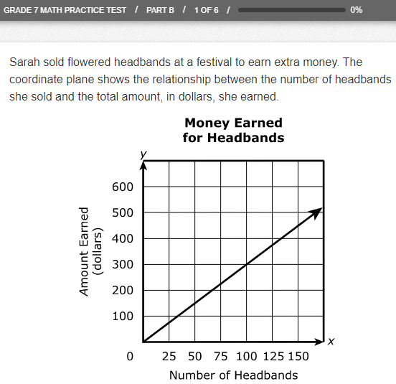
Calculators
Calculators will be available on some item sets.
On the item sets that allow a calculator, either a four function, a scientific or graphing calculator will appear when the Calculator button is selected.
To open the calculator, students will select the Calculator button.
To move the calculator on the screen, students will select the calculator and drag it.
Students can select the buttons or use their keyboard to use the calculator.
Selecting the Calculator button again closes the calculator.

Slide 25
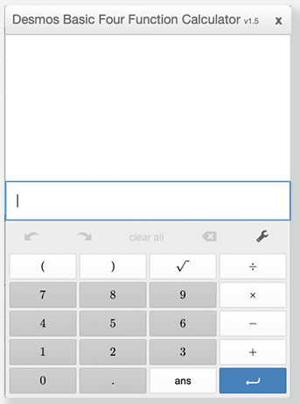
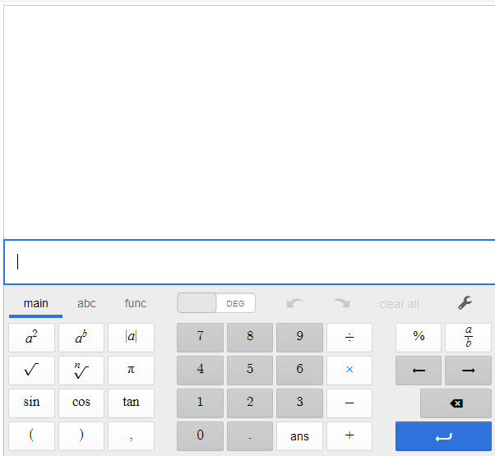
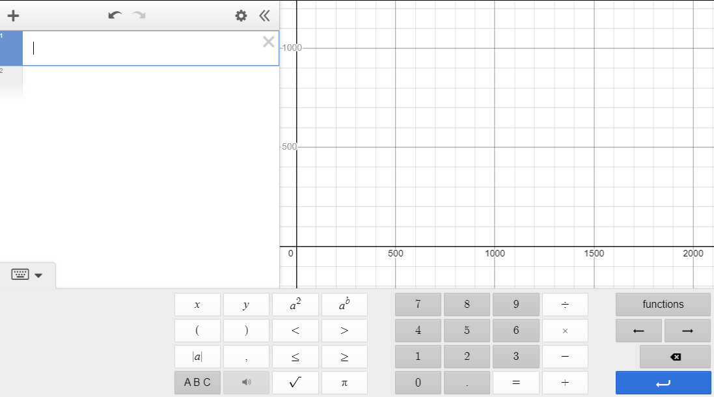
Tutorial Calculators
The tutorial will display icons for the calculator so students will be able to interact with a four function, a scientific, or a graphing calculator.
Students will not see all the calculators together on an item during the test.
Desmos Basic Four Function Desmos Scientific Calculator Desmos Graphing Calculator

Slide 26
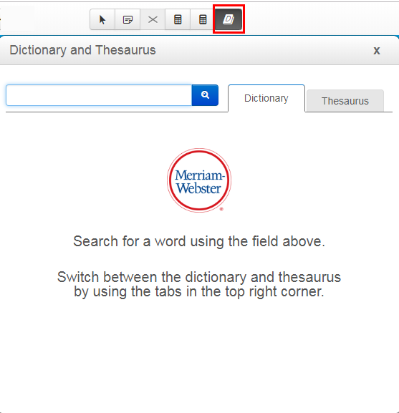
Dictionary
To open the dictionary, students will select the Dictionary button.
Students can search for a word.
This is in On-Demand Writing only.

Slide 27
Answer Eliminator
Multiple choice and multiple select questions have an Answer Eliminator tool.
Students can use this tool to cross out answer choices they think are incorrect.

Slide 28
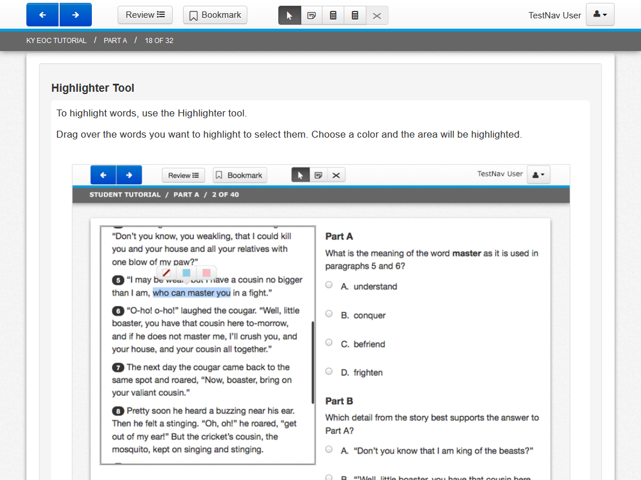
Highlighter Tool
To highlight words, students can use the Highlighter tool.
They can click and drag the mouse over the words they want to highlight to select them. They can choose a color and the area will be highlighted.
Selecting the words again and choosing Unhighlight will remove the highlighting.

Slide 29
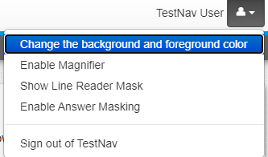
Tools in the User Dropdown Menu
Some tools are selected from the User dropdown menu.
These tools include Change the background and foreground color, Enable Magnifier, Line Reader Mask, and Enable Answer Masking.

Slide 30
Color Contrast Tool
The Color Contrast tool lets students choose the color of the words and screen.
After selecting Change the background and foreground color from the User dropdown menu, the color choices will appear.
Students will select their choice and select Continue.
The color setting students select will show until another choice is made.

Slide 31
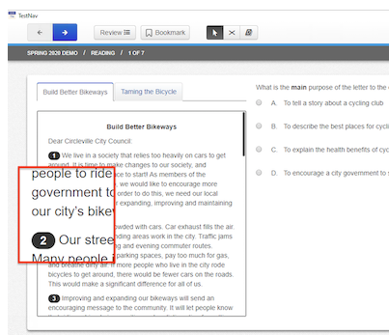
Magnifier Tool
The Magnifier tool lets students make part of the screen larger.
After selecting Enable Magnifier from the User dropdown menu, students can drag the magnifier over the area they want to make larger.
Students will then select Disable Magnifier and enter their answer.

Slide 32
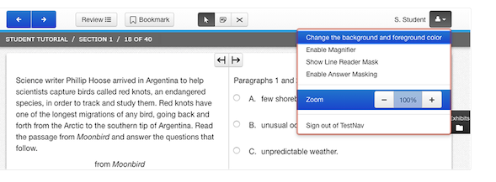
Zoom
Students can also zoom the entire screen larger.
The Zoom tool can be used to make the screen larger.

Slide 33
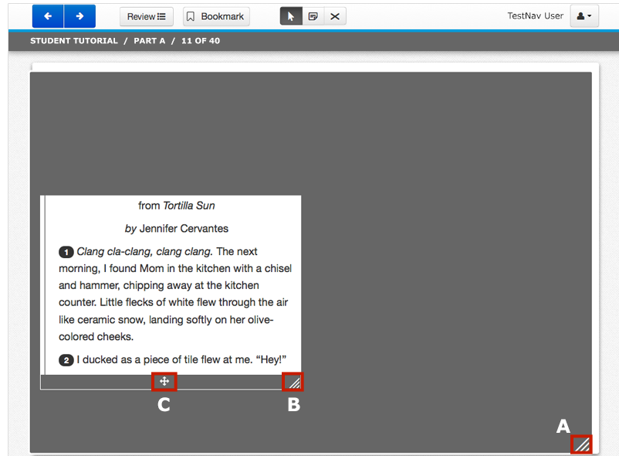
Line Reader Mask Tool
Helps students focus on one part of a question or reading passage at a time.
Students will select Show Line Reader Mask from the User dropdown menu and then drag the line reader mask over to the question or reading passage.
To close the reader mask, students will go back to the User dropdown menu and select Hide Line Reader Mask.

Slide 34
Answer Masking Tool
The Answer Masking tool lets students choose which answer choices will show on the screen. After selecting Enable Answer Masking from the User dropdown menu, all answers will be masked. To show a masked answer, students will select the eye icon next to the answer choice.

Slide 35
Working with Test Questions
The student tutorial will also teach students how to work with the types of questions that may be on a test, including:
Scrolling – students may need to scroll to get to the bottom of the page or a passage.
Multiple-Choice
Multiple-Select
Equation Editor
Short Answer
Extended Response
Technology Enhanced Items

Slide 36
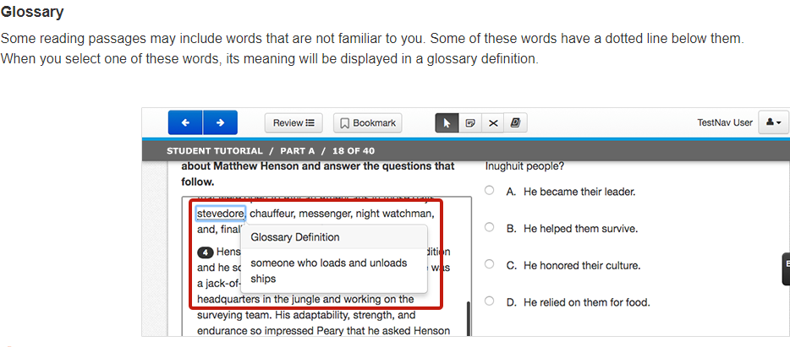
Glossary

Slide 37
Multiple-Choice
These questions have a circle next to each answer choice, and there is only one correct answer.

Slide 38
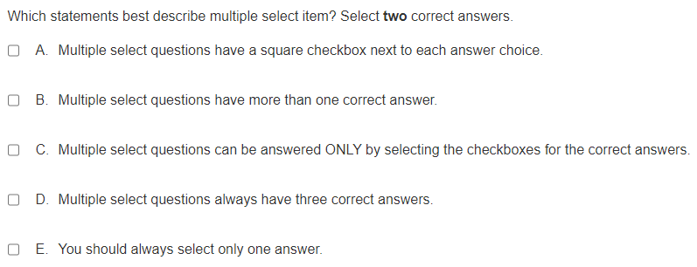
Multiple-Select
Multiple-Select questions have several answer choices and allow on or two choices to be selected. Multiple-select items are represented by a square next to each answer choice.

Slide 39
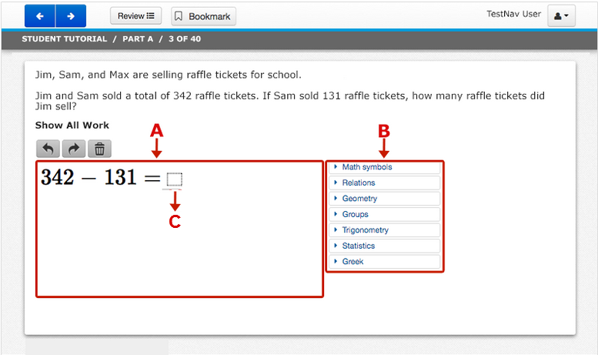
Equation Editor
For some questions, students must show their work.
They will type their work in the work box (A) using keyboard and math symbols (B) to the right of the work box.
After the work is shown, the answer is entered in the answer box (C).

Slide 40
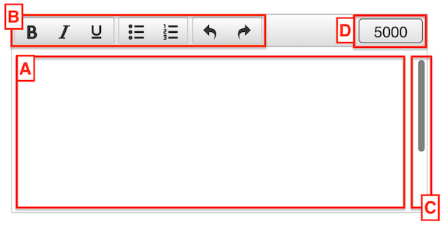
Short Answer and Extended Response
For short-answer and extended-response questions, students will type answers into a response box. They will click inside the response box (A) to begin.
Pressing Enter twice will start a new paragraph. Do not use the Tab key.
The toolbar (B) can be used to make words bold, italic or underlined. Bullets or a numbered list can also be added.
Answers may be longer than the space in the response box. If writing fills the box, a scroll bar (C) will appear. This can be used to see all writing.
Students do not need to use all the space for their answer.
On-Demand Writing will not have a character counter (D).

Slide 41
Technology Enhanced Items (TEI)
For TEI questions, students will have a variety of ways to answer the questions.
These could include the following:
Drag and Drop
Number Line
Inline Choice
Fill-in-the-Blank
Line-graph
System of Equations
Function Graph
Coordinate Plane
Hot Text
Table Grid

Slide 42
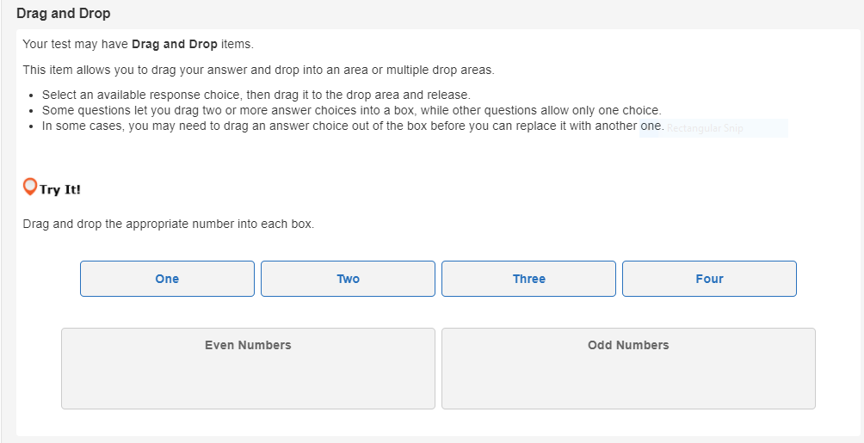
Technology Enhanced Items (TEI) continued
The item below is a sample of a Drag and Drop Item

Slide 43
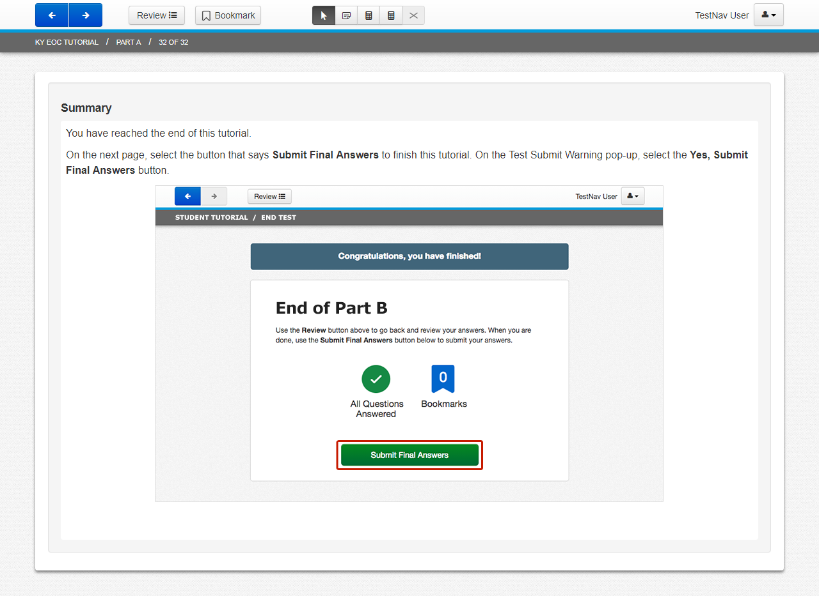
Summary Page
Informs students they have reached the end of the tutorial.
Contains additional instructions to select Submit Final Answers to finish the tutorial.

Slide 44
Resources List
PearsonAccess^{next}
Kentucky Portal
PearsonAccess^{next} Online Support
TestNav 8 Online Support
PearsonAccess^{next} Training Site (brown site)
Test Administrator Manual
Grade Specific Scripts
TestNav Student Tutorials

Slide 45
Contact Us
KDE:
(502) 564-4394
dacinfo@education.ky.gov
Pearson Help Desk:
(888) 437-1430

