Slide 1
2023-2024 Back to School Trainings K Screen
2023-2024 Back to School Trainings
Common Kindergarten Entry Screener
Lisa Jett, Program Consultant
Office of Assessment and Accountability

Slide 2
Agenda
Timeline Fall 2023-2024
Infinite Campus Preparations
Prior Settings
Screening Window
Core Assessment
Reminders: Data Entry, Nonparticipation
Kindergarten Screen Resources
OMS Updates

Slide 3
Timeline 2023-2024
Mid July – Sept. District screening windows open
Aug. 1 – 4 OMS accounts available (projected date)
Aug. – Oct. 15 OMS and data entry window
Fall 2023 Fall Release of State Assessment Data 2022-2023
December District reporting for 2023-2024 K Screen Window

Slide 4
Infinite Campus Preparations
Each kindergarten homeroom must be coded using the state code:
703001
Homerooms must be associated with a teacher whose district email address is entered in IC
If a student has a suffix in their name, make sure it is placed in the suffix box
Ensure the student’s date of birth is entered correctly
Check IC to be sure the child is not already enrolled in another district

Slide 5
Prior Settings Reminder
Only students who are actively enrolled need to have Prior Settings data entered in Infinite Campus (IC). Kindergarten screening results are derived from both Prior Settings Data in IC and screener data entered into the Online Management System.
Notes:
Only students who are actively enrolled need to have Prior Settings data entered in IC. Kindergarten screening results are derived from both Prior Settings Data in IC and screener data entered into the Online Management System. If there is Prior Settings Data in IC for a student, they will be listed in the kindergarten screening results.

Slide 6
Screening Window
Screening may begin 15 calendar days before the first day of school
Screening must not take place after the 30th instructional day unless a new student has enrolled before the deadline of October 15
The Online Management System (OMS) data must be entered within 15 instructional days after the screening window closes, no later than October 15th

Slide 7
Core Assessment
Abide by directions as written in the manual
Maintain consistency
Adhere to the discontinue point
Tab places in the screen for quick reference
Review the Implementation Guide for detailed notes

Slide 8
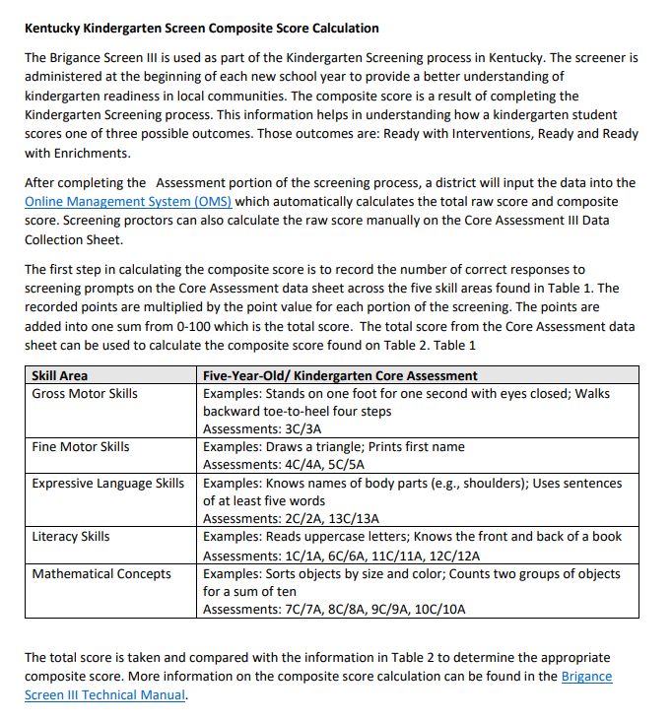
Core Assessment Continued
The Kentucky Kindergarten Screen Composite Score Calculation Document
Common Kindergarten Entry Screener webpage

Slide 9
Data Entry Reminders
Enter only one new screening session
Be sure all items on the Self-Help and Social-Emotional Scales are completed
Make sure to click “Submit to Score” after entering both the K Core Assessments and the SH/SE Scales
View the Group Report and Export as CSV to sort information by domains

Slide 10
Data Entry Reminders Continued
In an effort to avoid data inaccuracies, districts should not submit the Self Help and Social Emotional Skills Data (SHSE) in OMS if there is no Core Screen data being entered for the student.

Slide 11
Nonparticipation Students Reminder
Collection of nonparticipation is not required for K Screen in the Student Data Review and Roster (SDRR) application.
Please keep documentation at the school/district level for any student that does not test.

Slide 12
Kindergarten Screen Resources
K Screen Updates
Common Kindergarten Entry Screener website
Implementation Guide
K Screen Refresh Training
Prior Settings Video
Curriculum Associates Kentucky BRIGANCE video series

Slide 13
Implementation Guide
Timelines
K Screen Process
Forms
OMS Instructions
IC Reference Guide

Slide 14
Kentucky Kindergarten Screen Composite Score Calculation
Located on the Common Kindergarten Entry Screener webpage
Displays the skills demonstrated on the kindergarten screener
Assists educators in calculating the composite score for each student

Slide 15
Online Management System Updates
New this year, OMS Admins can only add new Admins to the OMS.
Teachers and classes will be transferred into the OMS through weekly data transfers between IC and OMS.

Slide 16
Contact Us
Ben Riley, Systems Consultant
Chris Williams, Program Consultant
Christen Roseberry, Program Consultant
Helen Jones, Academic Program Manager
Dr. Jennifer Stafford, Division Director
Krista Mullins, Program Consultant
Lisa Jett, Program Consultant
Melissa Chandler, Program Consultant
Shara Savage, Program Consultant

Slide 17
Other Back to School Trainings
Accountability Overview
ACCESS/Alternate ACCESS
AKSA (Attainment Tasks)
K Screen
ACT – Fall ACT Administration
Test Security

Slide 18
Division of Assessment and Accountability Support
Division of Assessment and Accountability Support
OAA/DAAS (502) 564-4394 dacinfo@education.ky.gov

Slide 19
End Slide

