Slide 1
NAEP Reporting
NAEP Data Explorer
NAEP Questions Tool
NAEP State Comparisons
State & District Profiles
NAEP Item Maps

Slide 2
NAEP Reporting Tools
All of the tools can be found from each other’s page by using the links at the top of each page
NAEP Reporting

Slide 3
State & District Profiles
Notes:
We’ll begin with Mathematics
<CLICK>

Slide 4
State & District Profiles
Profiles are a one-stop place for finding quick state and district level data for multiple subject areas over time
Most frequently hit page for NCES
State - nces.ed.gov/nationsreportcard/states
District - nces.ed.gov/nationsreportcard/districts

Slide 5
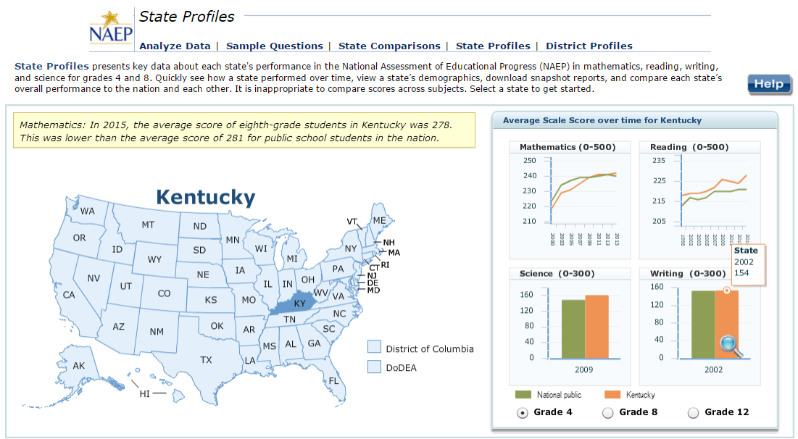
State & District Profiles

Slide 6
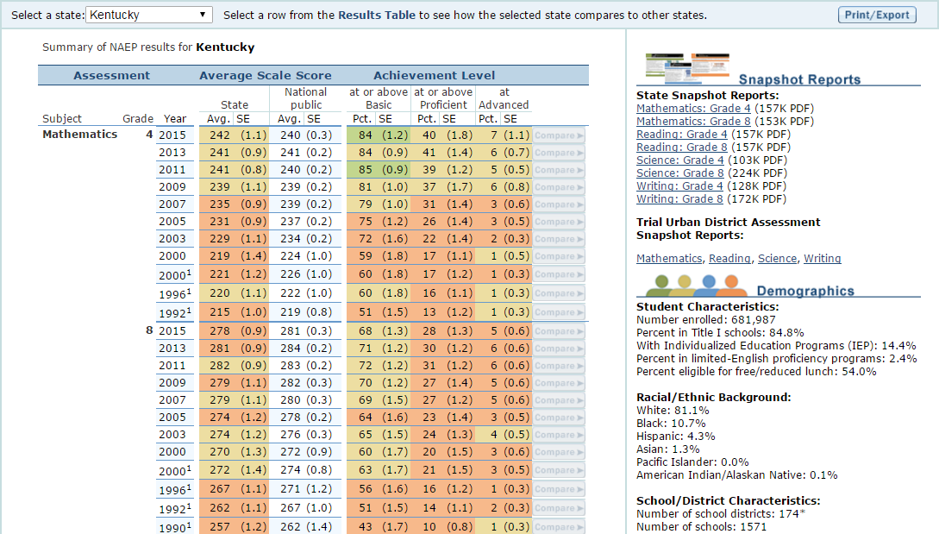
State & District Profiles

Slide 7
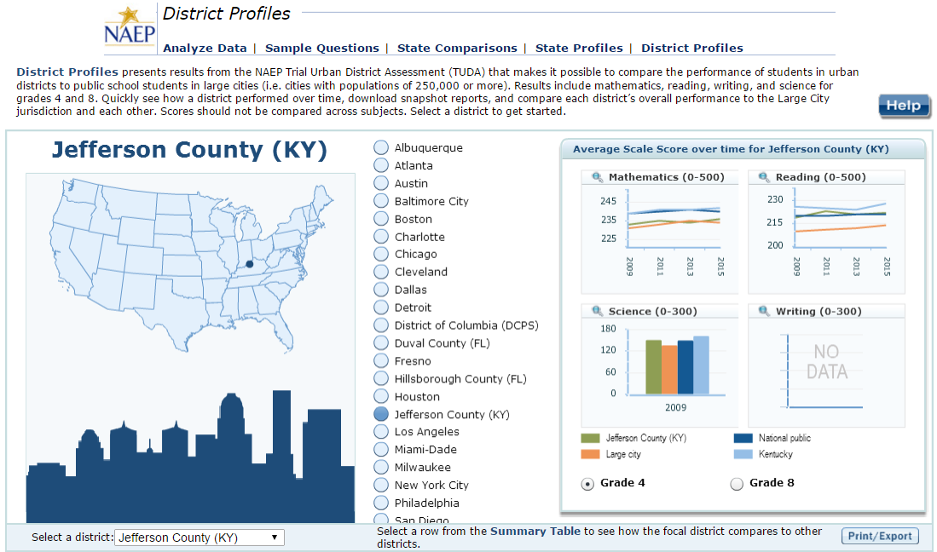
State & District Profiles

Slide 8
NAEP Questions Tool
Notes:
We’ll begin with Mathematics
<CLICK>

Slide 9
NAEP Questions Tool
NAEP releases a portion of the item pool to the public after every assessment cycle
Approximately 15-20%
NQT houses all of the released items
Examine student performance nationally or by state

Slide 10
NAEP Questions Tool
Test Yourself feature and capability to create and administer tests online
Provide back results
Gives comparison nationally or to a state
nces.ed.gov/nationsreportcard/nqt

Slide 11
NAEP Questions Tool

Slide 12
NAEP Item Maps
Notes:
We’ll begin with Mathematics
<CLICK>

Slide 13
NAEP Item Maps
Item Maps provide the location of individual items on the NAEP scale
Helps to illustrate the knowledge and skills demonstrated by students performing at different scale scores
Provides a sense of item difficulty
nces.ed.gov/nationsreportcard/itemmaps

Slide 14
NAEP Item Maps

Slide 15
NAEP Item Maps

Slide 16
NAEP State Comparisons
Notes:
We’ll begin with Mathematics
<CLICK>

Slide 17
NAEP State Comparisons
NAEP State Comparisons tool created to provide a single site for quick comparisons involving all states
Major subgroups such as Overall, Race/Ethnicity, National School Lunch Program eligibility

Slide 18
NAEP State Comparisons
Analytic goal to provide valid comparisons between states taking into account standard errors
Dissuade the use of uninformed ranking
nces.ed.gov/nationsreportcard/statecomparisons

Slide 19
NAEP State Comparisons

Slide 20
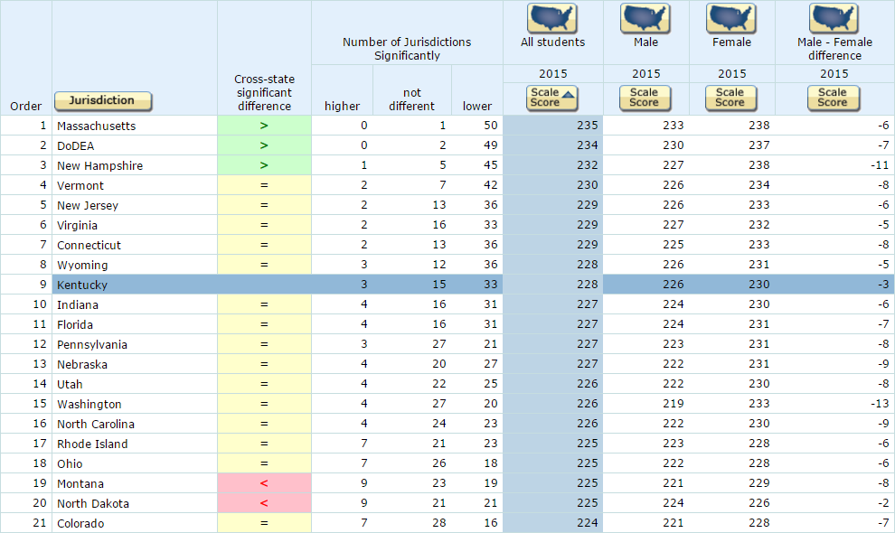
NAEP State Comparisons

Slide 21
NAEP Data Explorer
Notes:
We’ll begin with Mathematics
<CLICK>

Slide 22
NAEP Data Explorer
NAEP Data Explorer is the public interface with the NAEP data warehouse
Provides access to in-depth analyses of NAEP data at multiple levels
Keeps users safe in only allowing analyses that are valid to be undertaken
e.g. can’t compare math scores to reading scores
nces.ed.gov/nationsreportcard/naepdata

Slide 23
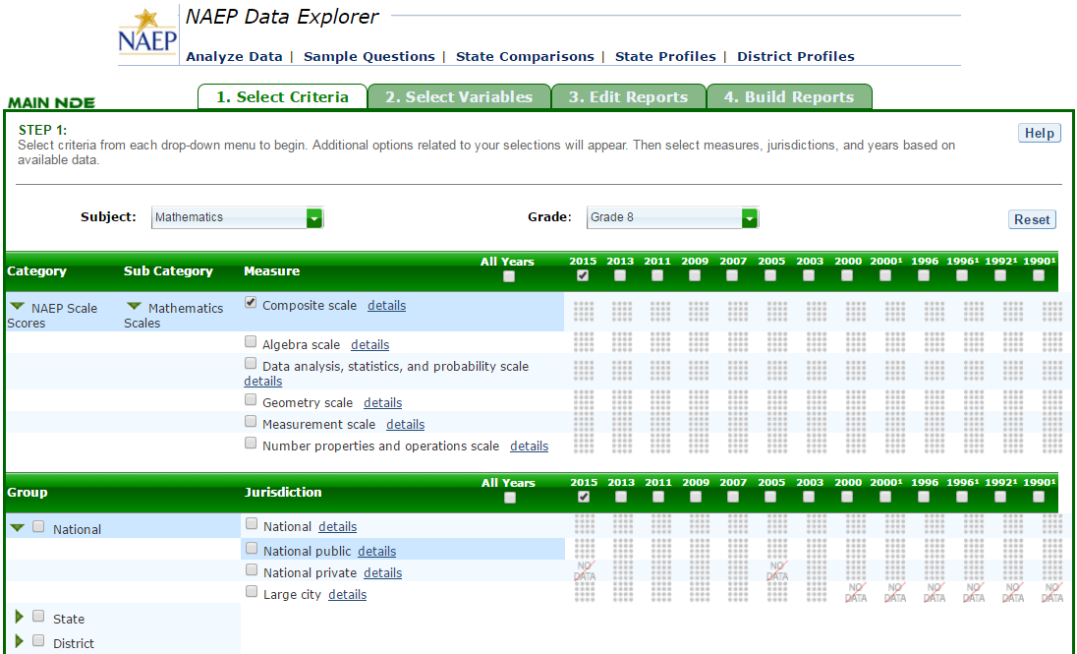
NAEP Data Explorer

